Slide 1
A Joint Venture: Working with Campus Financial Services
_________________________________________________
Sarah Hersh, ER Acquisitions Librarian
Toronto Metropolitan University
The Acquisitions Institute
18 May 2026

Slide 2
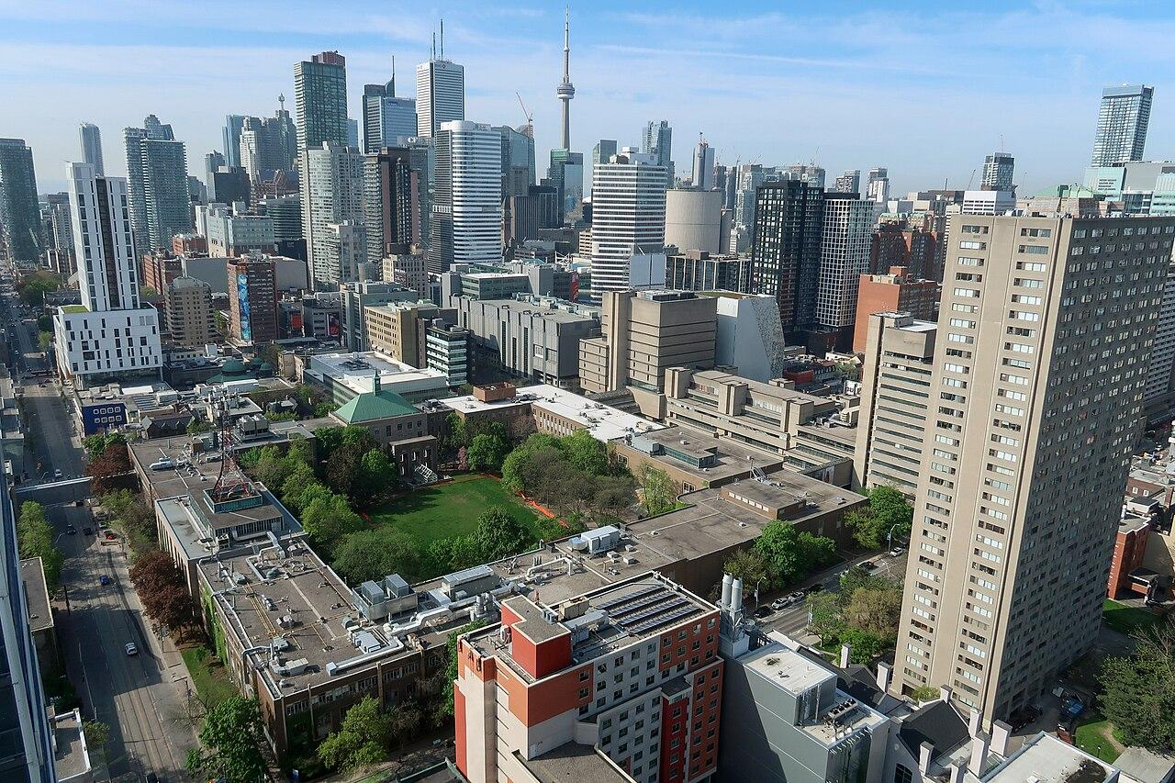

Slide 3
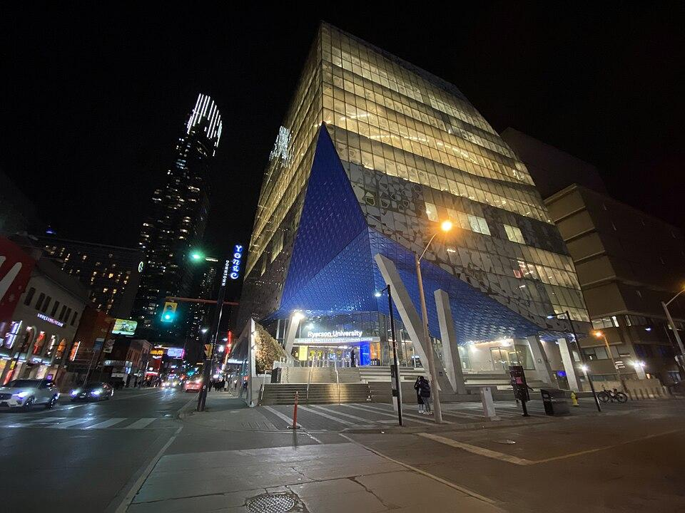
Toronto Metropolitan University
Public research university
FTE 41,558
60+ UG programs
70 grad programs
Chang School of Continuing Education
New School of Medicine

Slide 4
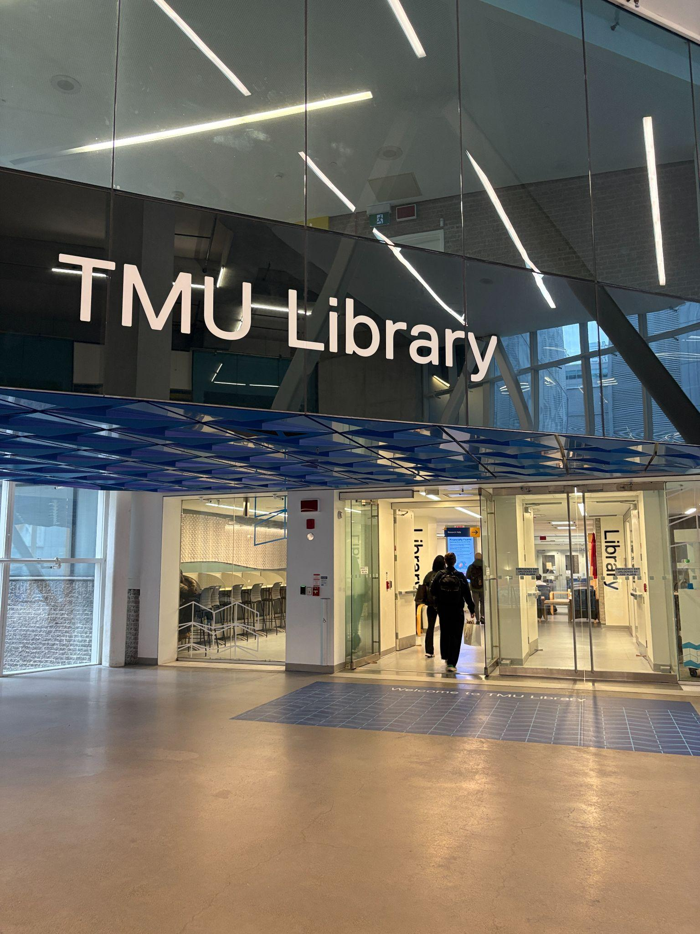
TMU Libraries
3 Libraries
Total staff just over 100, ~40 librarians
Collection Services
  22 librarians and staff
  7 in acquisitions

Slide 5

Recent Library Challenges
Staff shortages and librarians changing roles
Migration from Sierra to Alma
Departmental documentation

Slide 6
Legislation Affecting Procurement
Procurement Restriction Policy
  Building Ontario Businesses Initiative Act
  Replaced by Bill 72, Buy Ontario Act in 2025
Bill 194, Enhancing Digital Security and Trust Act

Slide 7
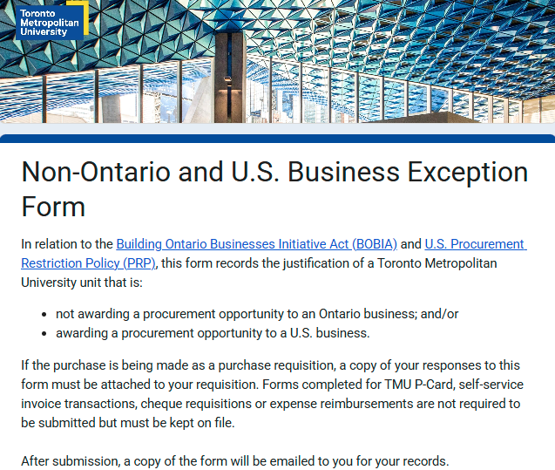
Currently required for all purchases

Slide 8
Subsequent questions we asked about procurement restrictions:
Are forms required for each transaction?
  Blanket POs?
How can the approved list of vendors be expanded?

Slide 9

Other Recent Challenges
Changing accounting practices
Audits
Fiscal year deadlines
Staff turnover in financial services

Slide 10
Accounting-Related Concerns
Process for flagging invoice as prepaid?
How can we ensure consistency?
Questions related to invoices for EBSCO journal subscriptions, consortial accounts, and subscriptions vs one-time purchases

Slide 11

Evolving Procedures
Bypassing the bidding process
Sole source documentation
Language on invoices
New privacy and security questions: Is this for an online service that stores or processes TMU data?

Slide 12

Opportunities
Collaborate with campus privacy office to ensure compliance with digital security legislation
Organize meetings to build relationships and address specific issues
  Volume of library purchasing
  Payment processes
  Streamlining forms

Slide 13

Continuing Opportunities
Get to know the structure of the Financial Services Department
Learn more about each step of the procurement process
Improve internal documentation

Slide 14

Lessons Learned
Schedule focused meetings with small groups
Ask more questions earlier
Keep a work journal
Talk with colleagues at other schools

Slide 15

Future Plans
Continue to refine communication
Develop meeting schedules
Improve our understanding of accounting principles and guidelines

Slide 16

Thank you!
sarah.hersh@torontomu.ca

Slide 17
Image Credits
Slide 2: Canmenwalker, CC BY 4.0, via Wikimedia Commons
Slide 3: Canmenwalker, CC BY 4.0, via Wikimedia Commons
Slide 5: Photo by 🇸🇮 Janko Ferlič on Unsplash
Slide 9: Photo by Jukan Tateisi on Unsplash
Slide 11: Photo by Katie Moum on Unsplash
Slide 14: Photo by Gülfer ERGİN on Unsplash
Slide 15: Photo by Nadine E on Unsplash
Slide 17: Photo by Scott Webb on Unsplash
Slides 4, 12, 13 by Sarah Hersh

