Slide 1

Sentinels in the Library:
Guarding Open Access Agreements from Misconduct
Zachariah Motts
Matthew Goddard
Iowa State University Library

Slide 2
A deepening publishing integrity crisis
13,437 articles were retracted in 2023. Only 1,510 articles were retracted ten years earlier in 2013.¹
A 2022 study suggested that ~2% of all article submissions were fake -- before the rise of generative AI.²

Slide 3
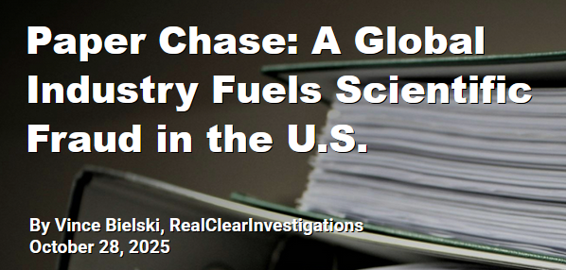
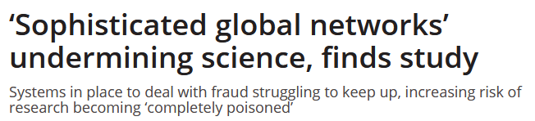
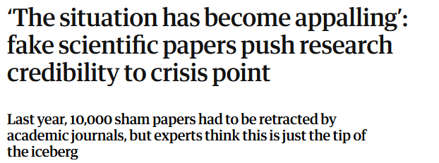
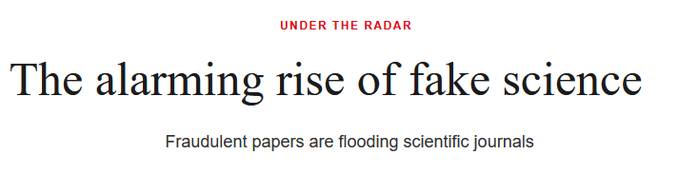
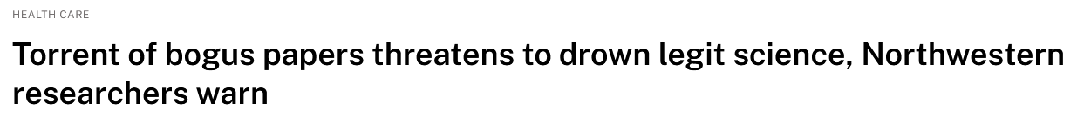
A deepening publishing integrity crisis

Slide 4
A deepening publishing integrity crisis
Authorship sales
Coercive citation
Citation cartels
Citation sales
Hijacked journals
Predatory journals
Falsified research
Fabricated research
Plagiarism
Fabricated peer review
Inappropriate self-citation
Stolen authorship

Slide 5
“There are entire areas of inquiry within my discipline that I have given up on because the literature is so polluted.”

Slide 6
Discuss:
1. How did we get here?
2. Whose fault is it?
3. Who cares?
4. Why?

Slide 7
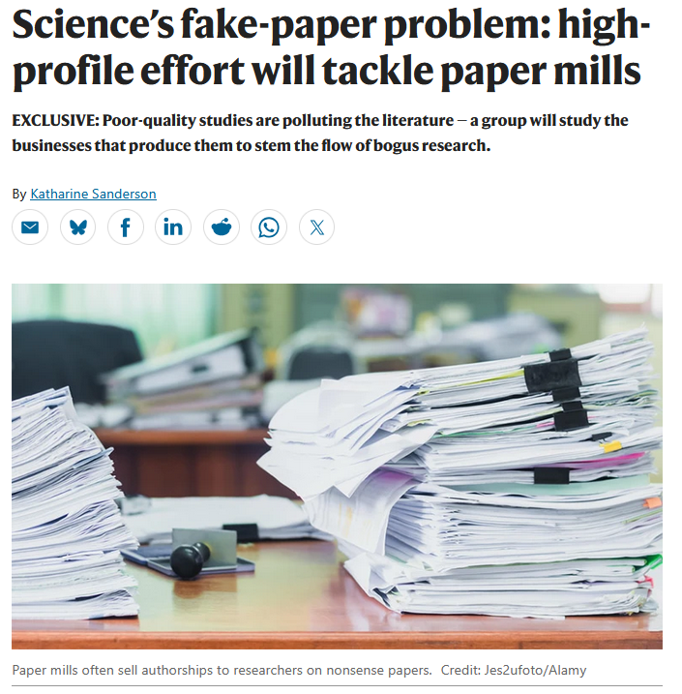
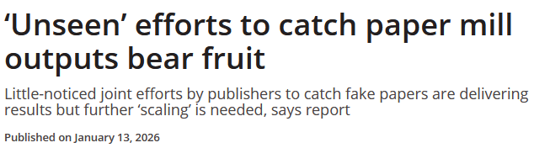

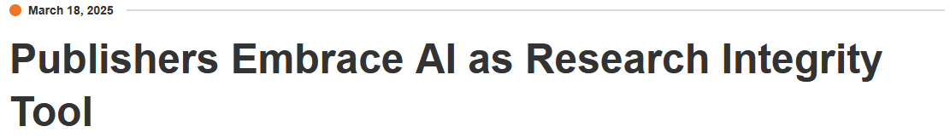
Publisher response

Slide 8
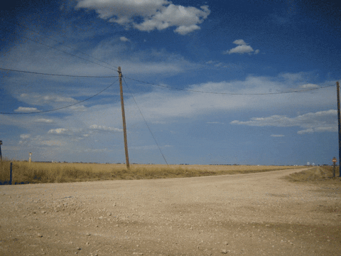
Institutional response

Slide 9
What does this have to do with library acquisitions?
Responsibility
Incentive
Role

Slide 10
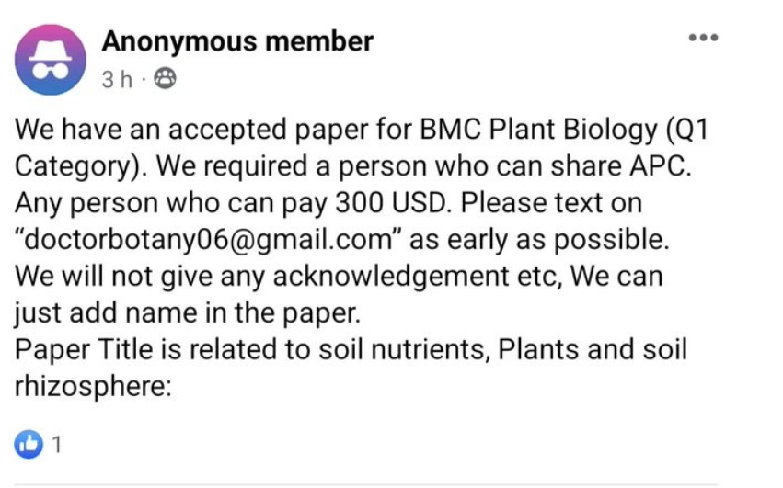
Libraries have a responsibility
Fiscal accountability
Owning our advocacy
Authorships/affiliations can be traded

Slide 11
Libraries have the incentive
Optimizing the allocation of scarce resources.
Authors, publishers and institutions want quantity – libraries want quality.
  As payee.
  As representative of the “reader” role.

Slide 12
Libraries have the right role
A view of submissions prior to publication.
A view of institutional publishing across publishers.
We hold the purse strings.
Bibliographic expertise.
Who else?

Slide 13
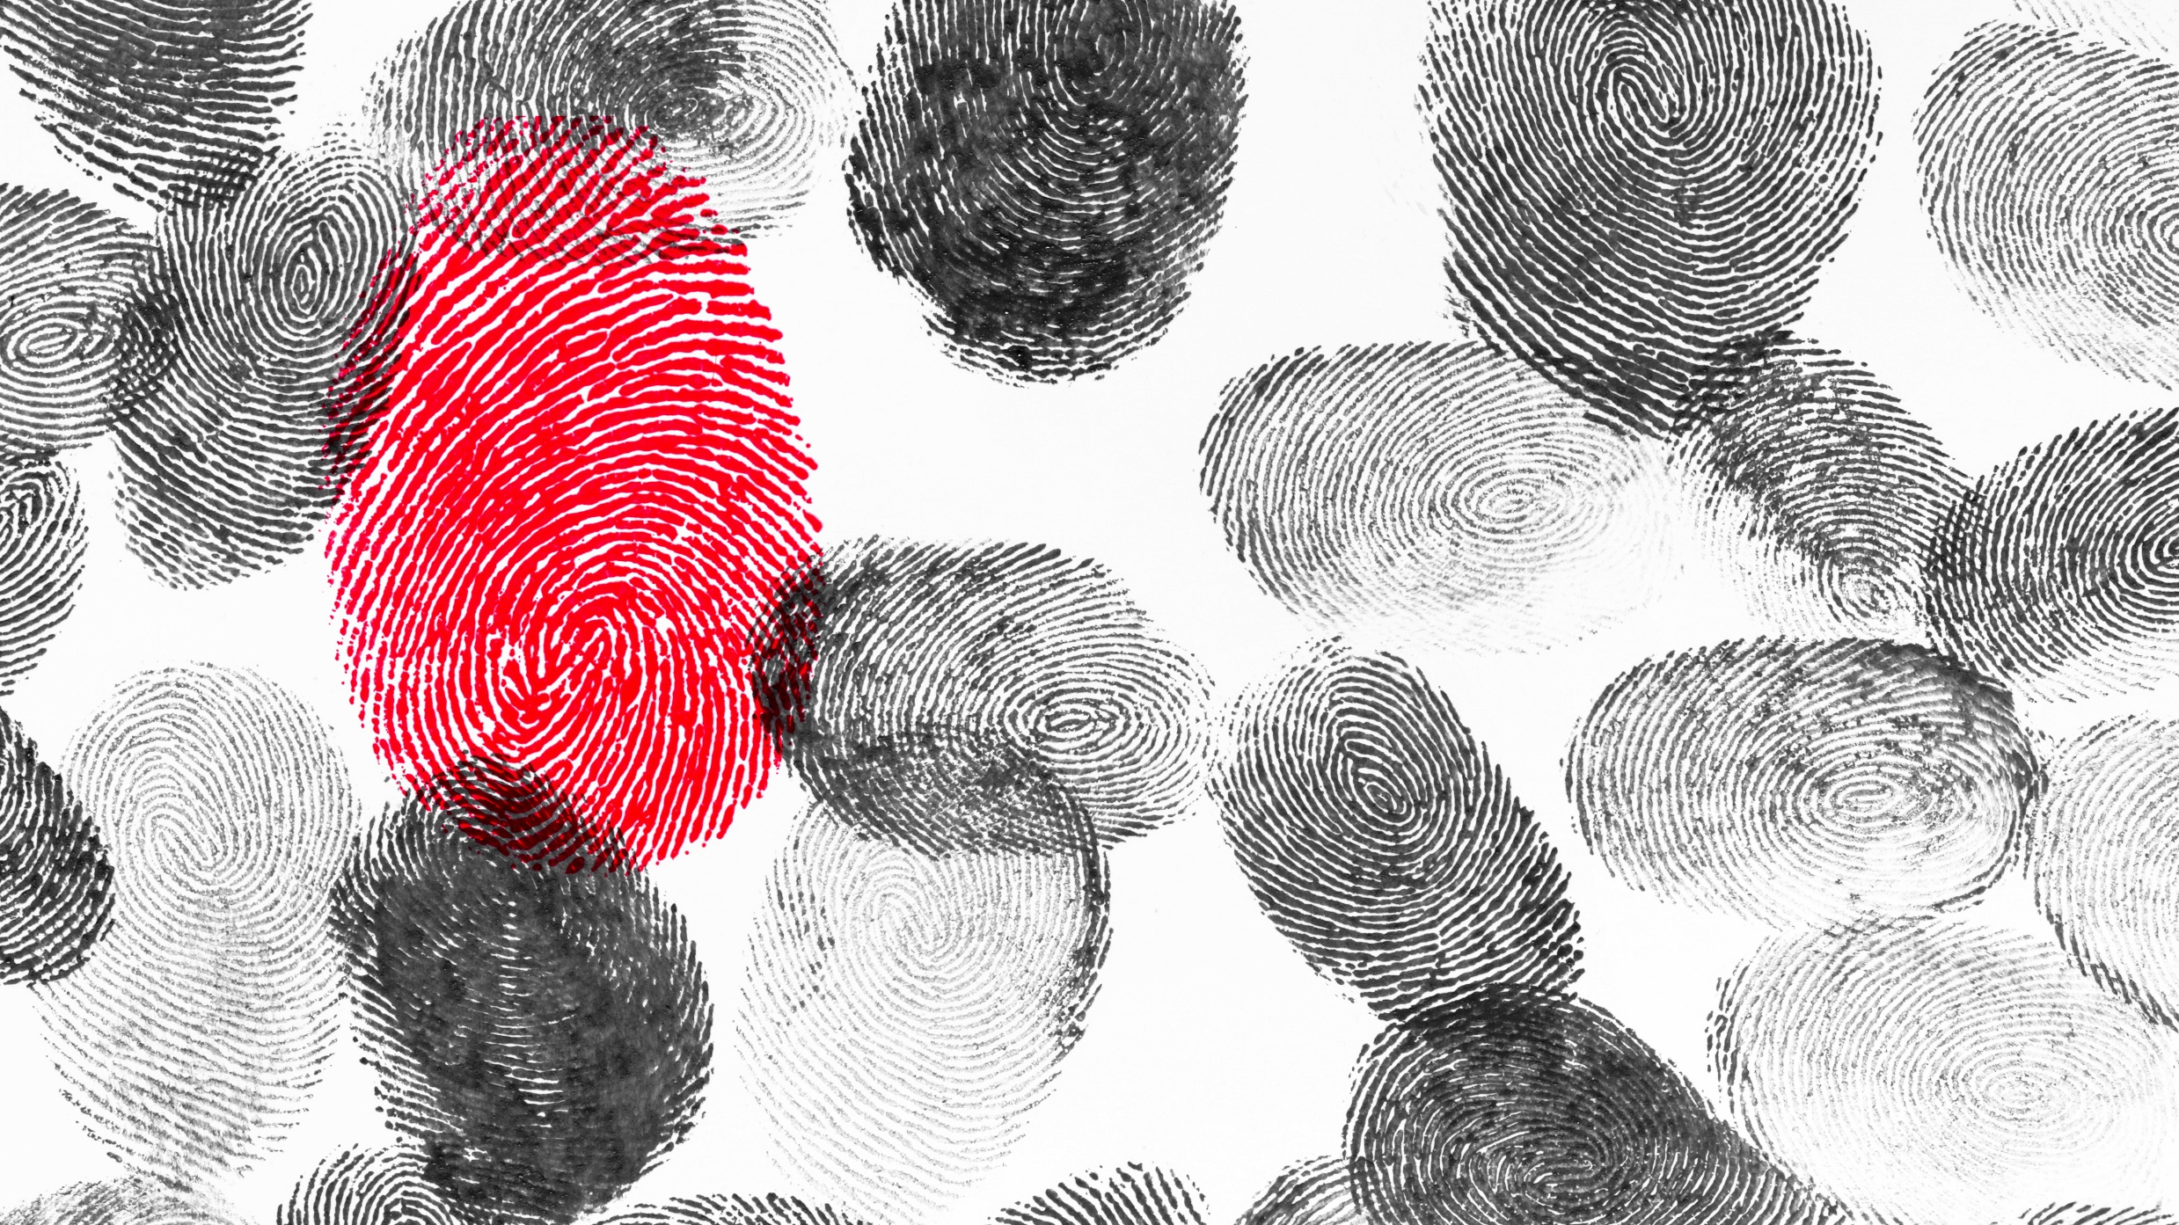
A Case Study in Publishing Integrity and Open Access

Slide 14
Caught: Library Wins!
Because of the two-article cap, we sent an email to the ISU author. That author denied knowing about this article.
The publisher was notified and quickly acted.
We now take steps to verify the author’s ISU email when no ISU email is used on an article.

Slide 15
But… Missed
We discovered that we had paid for an article with two of the same authors in 2023.
When reported to the other publisher, they had already opened an investigation. Ten articles had been submitted with these two authors. This one was the only one that was public.

Slide 16
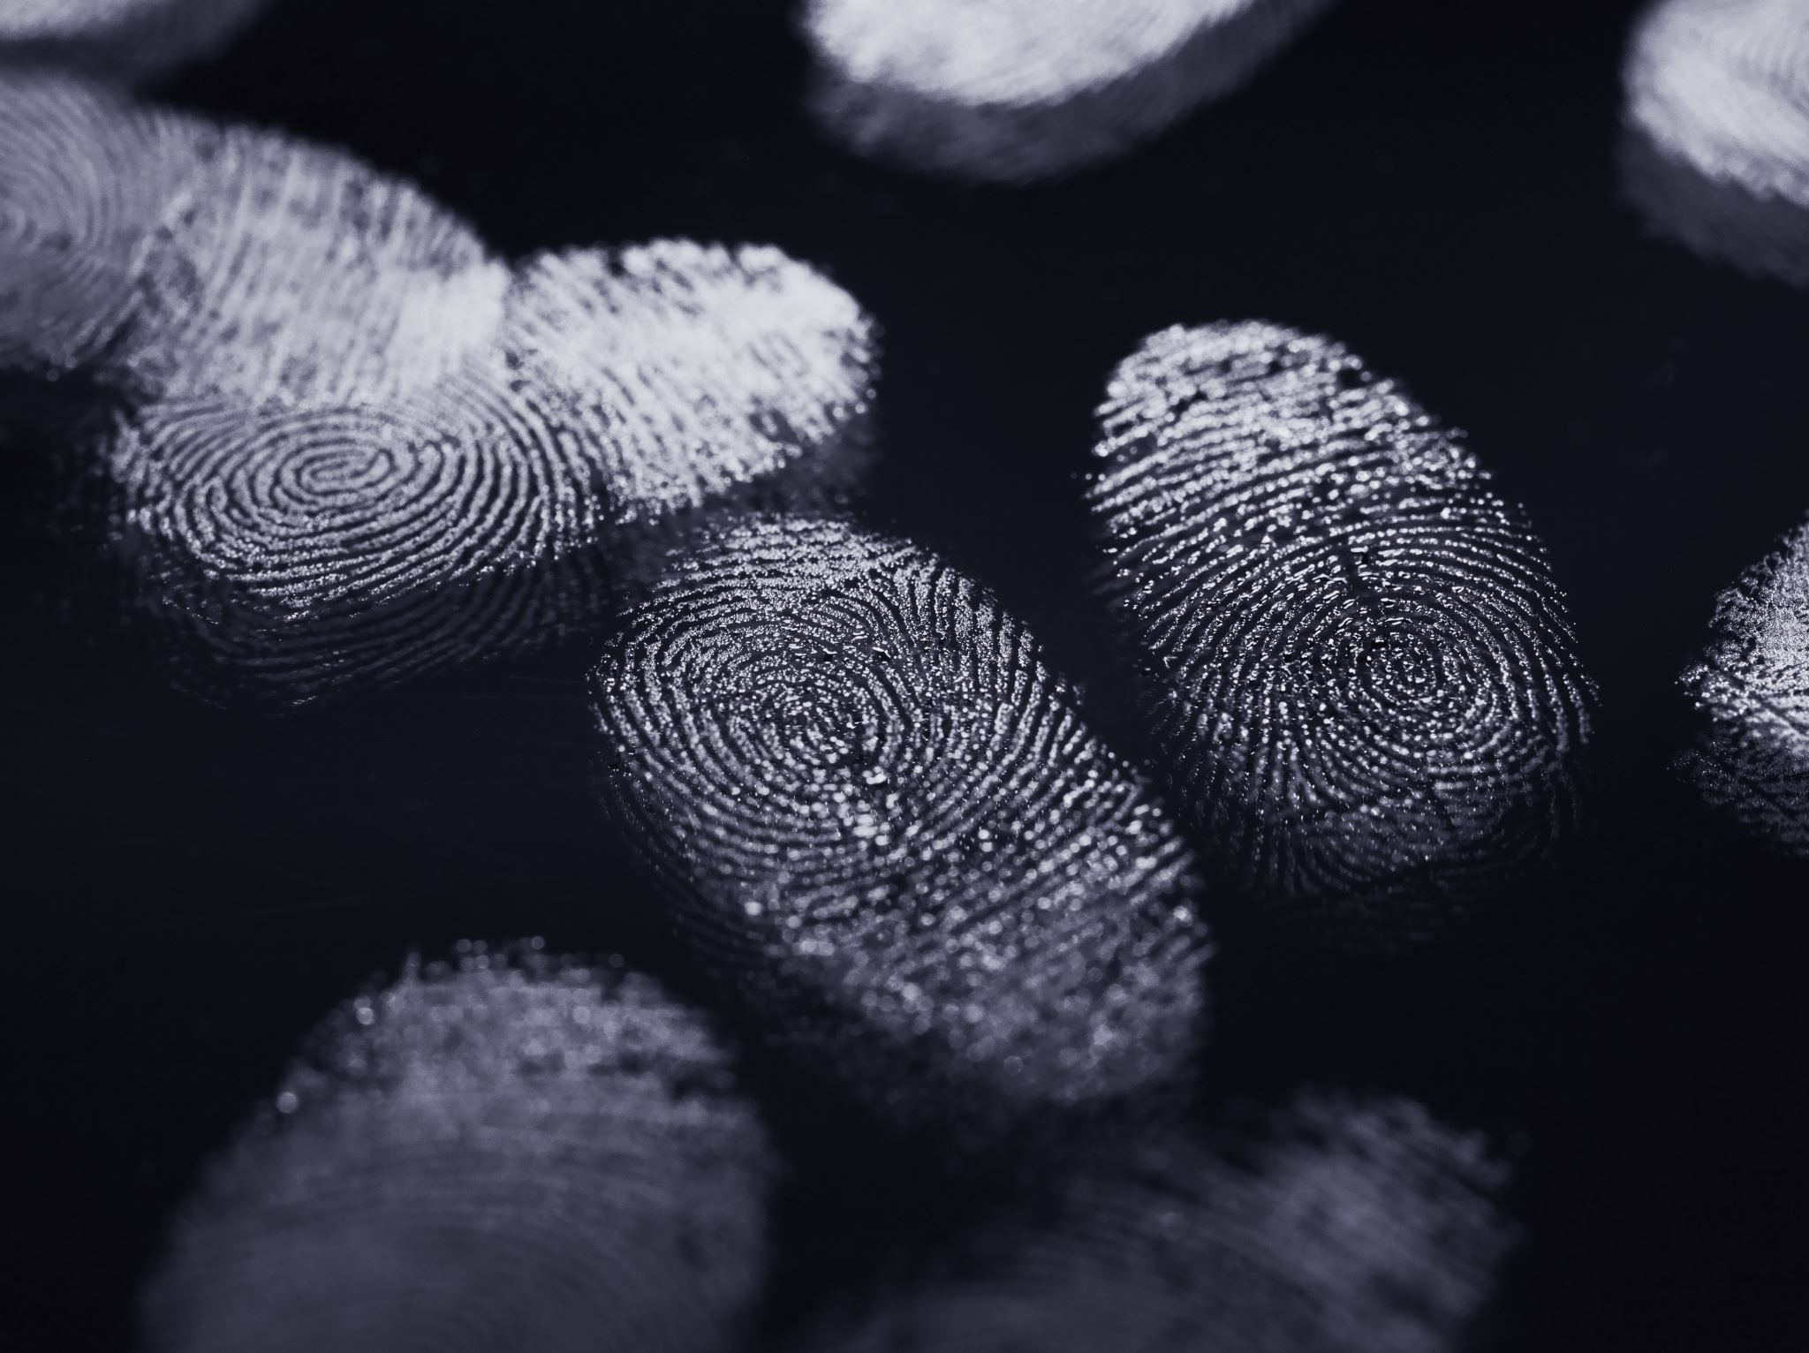
But Wait, There’s More!

Slide 17
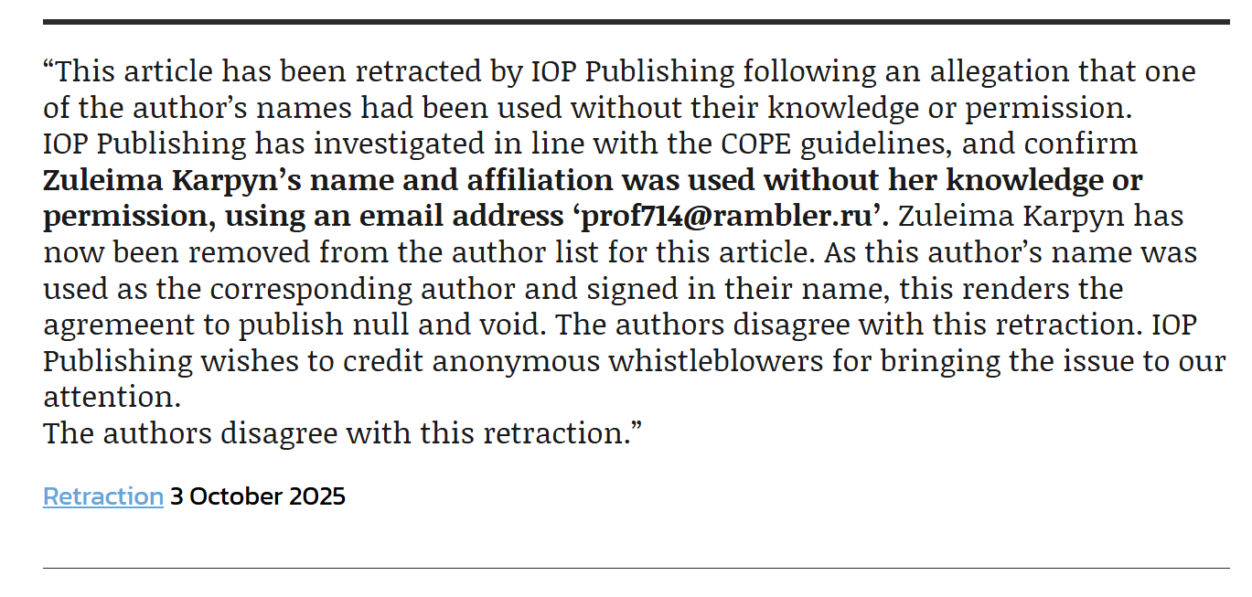
Discuss:
1.

Slide 18
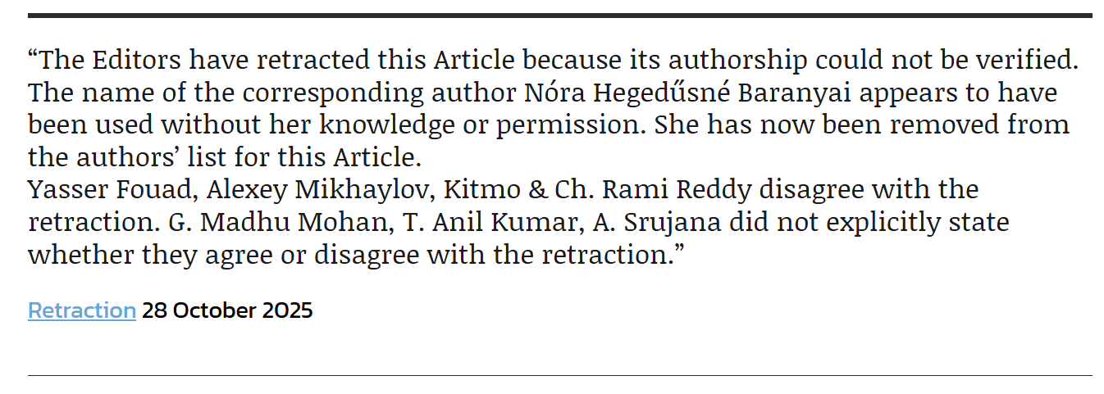

Slide 19
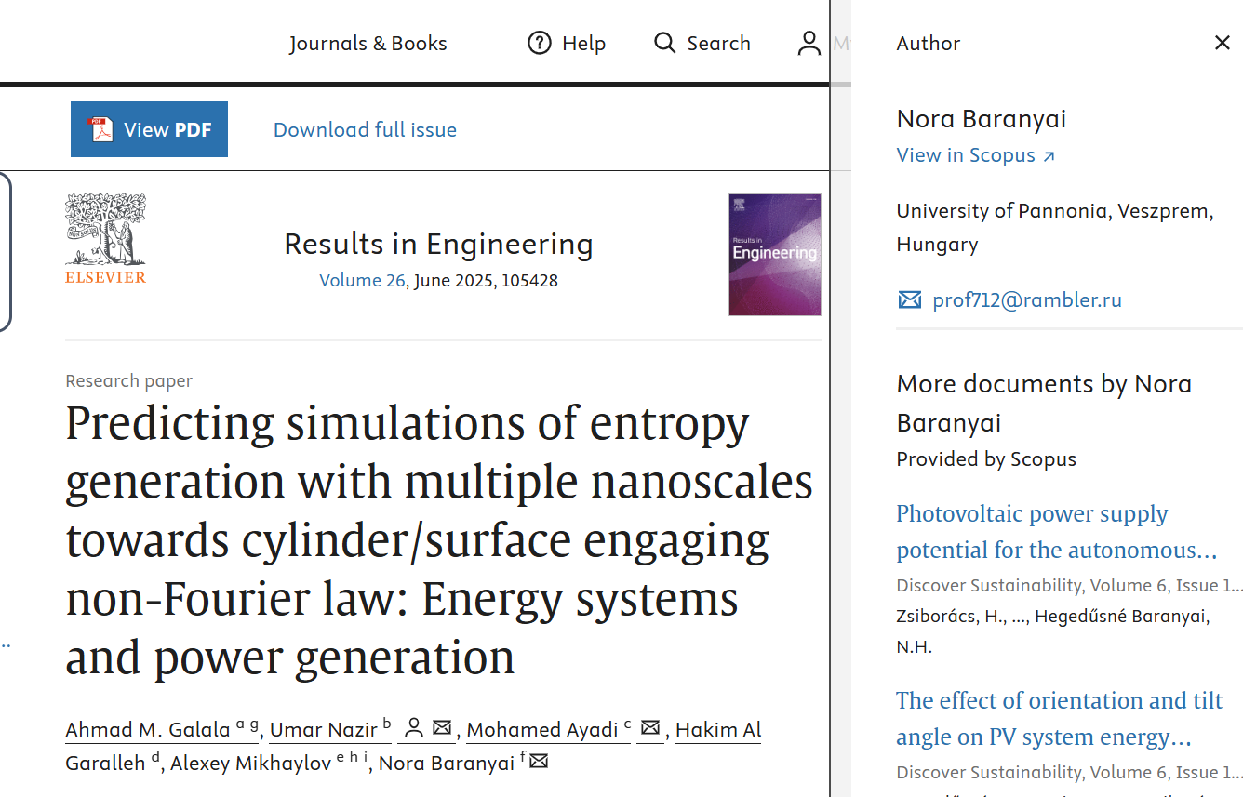

Slide 20
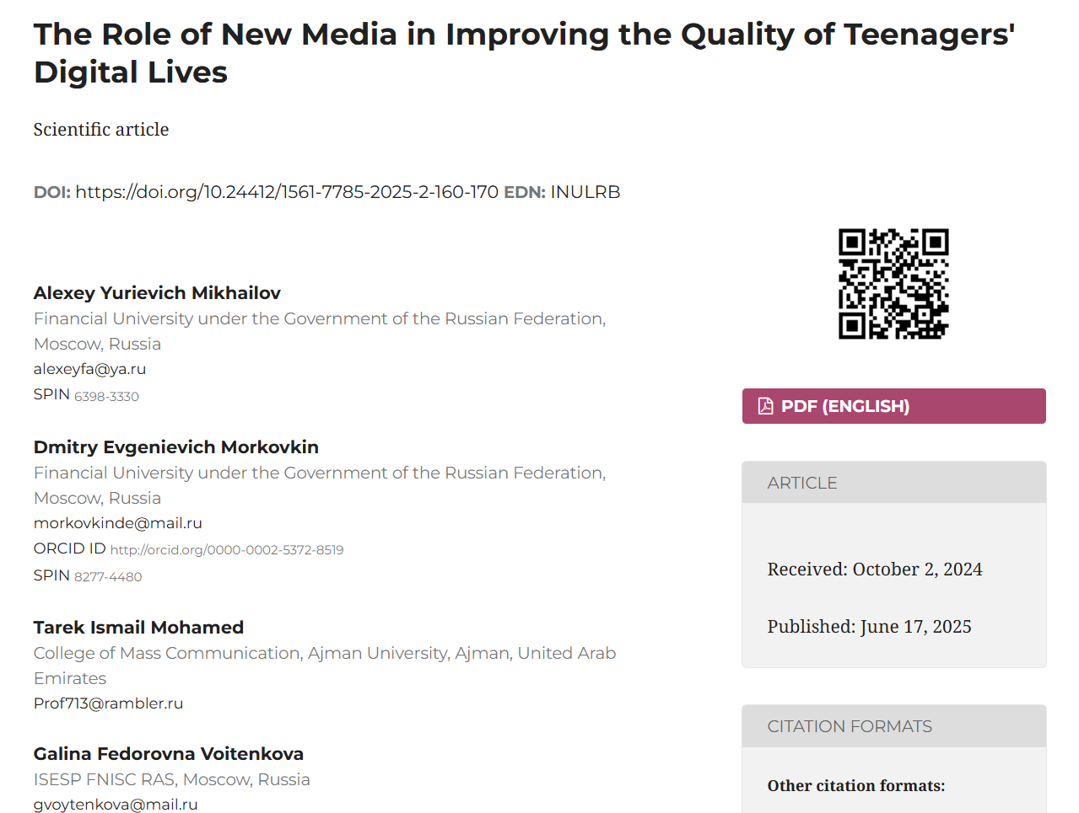

Slide 21
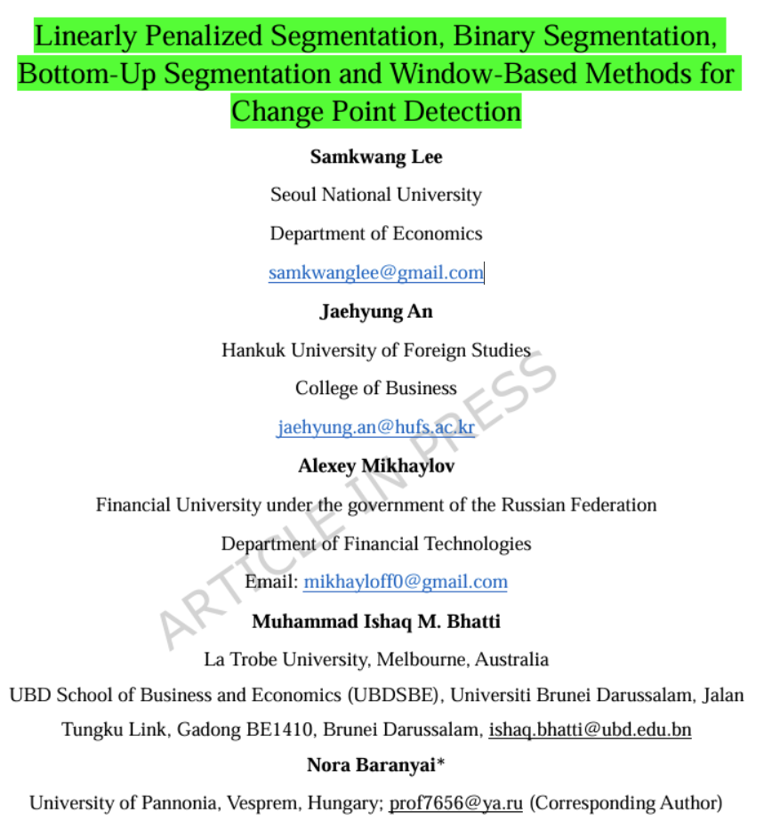

Slide 22
Targeting Open Access Agreements?
What is gained by these impersonations?
That seat on the paper could be sold rather than make the risky move of impersonation.
In every confirmed case of impersonation we have found from this author, the victim’s institution had an OA agreement with the publisher.

Slide 23
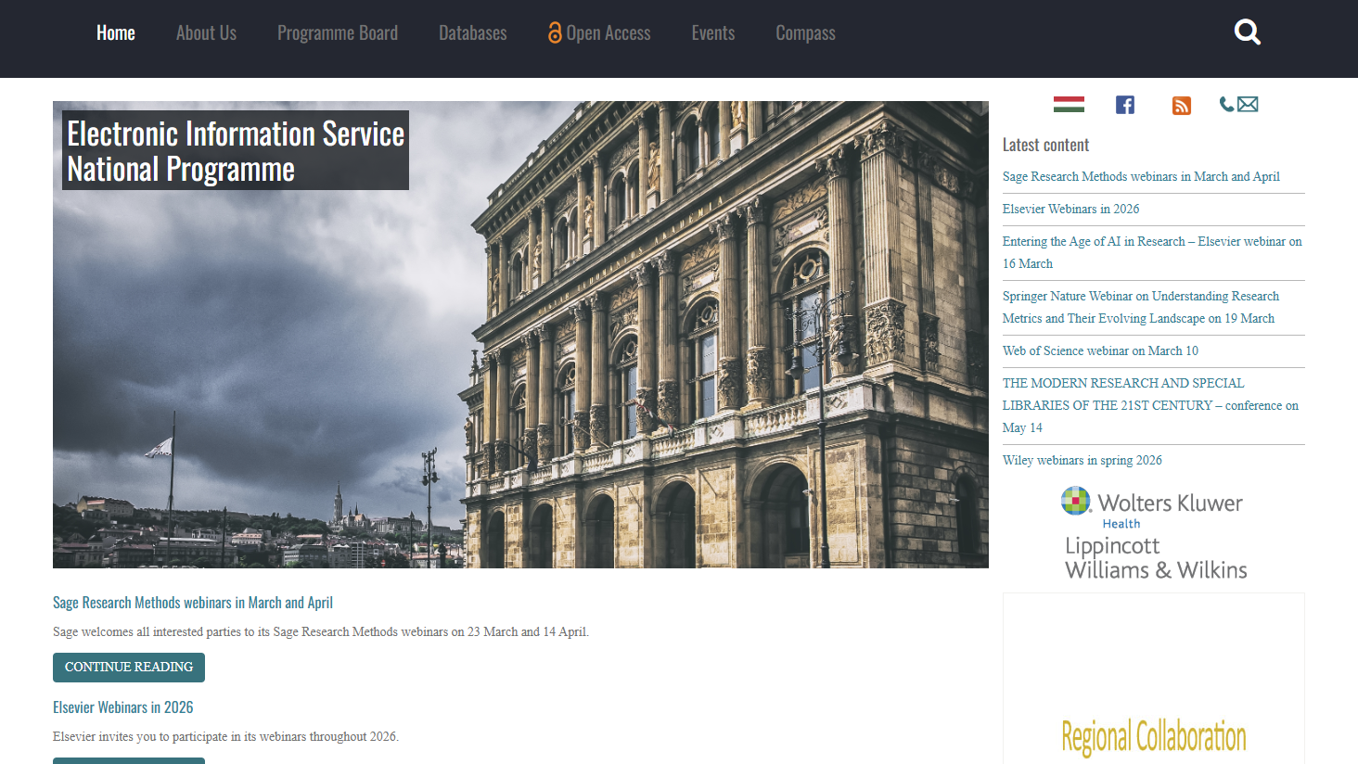

Slide 24
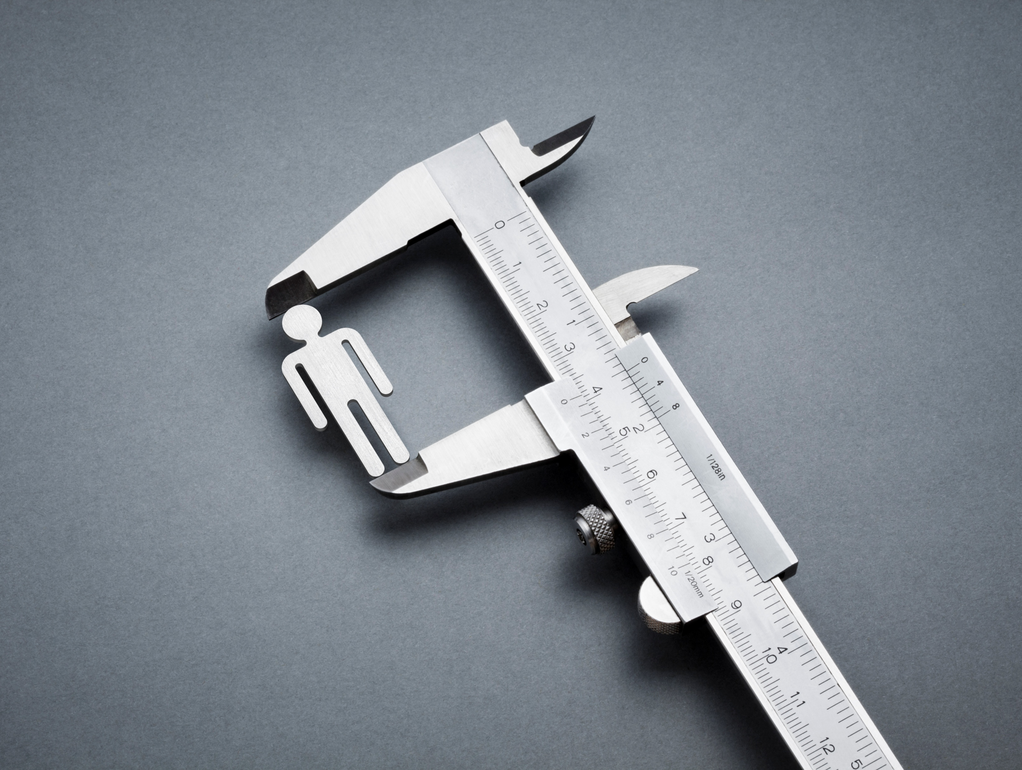
What We Have Learned
Eligibility verification is important
  Uncapped agreements can be automated, but should they be?
  Author identity verification: a vital step for publishers and libraries.

Slide 25

What We Have Learned
Collaborations are key
  Know the people in your institution: RIO, General Counsel, librarians.
  Know the vendor contacts: some publishers have great, responsive RI teams

Slide 26
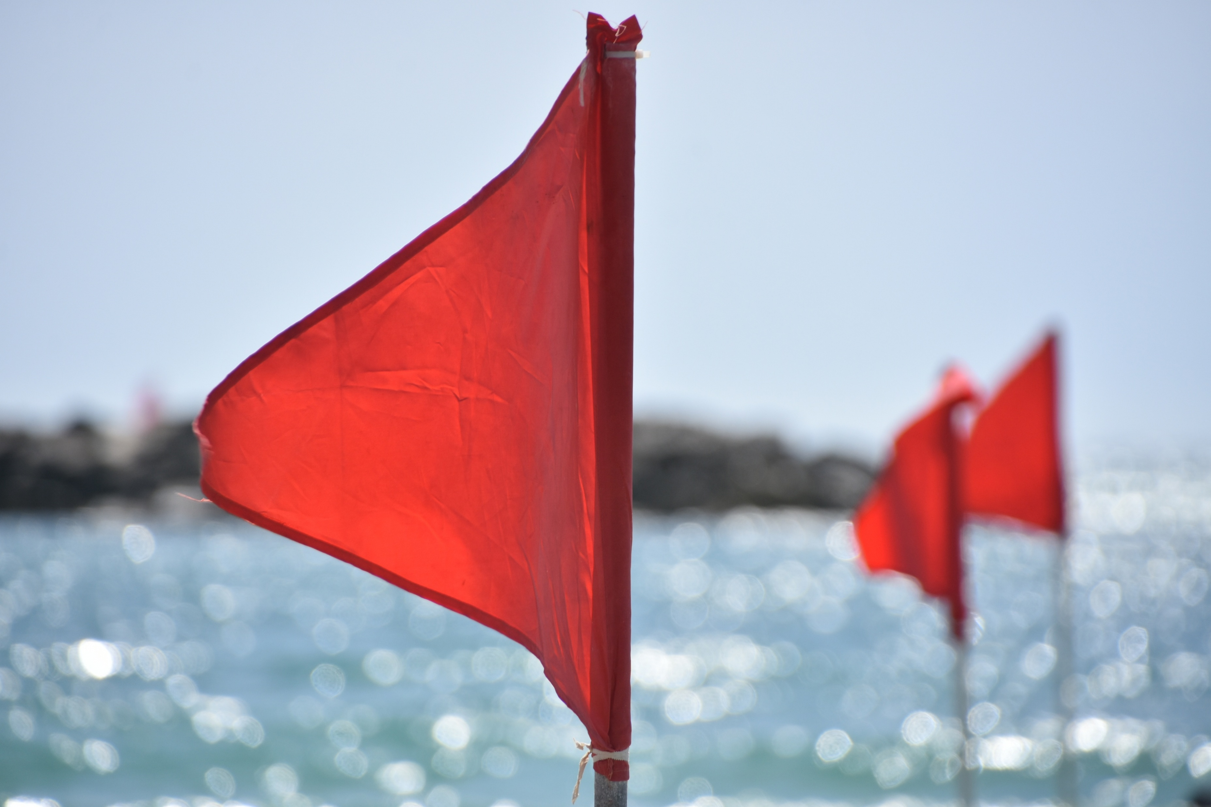
What We Have Learned
Building awareness makes a difference
  Know the red flags
  Resources are available: COSIG, PubPeer, Retraction Watch, COPE, U2A

Slide 27
Publishing Integrity Red Flags
No institutional e-mails
Oddly prolific author
Strange collaborations
Sketchy institutions (RIRI)
Subject matter out of scope
Co-author switching
Co-authors with high retraction rates

Slide 28
What We Can Do
Education
Too few conversations on publishing integrity in library circles.
Learn how to spot a suspicious paper.
Tools
Install the PubPeer extension.
Agreements
Include mechanisms for approving eligibility.
Don’t completely depend on the publisher.
Report

Slide 29
References
1. The Retraction Watch Database. New York: The Center for Scientific Integrity. ISSN: 2692-4579.
2. Van Noorden, Richard. “How Big Is Science’s Fake-Paper Problem?” Nature (London) 623.7987 (2023): 466–467.

Slide 30

Questions and discussion
Zach Motts, zmotts@iastate.edu
Matthew Goddard, mgoddard@iastate.edu

