Slide 1
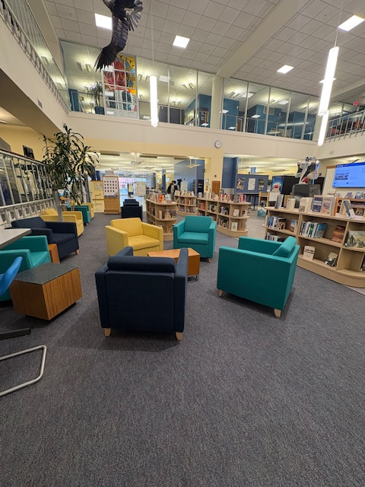

Building Community Narratives: The Power of Inclusion in the Bobcat Browse Collection
The Acquisitions Institute at Timberline Lodge
Monday, May 18, 2026
Rachelle McLain, Collection Development Librarian,
MSU Library

Slide 2
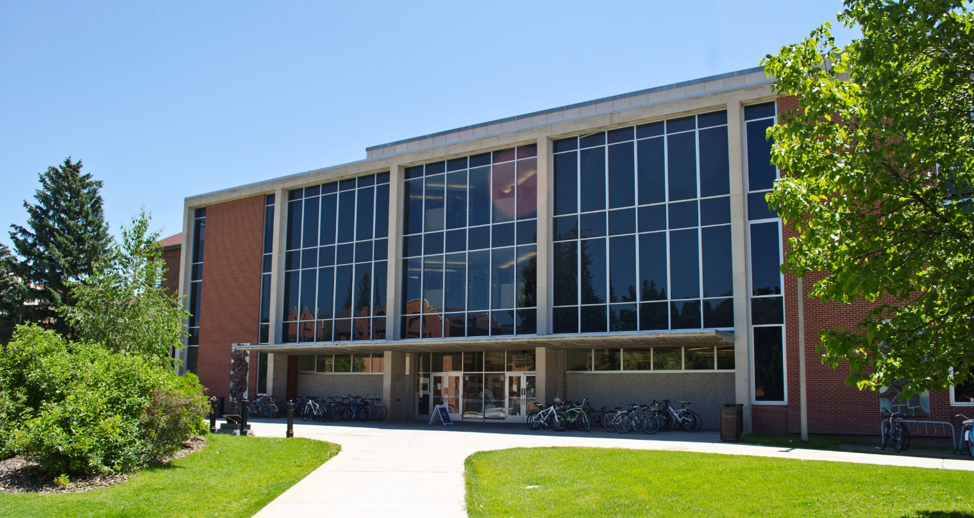
MSU Library Quick Facts:
Total Enrollment: 17,165 (Fall 2025)
250+ Undergraduate Programs
115+ Graduate Programs
R1 Institution
State Land-Grant
55+ Library Faculty & Staff
$6.3 Million Materials Budget

Slide 3

About
Bobcat
Browse

Slide 4
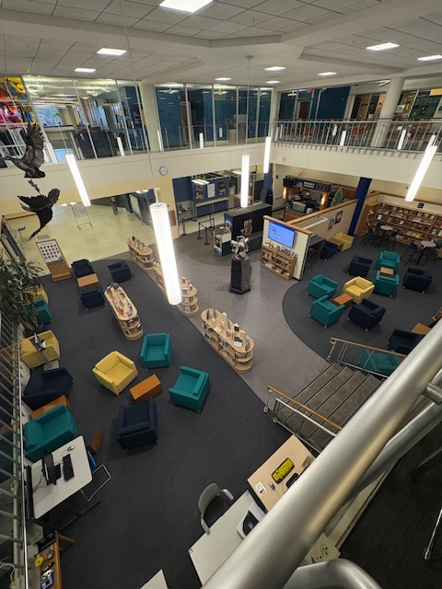
Popular fiction and non-fiction reading collection on the 1st floor of the library
Across from the coffee shop, Brewed Awakening
Across from another reading area that includes New Books, magazines, & newspapers
Collection is made up of print books recommended by students, faculty, and staff

Slide 5
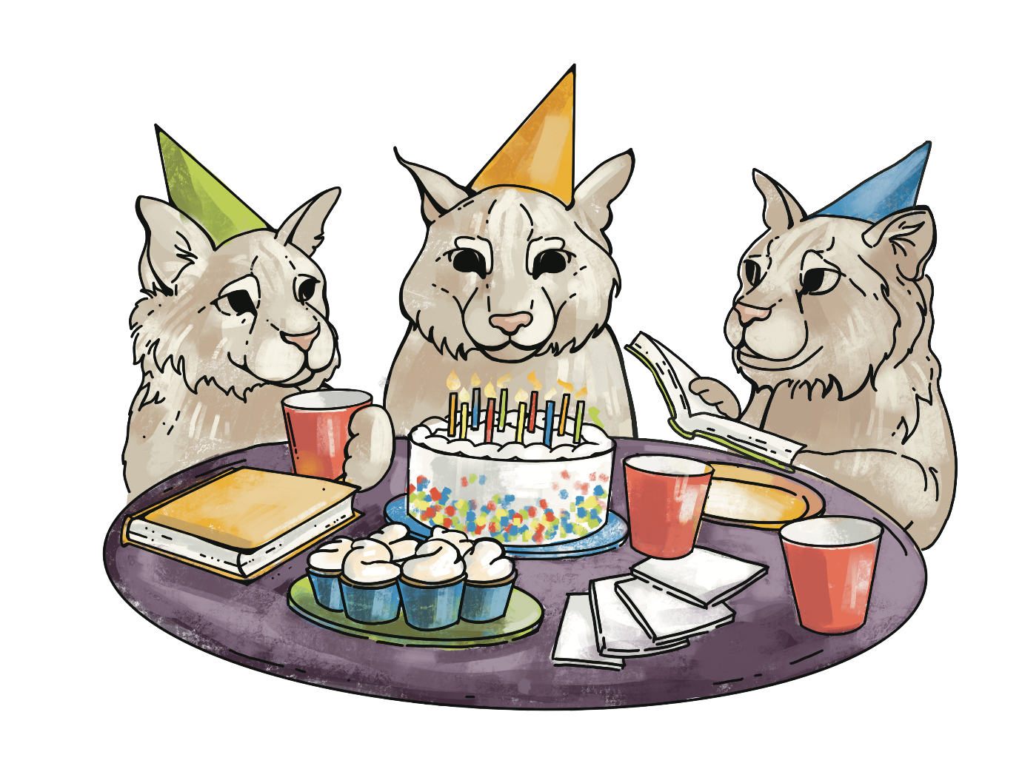
Bobcat Browse Committee
Eight committee members
  Two co-chairs
  All members from various library departments
Meet once a month, in person
Agenda items often include:
  Planning featured collections
  Deselection/maintenance
  Soliciting recommendations
  Furniture (yes there was drama!)

Slide 6
How Did Bobcat Browse Come About?
1993
Dream of an academic librarian in training
November 2012-January 2013
Building Community Grant
Spring 2013
"Browsing" Proposal to Administration
Summer 2013
Purchase of fixtures, setting procedures, gathering suggestions
Fall 2013
Open to the public!
Summer 2015
Expanded scope of Bobcat Browse; added fixture & sub-categories
Summer 2023
Celebrated! Bobcat Browse 10th Birthday Party!
Summer 2025
New fixtures & chairs
Summer 2026
New display fixture & permanent signage

Slide 7
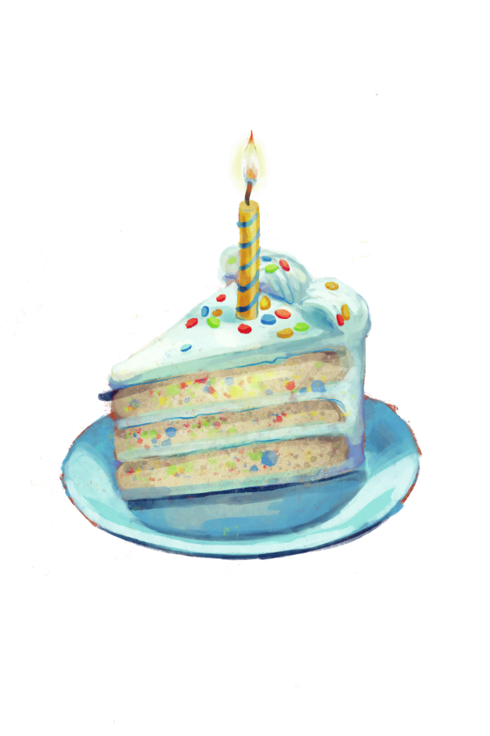
How Has Bobcat Browse Evolved?
From an “experiment” to an established feature
Expansion
Integration with outreach efforts
Created a “Featured” sub collection
Removed divisions by recommender status (faculty/staff/students)
Added Montana book (books about or set in Montana)
Added MSU authors
New book fixtures and chairs

Slide 8

Browse By
the
Numbers

Slide 9
How Do We Measure Success?
Usage
Who uses it?
Circulation
Proportion of collection that loans
Average loans per item
Engagement
Recommendations
Events
Program visitors
Observation

Slide 10
Who Is It For? Who Uses It?

Slide 11
Circulation

Slide 13
Notes:
We also look at our average loans per item, which is the number of loans divided by the number of items in the collection. This is really about the bang for our buck in terms of the usage we see for titles we purchase for the collection. Compared to our general collection, Browse items circulate much more frequently.

Slide 14
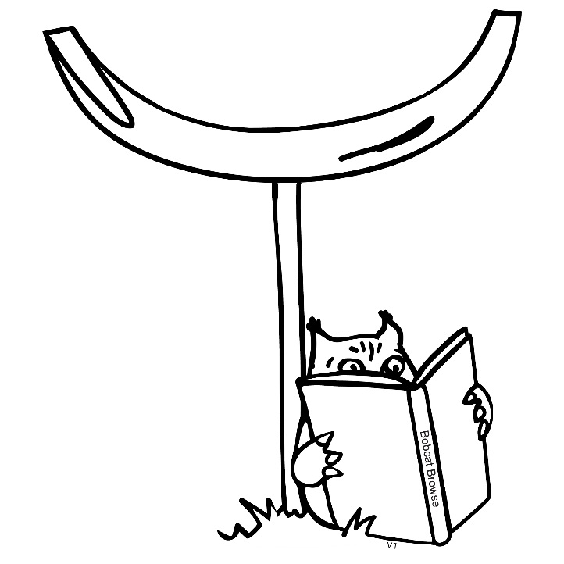
Making Bobcat Browse Inclusive and Dynamic!

Slide 15

How Do We Make it Dynamic?
Deselection twice per year
Highlight new books
Ensure we are collecting MSU authors
Bobcat Browse book group
Multiple methods for recommendations
Shortened loan period to three weeks
Integrate with other library outreach efforts

Slide 16

How Do We Make It Inclusive?
We ask what people want to see in the collection
Order award winning books
Make connections
Avoid special labels

Slide 17

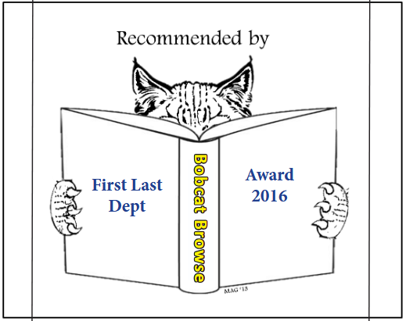
How Do We Make It Inclusive, cont.

Slide 18

How Do We Amplify Diverse Voices?
Browse Featured
Temporary Display Fixtures
Diverging from Euro-traditional viewpoints
Actively seeking recommendations

Slide 19

How Do We Promote the Collection?

Slide 20
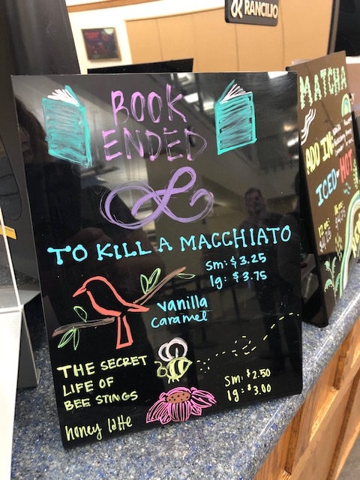
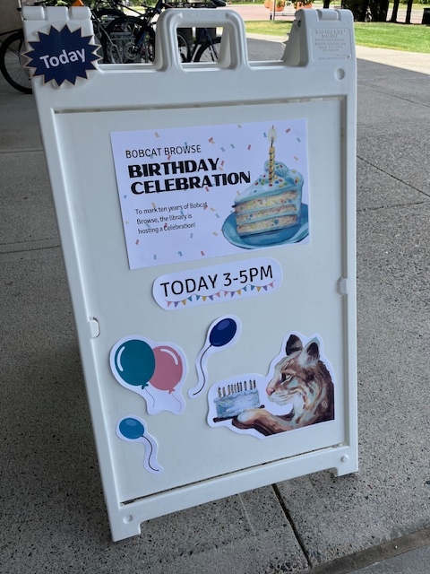
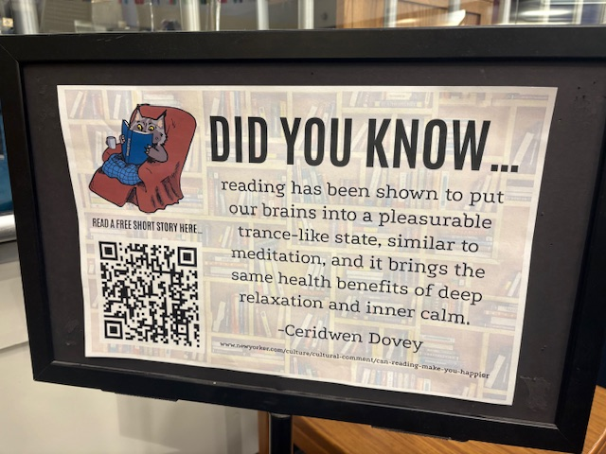

Slide 21
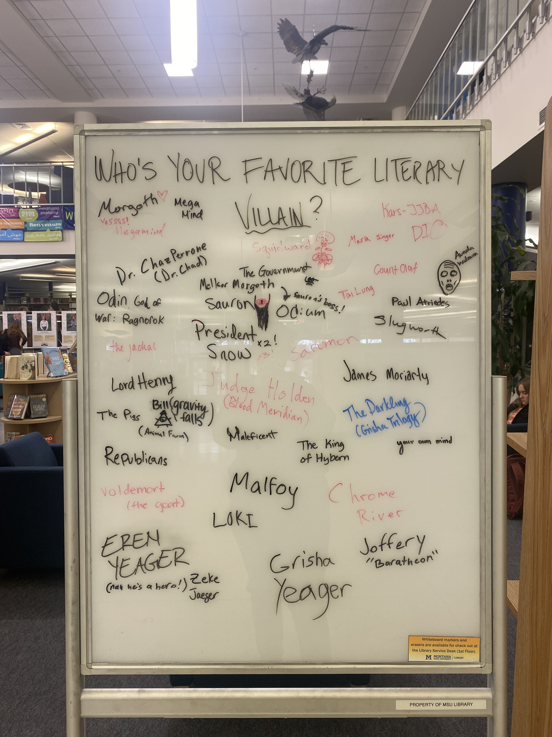
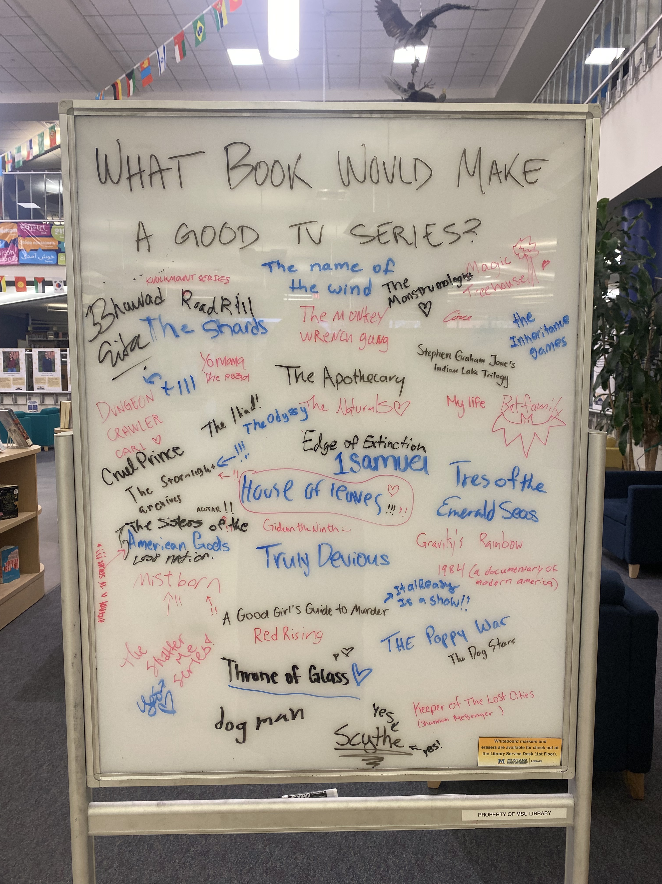
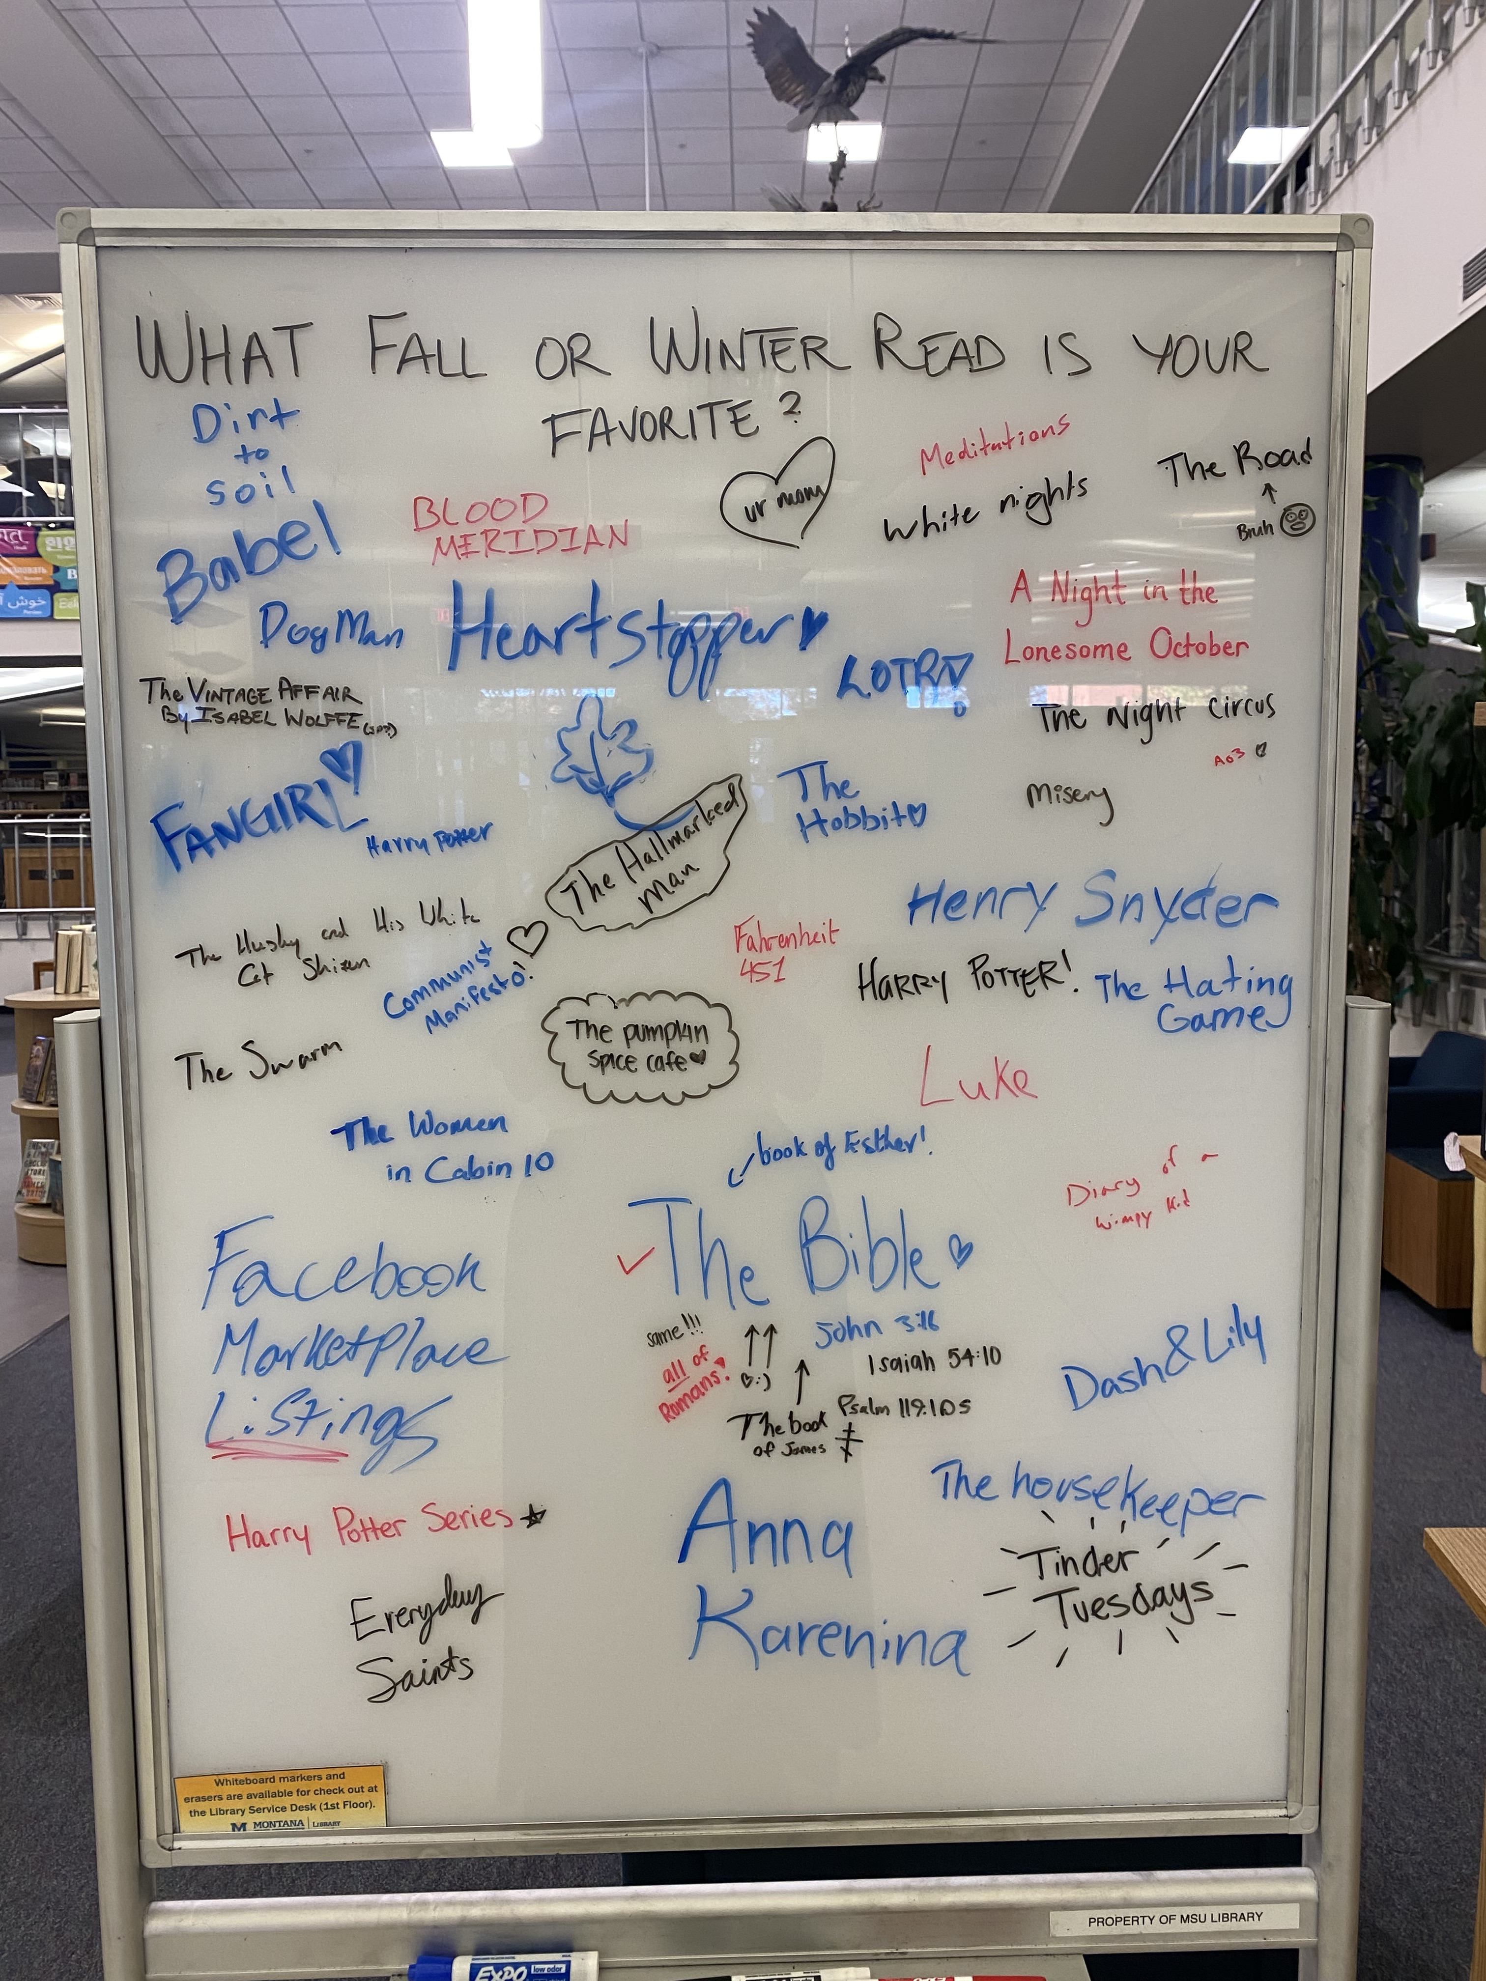

Slide 22
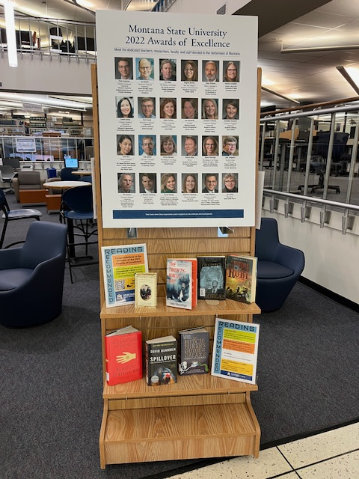
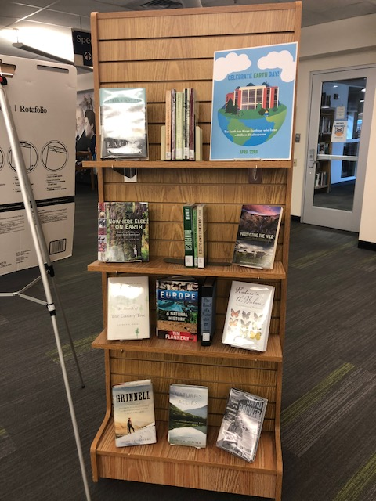
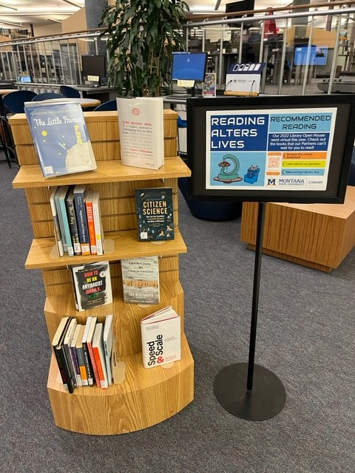
Rotating Displays

Slide 23
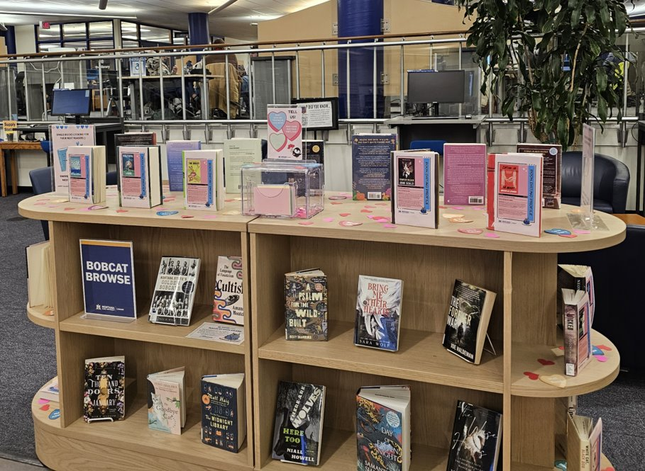
Valentine’s Day Display
Bobcat Browse Book Dating
Created Book Dating Profiles Using AI

Slide 24
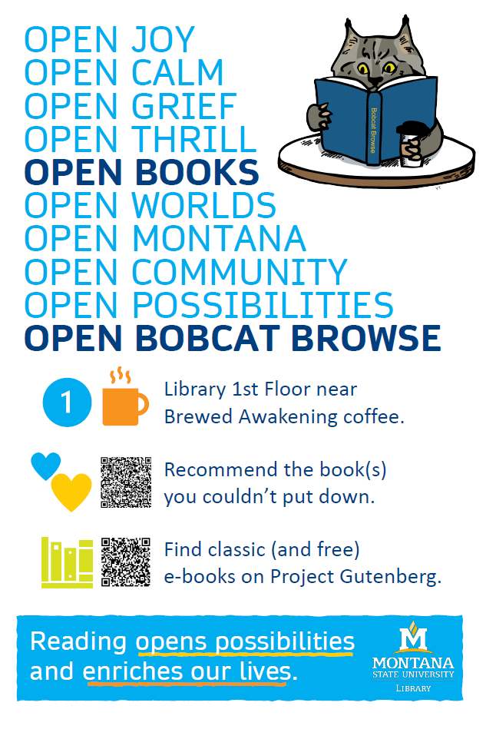
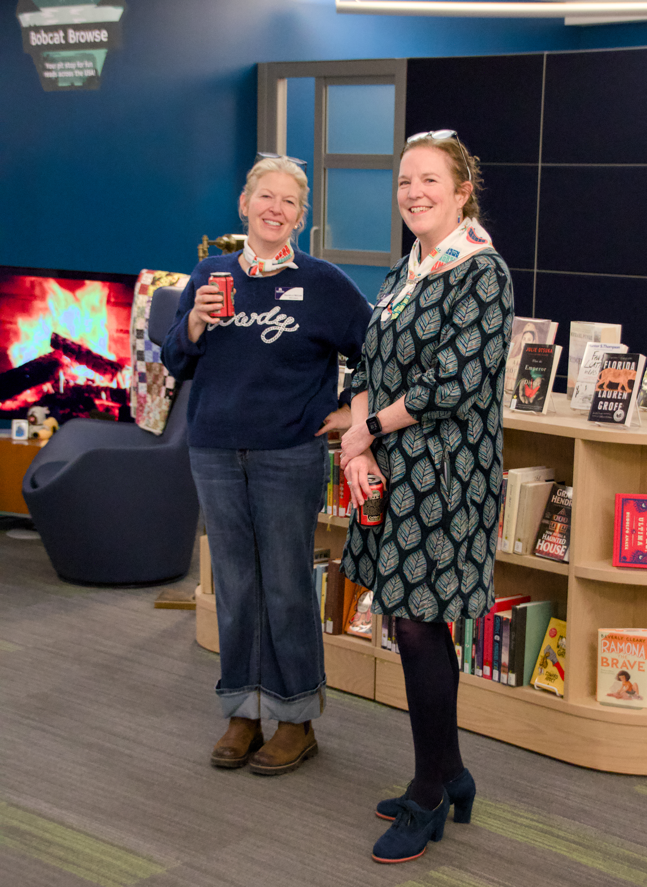
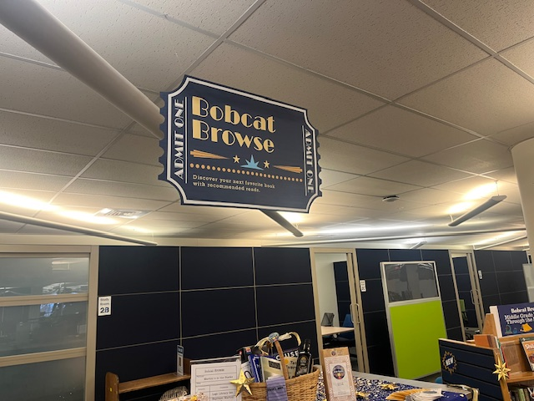
Library Open House

Slide 25
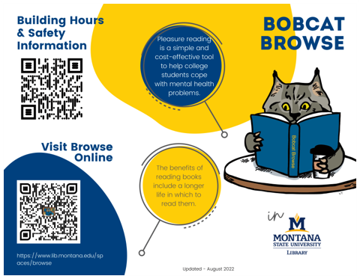
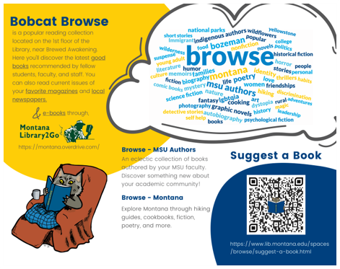
Bobcat Browse Promotional Materials

Slide 26
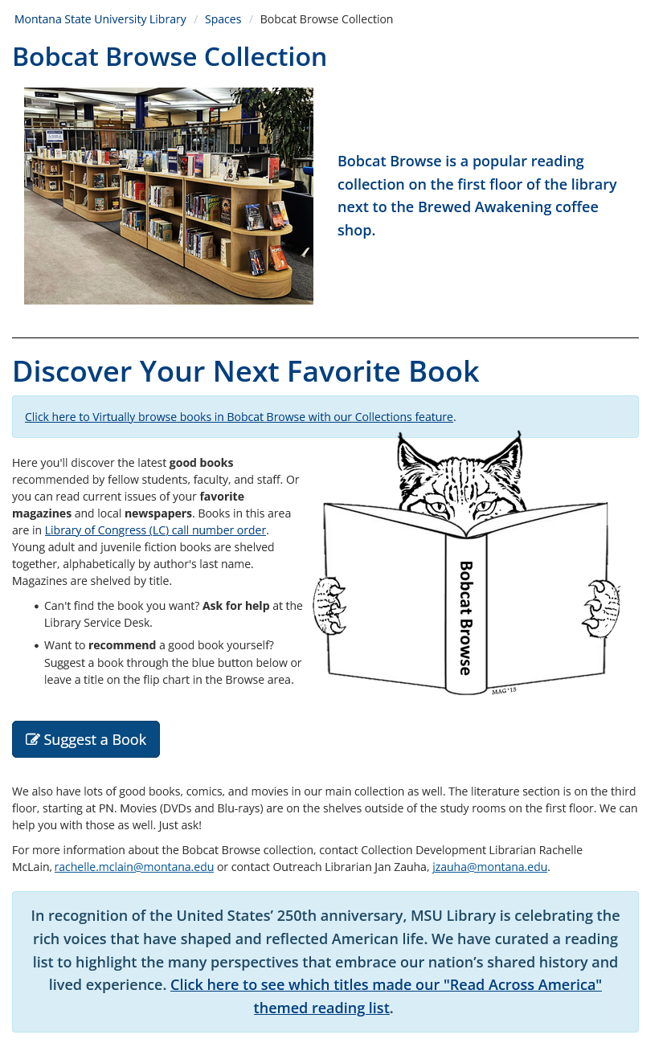
Bobcat Browse Webpage

Slide 27
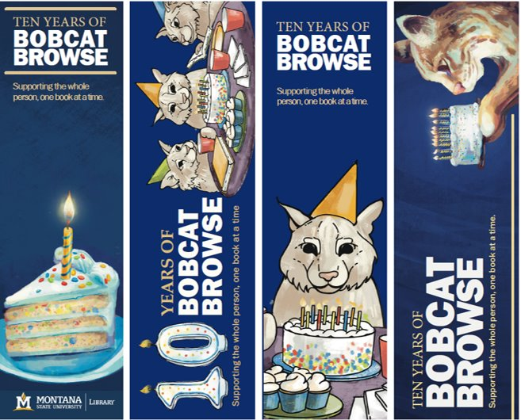
Bookmarks
Designed by student employee Emma Bergman
Design awarded the 2024 ALA Core PR Xchange Award
Services & Resources Top Honors

Slide 28
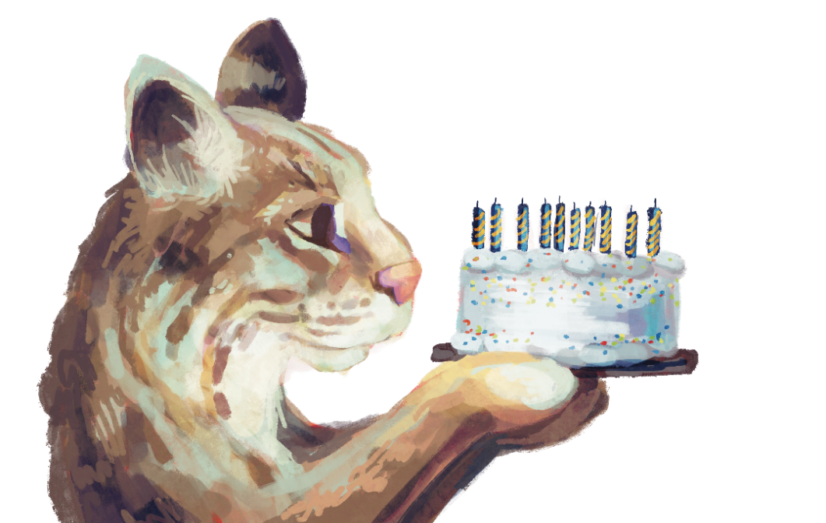
What Does the Future Hold?

Slide 29

Current Challenges
E-book inclusion
Consistent and accurate shelving
Sustainable maintenance/collection development
Outreach
Finding the best way to get suggestions

Slide 30
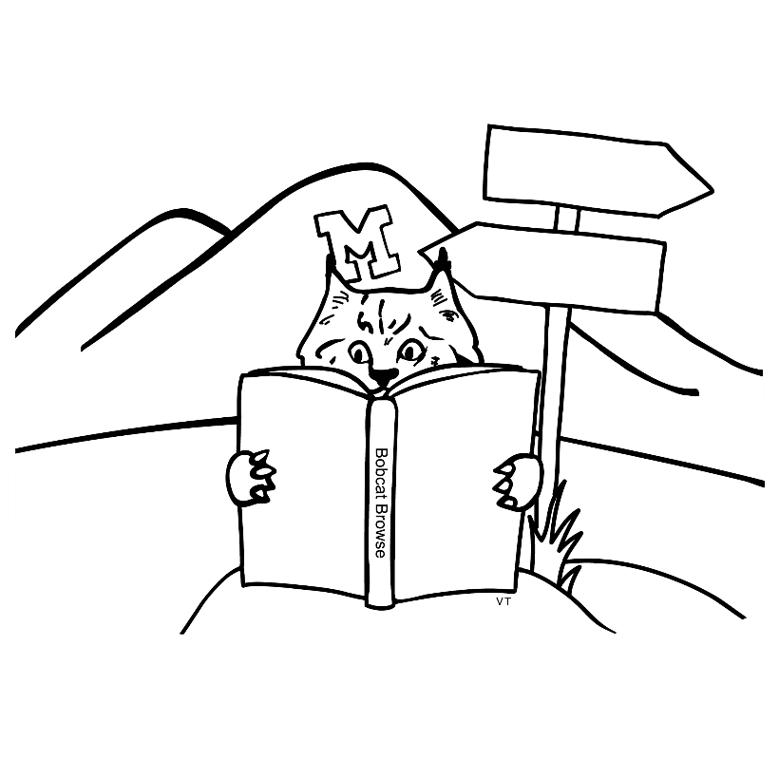
What Are Future Threats?
Funding?
Censorship?
Staffing?
Administration changes?
Space changes?
Reading habits?

Slide 31

Questions? For You and For Me!
Do you have a similar collection at your library?
What are ways you’re promoting reading?
Have you bridged the electronic and print gap successfully?

Slide 32

Thank You!
Rachelle McLain
rachelle.mclain@montana.edu

