Slide 1
Leveling up:
Understanding what we have
Rice Majors, UC Davis
Acquisitions Institute at Timberline Lodge, 2026

Slide 2

“It’s simply the greatest
wine library in the world.”
Hugh Johnson, OBE
Notes:
UC Davis is known internationally for its collections around viticulture and enology, that is – grape-growing and wine-making.
Are we the greatest in the world?
It’s hard to agree on a definition of “greatest,” and, even if we could, we’ve never been sure how to go about comparing ourselves to others.
So we rely on this quote from Hugh Johnson, since we can factually state that he said this.
If you don’t know who Hugh Johnson is, that’s ok – he’s a prominent and distinguished wine writer, and his name is legend among the potential users of such a rarified collection.
Recent archival donations from several luminaries in the coffee industry led to a question about how strong our coffee collection is – meaning collection of published materials – and what our appetite for further donations is to make it stronger, and what it would take for us to have the strongest collection.
At the same time, we have recently begun offering research travel grants to scholars who want to come use our collections – and ask them to describe what they would use in their grant applications.
So, how do we know what we have?

Slide 3
Problem statement
How well do we understand our “level 5” collections?
  Built over decades, by a series of curators or collectors, augmented by donations over time
  A mix of thoughtful and less thoughtful choices, with most choices having no feedback mechanisms
  We know we have a large collection. Do we have the biggest, rarest? Best? What are we missing?
If we don’t know, how can our users know what we have?
Notes:
The Research Libraries Group developed a system of collecting levels known as the RLG Conspectus, intended primarily for the uniform evaluation of collections in research libraries. The use of these collecting levels evolved from a tool for evaluation into a meaningful set of descriptors employed in library collection policy statements. Updates to the RLG Conspectus ended in 1997, and RLG became a part of OCLC in 2006.
Level 5 is defined as: Comprehensive Level: A collection which, so far as is reasonably possible, includes all significant works of recorded knowledge (publications, manuscripts, and other forms), in all applicable languages, for a necessarily defined and limited field. This level of collecting intensity is one that maintains a " special collection." The aim, if not achievement, is exhaustiveness. Older material is retained for historical research. In law collections, this includes manuscripts, dissertations, and material on non-legal aspects.

Slide 4
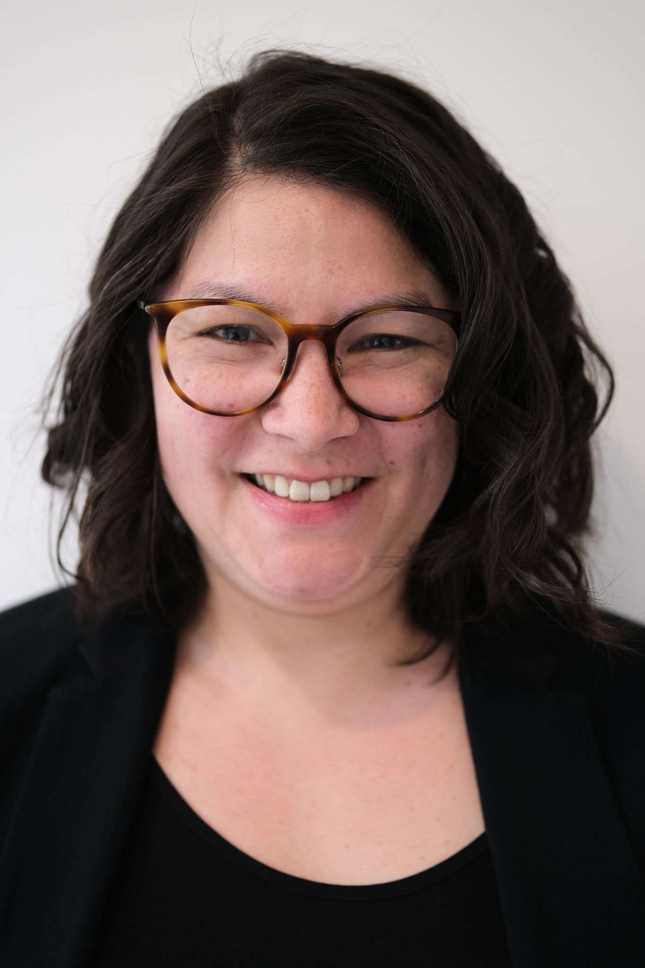
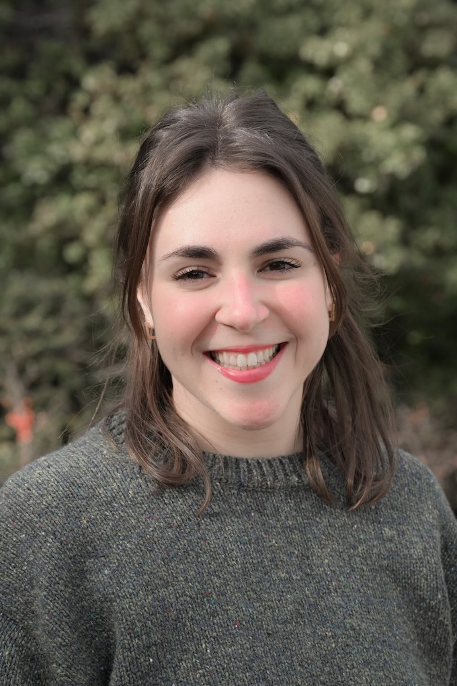
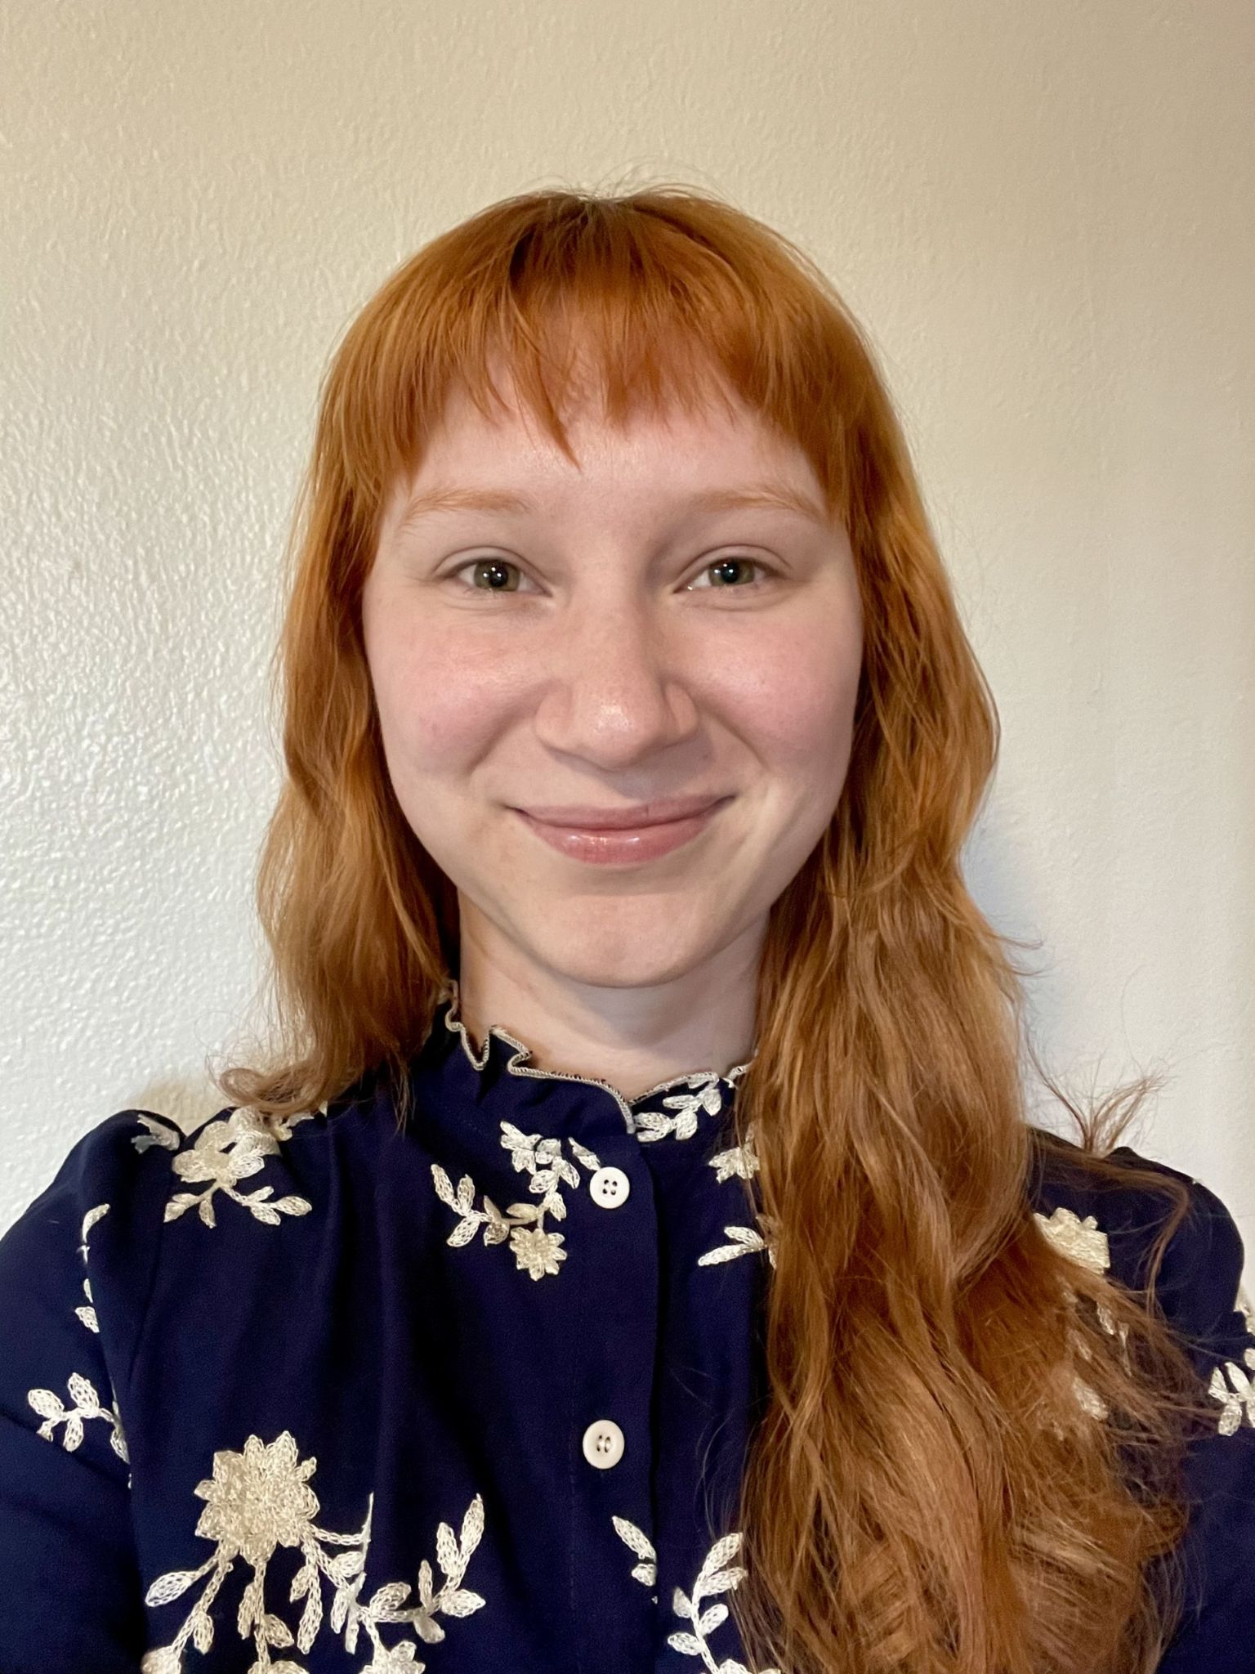
Library school interns
Cohort model for cross-pollination
  Lab books
Paid positions
Blog posts to create visibility of work

Slide 5
Possible areas of work
Analyze and describe the collection
  Scope, strengths, characterization of collections
Competitive analysis
  Who are our comparator libraries?
  What differentiates our collection from other libraries?
  How do libraries describe their distinctive collections?
  Where should we grow to reach our own goals?
Blog posts (etc.) to communicate this to users
Notes:
Curious to put some effort into this for a few areas
To explore what we can find out using emerging tools for accessing and analyzing our data
To confirm how scalable some of these processes might be
Beyond the scope of this project: what does no library have?
Describe the collection
Its scope, its strengths, what do we have that’s truly rare, an assortment of “fun facts” and “curious findings,” maybe something about provenance when known – output could look like text for a webpage
As a component of this, articulate how we identify these materials within the broader collection (e.g., call number ranges, search terms)
How do other libraries describe their distinctive collections? Is there a compelling example we could use as a model?
Identify candidate materials in the general collection for transfer to special collections locations
Competitive analysis – what other libraries have strong collections, and what do they have that we do not?
What are we missing?
Can we create a list of what we’d like to own?
Probably not answerable in the span of an internship: What does no library have?
Are there other outcomes we would like to have?
Blog posts on these collections?

Slide 6
Agricultural technology
California food & drink
Tea
Dairy & dairy cattle
Asian culinary
Wine (viticulture & enology)
Chocolate & cacao
Beer
Coffee
Nematodes
Olives
Bees & honey
Notes:
Faced with ignorance about how easy or hard this work would be, we brainstormed a fair list of topics so that the interns could easily pivot to other work if they ran into obstacles and/or achieved things faster than expected.
Some of these topics map fairly well onto LC call numbers.
Others do not map well, but can be searched for via other means.
Analyzing some topics simply aren’t [well] supported by bibliographic data alone (e.g., “in fiction”).

Slide 7
Analysis with Choreo & other tools
Compare to a list of libraries (Choreo)
  Predefine a list of comparator libraries
Compare to all OCLC libraries (Choreo)
  Some analysis required exporting (Google Sheets)
  Would need to use R or similar for larger data sets
Still to come: PowerBI, generative AI tools

Slide 8
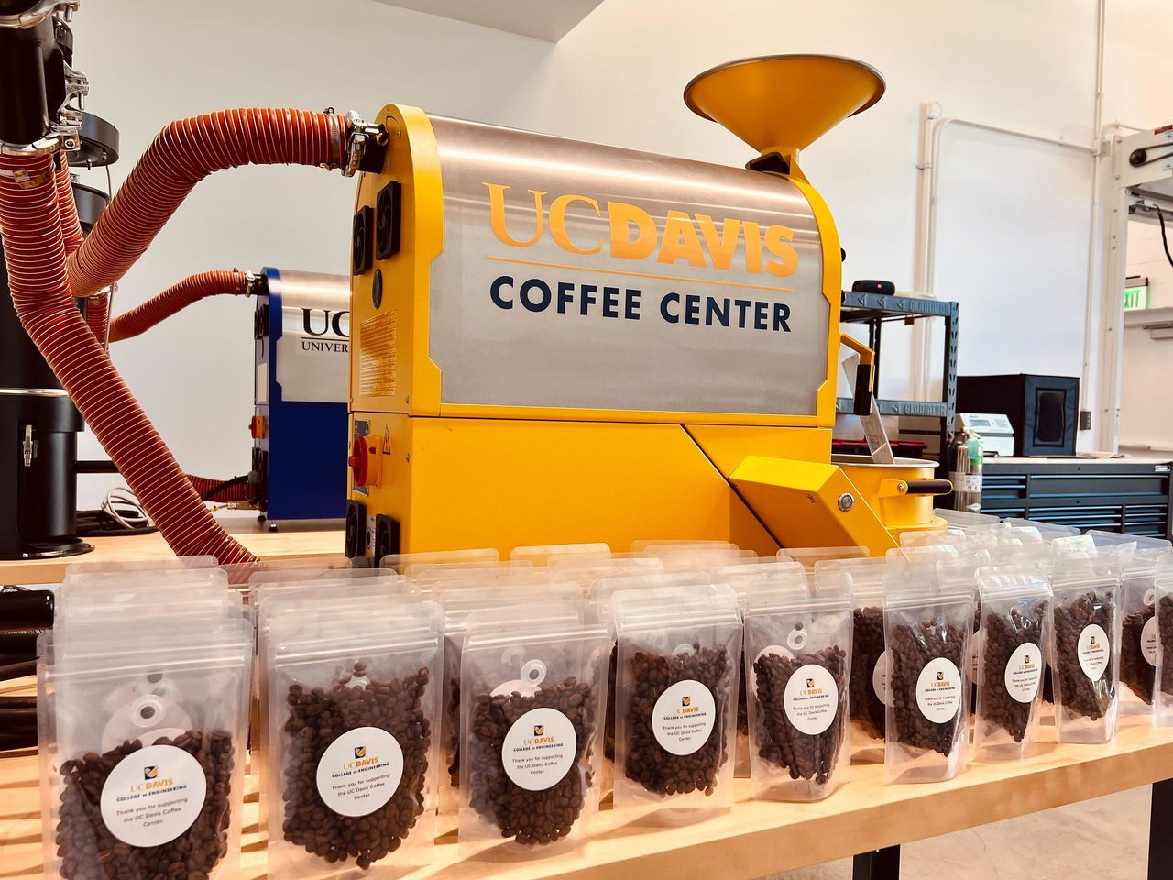
close-up on coffee
collection analysis

Slide 9
Coffee collections overall
Total size of collection(s) - U.S. peers
Harvard 908
UC Berkeley 909
UT Austin 868
Cornell 867
NYPL 816
Stanford 690
Yale 640
Wisconsin 624
U Chicago 574
UC Davis 544
Princeton 541
NYU 508
Total size of collection(s) - world
Library of Congress 1734
Harvard 908
UC Berkeley 909
UT Austin 868
Cornell 867
NYPL 816
Stanford 690
Yale 640
Wisconsin 624
National Agricultural Library 586
U Chicago 574
British Library 551
UC Davis 544
Princeton 541
NYU 508
Notes:
Data pulled on March 14-15, 2026
These numbers are relative to the “superset” of 10,747 coffee-related titles in the ~1164 libraries in the comparator group. (1164 is worldwide, and includes a few “false positives” for non-library entities that register holdings with OCLC / WorldCat.)
Size of collections is based on OCLC numbers, so “one” item might be an entire serial run. The numbers here are to give a general sense of collections size.

Slide 10
History
GT 2918-2929
Coffee industry
HD 9199
Agriculture
SB 269-270
Coffee technology
TP 645
Coffee culture
TX 415
Cookbooks
TX 817.C6
Harvard
NYU
Princeton
Stanford
Columbia
…
UC Davis (15)
UT Austin
Harvard
Stanford
UC Berkeley
Cornell
…
UC Davis (30)
UC Berkeley
UT Austin
Cornell
NYPL
Virginia Tech
…
UC Davis (19)
UC Davis (1)
UT Austin
UC Berkeley
Cornell
MIT
UC Davis (1)
Harvard (1)
NYPL
UC Berkeley
Cornell
LAPL
Miami Dade College
Hennepin County Lib
Cleveland PL
NYPL
…
UC Davis (8)
The premier coffee collections in U.S. research libraries
Notes:
This breaks out coffee by sub-topic. You can see that UC Davis is stronger in some sub-topics than others. Institutions are ranked by the total number of titles they own.

Slide 11
History
GT 2918-2929
Coffee industry
HD 9199
Agriculture
SB 269-270
Coffee technology
TP 645
Coffee culture
TX 415
Cookbooks
TX 817.C6
Harvard
NYU
Princeton
Stanford
Columbia
…
UC Davis (15)
UT Austin
Harvard
Stanford
UC Berkeley
Cornell
…
UC Davis (30)
UC Berkeley
UT Austin
Cornell
NYPL
Virginia Tech
…
UC Davis (19)
UC Davis (1)
UT Austin
UC Berkeley
Cornell
MIT
UC Davis (1)
Harvard (1)
NYPL
UC Berkeley
Cornell
LAPL
Miami Dade College
Hennepin County Lib
Cleveland PL
NYPL
…
UC Davis (8)
+80 books
+421 books
+137 books
+122 books
For UC Davis
to become #1…
The premier coffee collections in U.S. research libraries
Notes:
This teases out how much larger UC Davis’s collections would need to be for us to say we were #1 in each of these areas.
For example, for History we would need to add 80 titles.

Slide 12
Some observations
Focusing on different dimensions of coffee
Large number of titles in German owned by UC Davis
  We have no idea how or why this happened
Even the largest (Harvard) has only 9% of the “superset”
There are some surprises – e.g., Miami Dade College
We assume we are the first to do this kind of deep analysis, so many of the libraries listed may be unaware of where their collections are strong/weak
Notes:
Researchers likely have to visit multiple institutions
UC Davis has 5% of the superset
Sometimes libraries have received donations that yield collections that are deeper than their academic programs might warrant

Slide 13
Some caveats
Call numbers an imperfect proxy for collection strength
  Some call numbers group “hot beverages” together
  Books on other topics that have coffee content within
  Dissertations on coffee likely excluded
Non-book materials (e.g., pamphlets, videos) often excluded
  Libraries that catalog pamphlets individually will appear to have larger holdings
Notes:
Some call numbers group “hot beverages” together and don’t easily allow us to segregate coffee from tea, hot chocolate, etc.
Books on topics beyond coffee, but which have strong coffee content within them, may have call numbers that excluded them from this analysis
Dissertations - even on coffee - likely have call numbers that do not reflect their subject matter
That said, if an OCLC record had an LC call number for a video, it would be counted – and it would be counted for the entire comparator group in that case

Slide 14

nematodes
bees & honey

Slide 15
Nematode collections overall
Total size of collection(s) - U.S. peers
UC Berkeley 689
Cornell 597
UC Davis 565
Urbana-Champaign 474
Virginia Tech 466
U Minnesota 459
U Chicago 400
U Wisconsin 400
NC State 390
U Georgia 380
Total size of collection(s) - world
UC Berkeley 689
Library of Congress 688
National Agricultural Library 687
Cornell 597
UC Davis 565
McGill 558
Urbana-Champaign 474
Virginia Tech 466
U Minnesota 459
Simon Fraser 429
Davis jumps to #1 among peers for SB998 alone (nematodes in agriculture / soil health & management)
Notes:
Data pulled on March 14-15, 2026
Size of collections is based on OCLC numbers, so “one” item might be an entire serial run. The numbers here are to give a general sense of collections size.

Slide 16
Suggestion: Bees and honey
Bring together a bee & honey collection:
Pollinators (including wasps)
Apiculture, including honey manufacture and the honey industry
Pests/Colony Collapse Disease
Honey as medicine
Mead
Adding mead creates a bridge to the viticulture and enology collections and research, providing a link to beverages and brewing, which UC Davis touts as a collection strength.

Slide 17

communicating this to users (and donors)
some thoughts from the interns to date

Slide 18
Tone ranges: “cut and dry” to “storytelling”
Statistics about size
Collection development policy
Listing donors, sometimes with biographical information
Context about how collections came to be
Examples of exquisite holdings or texts
Descriptions and synthesis of areas of strength
Confident, expansive language to position holdings as internationally significant
Notes:
How libraries describe holdings
Talking about the collections on your website ends up as a proxy for institutional interest – it’s so much easier for users to find your resources.

Slide 19
Moving beyond text
Images and multimedia
Strong headlines: spark curiosity, show items in context
Explicitly linking collections to other library efforts
  Digitization
  Tours, exhibits, storytelling
Positioning collection as accessible both in-person and online

Slide 20
Problems to avoid
Descriptions that are functional rather than narrative
  Lacking an explanation of why the collection matters
Assuming familiarity with library organizational structure
  No clarity about how to find related collections at the same institution

Slide 21
Adopt an NYPL-style description
Now: The library supports research across disciplines…
Proposed: This collection documents the global history of tea as a ritual, commodity, and cultural practice, offering rare insight into colonial trade, sensory culture, and everyday life.
Notes:
Adopt an NYPL-style description of the collections
Elevate lesser-known holdings (like the hyper specific areas under food & drink) into flagship narratives, creating clearer branding for specialized strengths

Slide 22
Chocolate
UC Davis has one of the top four library collections in the country, with Cornell, UC Berkeley, and NYU.
Davis is the strongest in cooking, baking, beverages, industry, manners and customs – the strongest general collection and rare book collection of general works on chocolate and cacao.
The Noling Beverage Collection dates from the turn of the last century, providing a snapshot of the chocolate industry before its establishment into a major worldwide economic powerhouse.

Slide 23
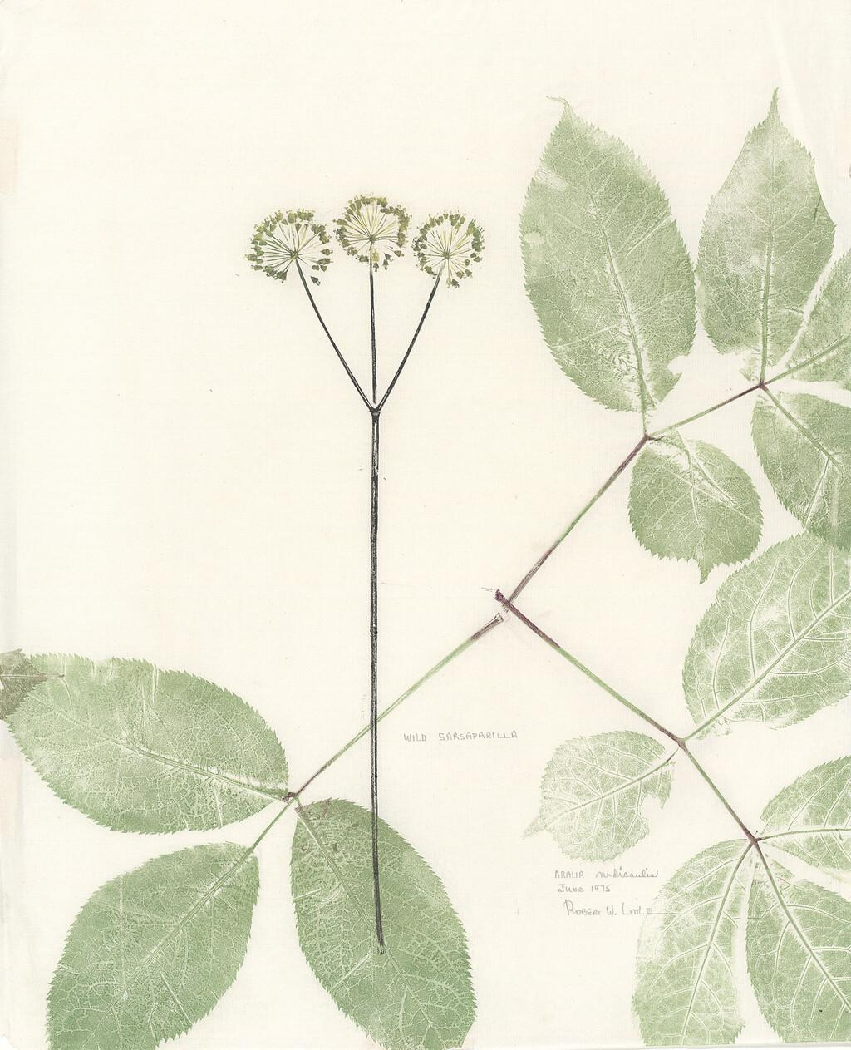
the effect of silence
Notes:
I became aware during this project of some of the effects that our relative silence about our collections is having on the user experience.

Slide 24
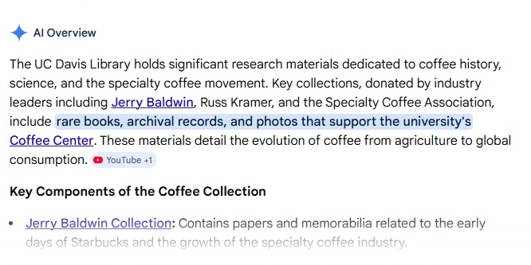
Notes:
Here is an example of a recent Google search for coffee, where a user is trying to figure out what we have.
For coffee we have a stand-alone webpage that articulates the breadth and value of our coffee collections, and Gemini has leveraged that to create a summary for this search. If you try a similar search for a topic where we lack a webpage, this summary is not present, and the collections are harder to find.
By releasing high-quality descriptions of our collections onto the web, we can empower users to find our collections using the tools they already use.

Slide 25
What haven’t we done (yet)
Largest collections would need R or similar to analyze
PowerBI to visualize some of the data
Identify works that contain these topics
Generative AI to help summarize and analyze large sets of data about library holdings?
Highlighting these collections on our website using storytelling in our descriptions
Notes:
Our largest collections (which we care about deeply!) would need R or similar to do the analysis
For example, for materials in HathiTrust, could we analyze the full-text?

Slide 26
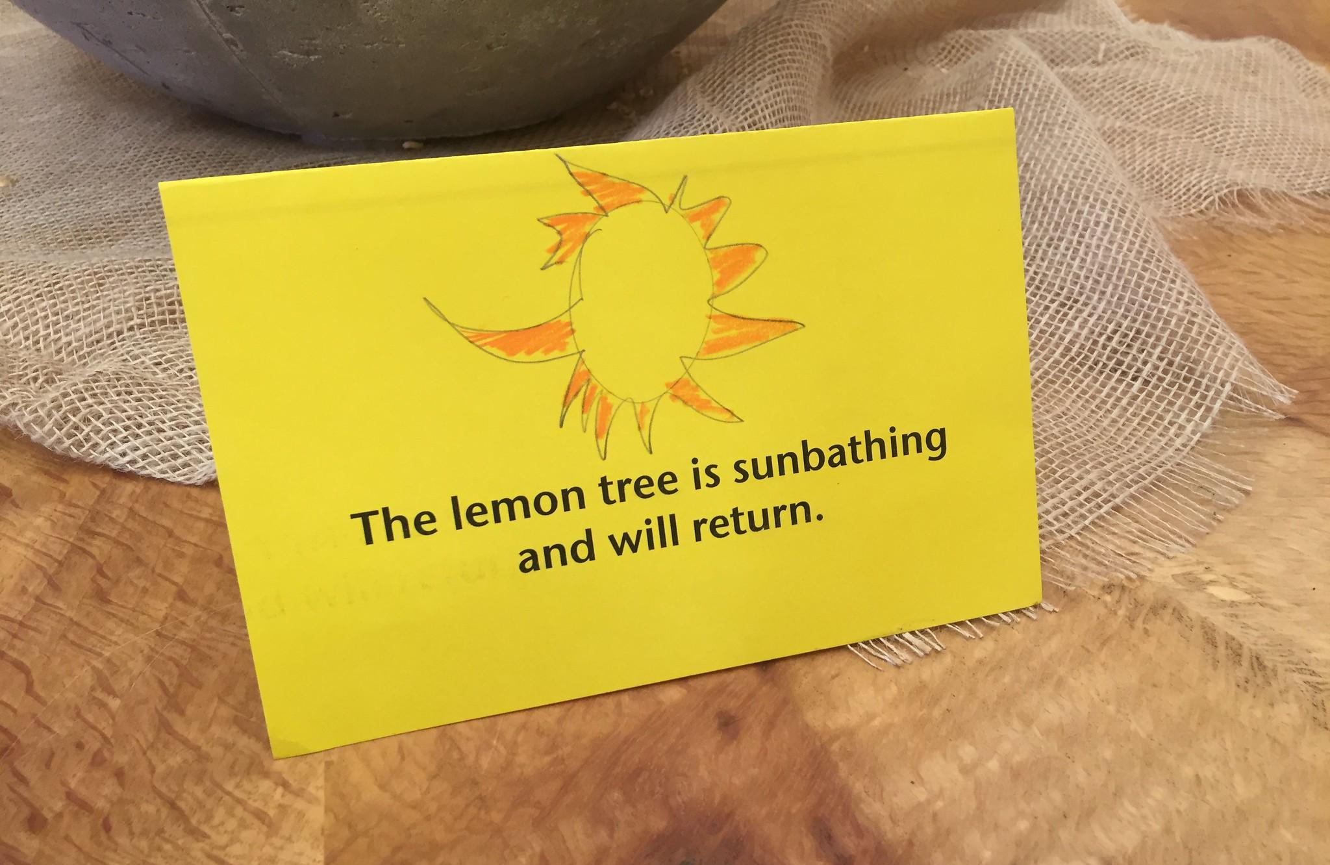
Questions & discussion
ramajors@ucdavis.edu
thanks to our interns:
Kristina Bellas
Mei Chin
Cheyenne Perry

