Slide 1

Consortia Cancellations: Campuses at the Crossroads
Becky Imamoto, UC Irvine
Megan Rosenbloom, UCLA
Dave Schmitt, UC San Diego
Notes:
Presentation: Monday the 18th from 11:10am – 12:05pm

Slide 2
Overview of the Situation
Our "consortia" includes the 10 UC campuses and the central negotiating unit California Digital Library (CDL). No outside orgs.
Each campus votes on any given deal.
Campuses vary widely in size and funding.
Charge from Council of University Librarians (CoUL) to model systemwide cuts from 3% & increasing increments for future fiscals
Quickly shifted to "cut 3% this fiscal."
  This resulted in a very tight timeline to consider, enact, and communicate cuts as the FY had already begun
Notes:
Dave. 3 minutes.
“The UC collection coalition remains strong, with over $60million in resources continued to be funded collectively.”

Slide 3
Added Complications
Most of UC senior library leadership turned over since Covid
Varying levels of campus budget uncertainty & campus reliance on systemwide deals
Unprecedented political interference: grant freezes & lawsuits
Notes:
Megan. 3 minutes.

Slide 4
Final Decisions
Most of our funds go to a small minority of packages
  Other resources are so inexpensive they make little difference to cut
Multi-year agreements make "cut this year" decisions difficult
Our timeline was so short we had limited use stats in some cases
Focused on A&I databases, with no loss of content
Ebooks were targeted, as individual titles could be purchased as needed, and in future years
We tried to spread cuts out over disciplines and resource type
Notes:
Dave. 3 minutes.

Slide 5
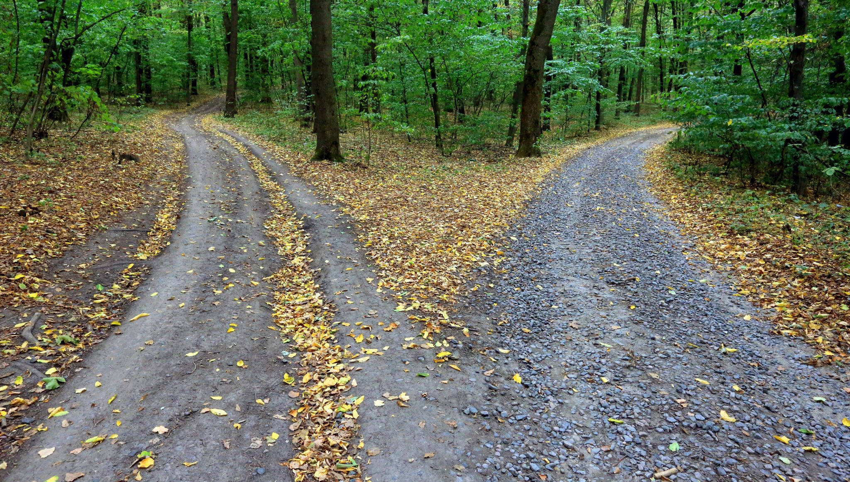
Impact on Consortia
Consortial purchases tend to be the most agreed upon content (highly used, broad appeal). They generally are most economical too due to consortial buying power and centralized management.
Varying budgets means impact will be felt differently across the consortia.
Notes:
Becky. 3 minutes.
These cuts can have great impact. What does it mean to be a consortia (pooling resources to achieve common goal)? Can we truly be one library system with inequity of resources?
Available funds from the system were used to offset the cost that some campuses could not contribute to retain the systemwide deal.

Slide 6



Our Three Libraries
UC Irvine
UCLA
UC San Diego
36,631 enrollment
$9M Collections Budget
9% cut since FY22-23
18 Selectors
46,678 enrollment
$12M Collections Budget
26 Selectors (currently reorg'ing)
45,000+
$9M (was $10.5M 1 year ago)
5 selectors (down from ~20 as we reorg’d)
Notes:
Becky: I can cover this slide for all of us, if you are okay with that. I think 1-2 minutes total is fine.
UCSD: shifted from a liaison model with subject selector roles to a strategist model which concentrates collection budget management and purchasing decisions to 5 people.

Slide 7

UC Irvine:
Library Discussions
Wait a year / Gather info
Few exceptions
Activated Article Galaxy Scholar
Anecdotally the librarians seemed more upset than campus
Notes:
3 minutes.

Slide 8
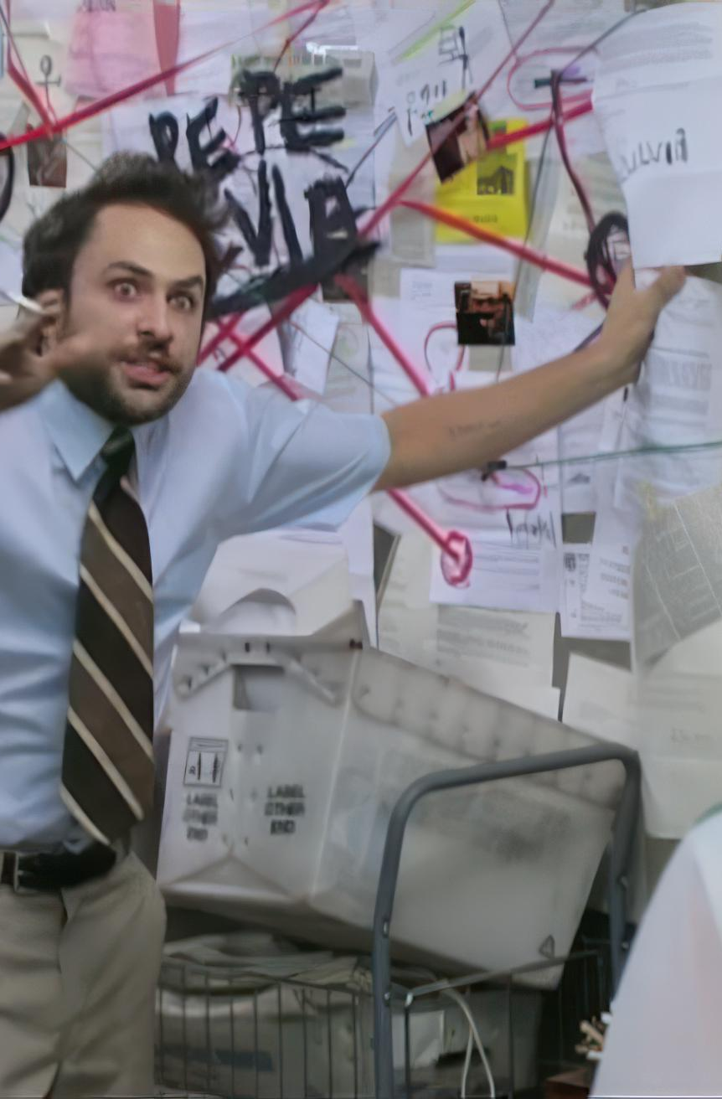
UCLA:
Library Discussions
Some reinstated with selector request & justification
New Collections Strategies team handling renegotiations work alongside other end of fiscal purchasing.
Starting quotes many times over former UCLA spend; negotiated but often steep increases
Reinstatements' performance closely monitored
Notes:
3 minutes.

Slide 9

UC San Diego:
Library Discussions
Had just undergone a massive budget cut and layoffs
No local sub replacement possible
Many of our local collection cuts were made with the belief that consortial resources were stable
Consortial purchases made with general funds, local purchases with endowments
Notes:
3 minutes.

Slide 10

UC Irvine - Campus Reactions
Communications Plan
  Shared with Provost
  Created webpage
  Email to campus
  Presented at the Faculty Senate’s Council on Research, Computing, and Libraries
  Follow up email from subject librarians to departments
Campus Reactions
Notes:
Foundations and Trends / PhilPapers / Math journals (tier 1 or 3?)

Slide 11
UCLA – Campus Reactions
New leadership, new collections team, changing library structure
Renegotiations led to huge amount of extra work on quick timeline
Reinstatements limited relevant audiences, so communication was targeted & spread through librarian contacts to relevant depts
Also library news story and website with rationale & alternative access options
Tense librarian reactions, less word from users, might not notice shut offs yet

Slide 12
UC San Diego – Campus Reactions
Consortial cuts were relatively minor compared to local cuts
Created a webpage which included and exhaustive list of cuts (1000+ titles)
Sent information to departments, spoke to Academic Senate
Because of campus-wide cuts, campus generally understood and commiserated, but everyone has their own funding to worry about
Overall, only heard complaints about 2 relatively inexpensive resources, otherwise quiet. (which has its own implications)

Slide 13

Lessons Learned / Future Plans / Implications for Other consortia
Plan earlier!
Schedule periodic reviews instead of scrambling when in an emergency.
Formalize usage gathering and campus access.
We’re better together.
Notes:
4 minutes

Slide 14
Questions?

