Slide 1
By/With Indigenous Children's Literature from Abya Yala:
Picture Books as Cultural Artifacts for Language Learning in Higher Education
Kathia Ibacache, Romance Languages Librarian
Natalia Umaña, Education Librarian
University of Colorado Boulder
Acquisitions Institute at Timberline Lodge, May 2026

Slide 2
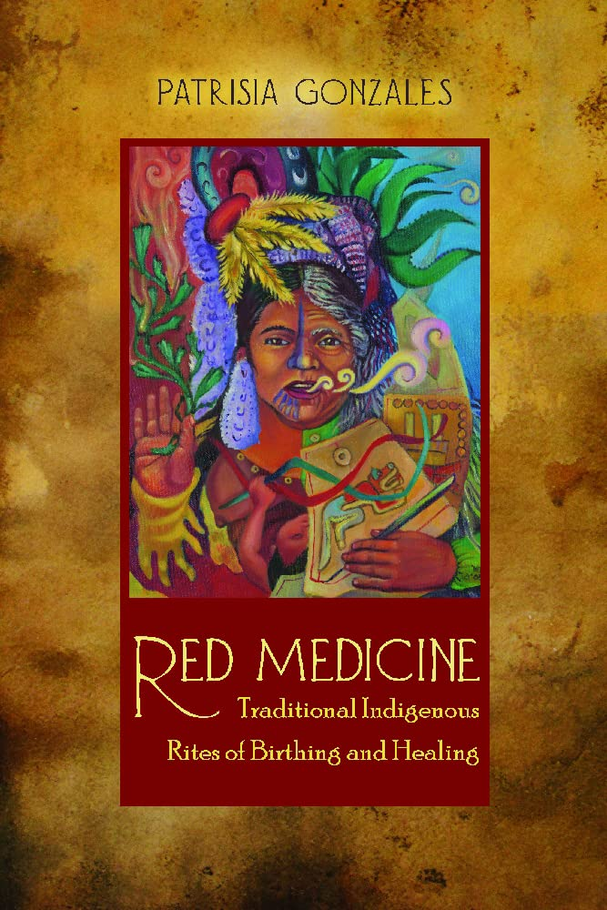
¿Dónde está tu ombligo? Where is your belly button?
(Gonzales 2012, 166)
Our positions to, with this presentation

Slide 3
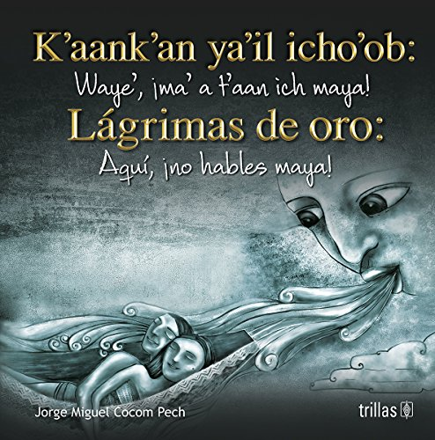
Opening thoughts
When people think of illustrated and picture books, we associated them with books for children

Slide 4
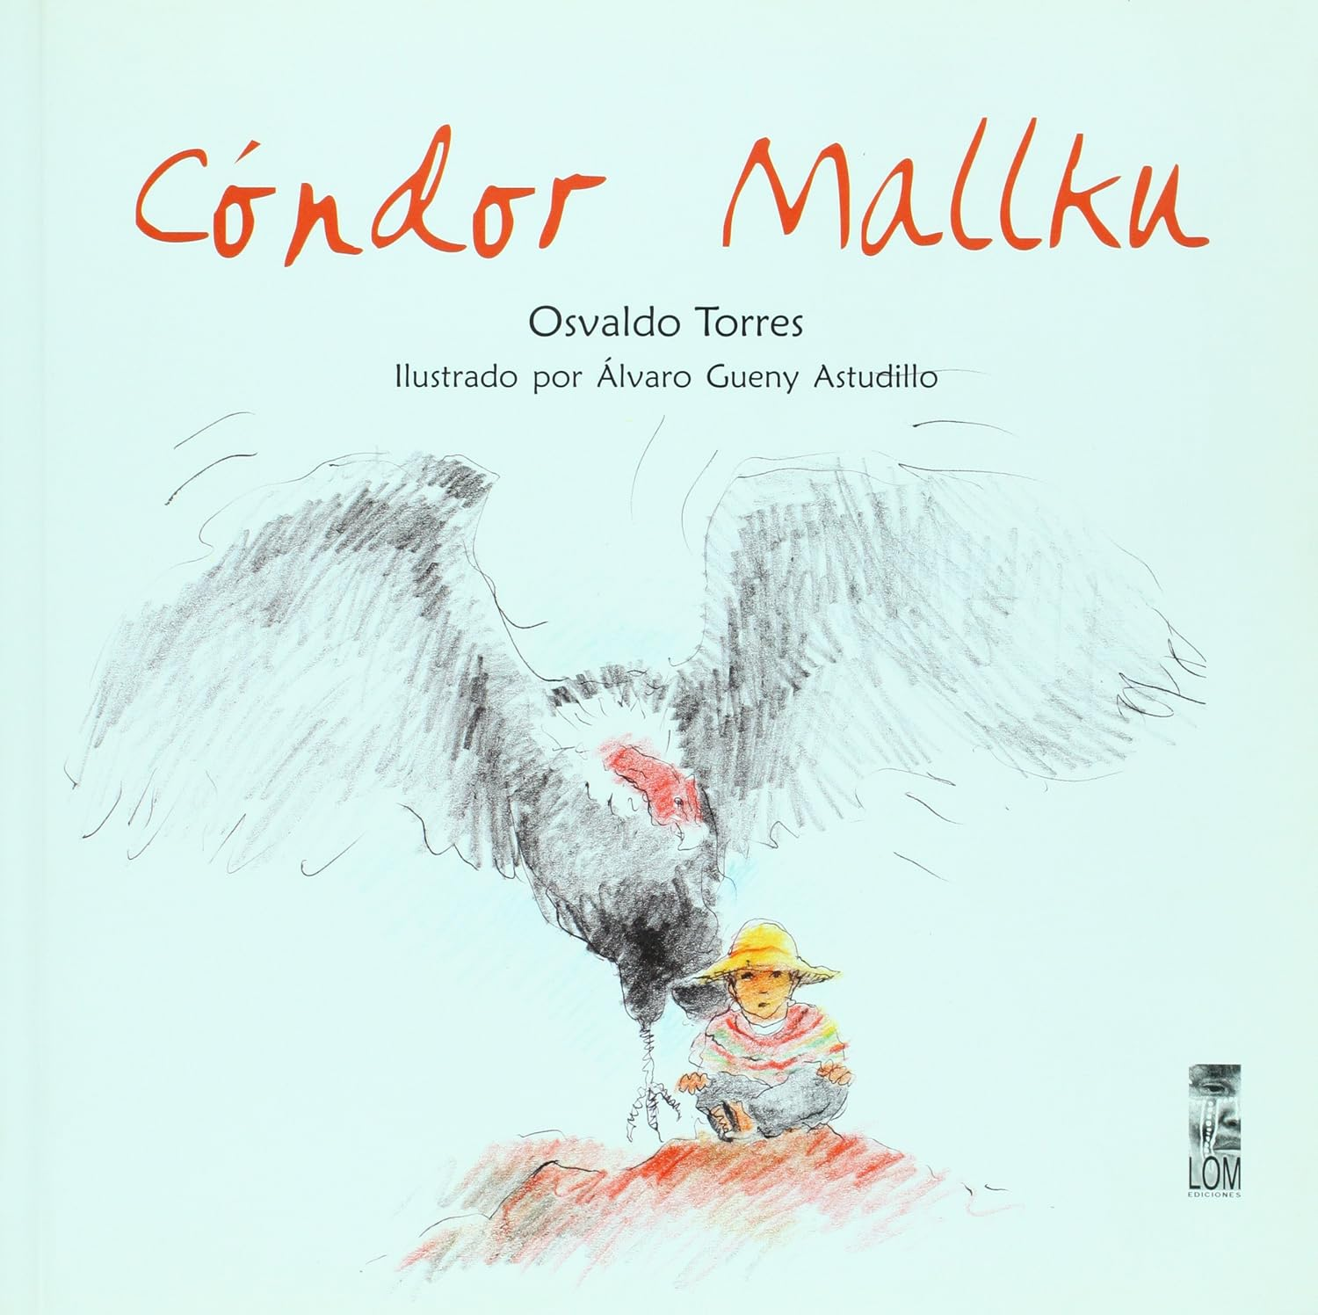
Opening thoughts
Authored by By/With Indigenous people
Serve as cultural artifacts
L2 Spanish classroom; K-12 pre-service teachers
Monolingual (Spanish) and multilingual (Indigenous language-Spanish)
Acquisition beyond the peripheries

Slide 5
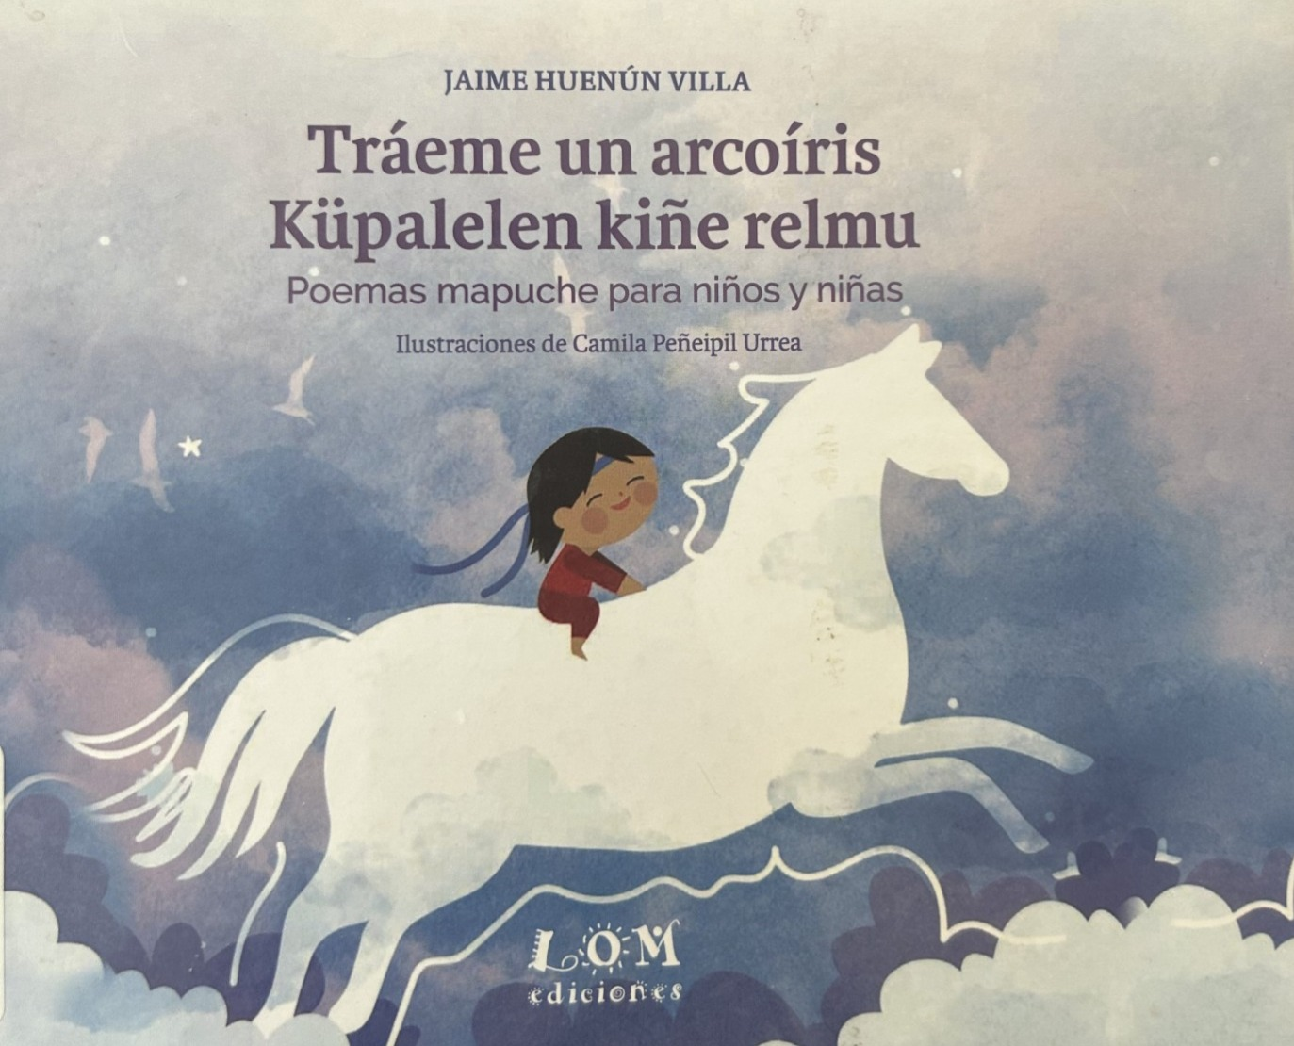
What brought us to this Examination?
Current approach to L2 Spanish learning
Pre-service teachers & Education
Acquisition: Moving beyond the peripheries

Slide 6
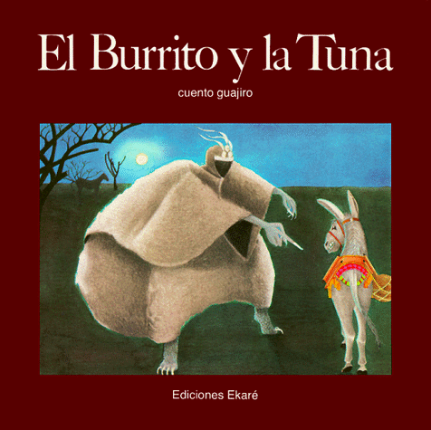
Scope
By/With
Authored by a self-identified Indigenous person
Or in collaboration between Indigenous people and non-Indigenous people
Javier Munoz-Diaz, Kathia Ibacache and Leila Gomez. Indigenous Materials in Libraries and the Curriculum: Latin American and Latinx Sources. Routledge Focus (2024): 20, 26.
Authentic books
Written by members of a given cultural group for native speakers (Galloway, 133)
Vicky Galloway. “Constructing Cultural Realities: ‘Facts’ and Frameworks of Association.” In The Coming of age of the profession: issues and emerging ideas for the teaching of foreign languages. Edited by Jane Harper, Madeleine Lively, and Mary K. Williams. New York: Heinle & Heinle (1998): 133.

Slide 7
How these books fit in the higher ed. classroom?
  Bring more cross-cultural and transcultural diversity through art and content
  Build vocabulary
  Exposure to different topical lenses
  Validation via cultural relevance

Slide 8
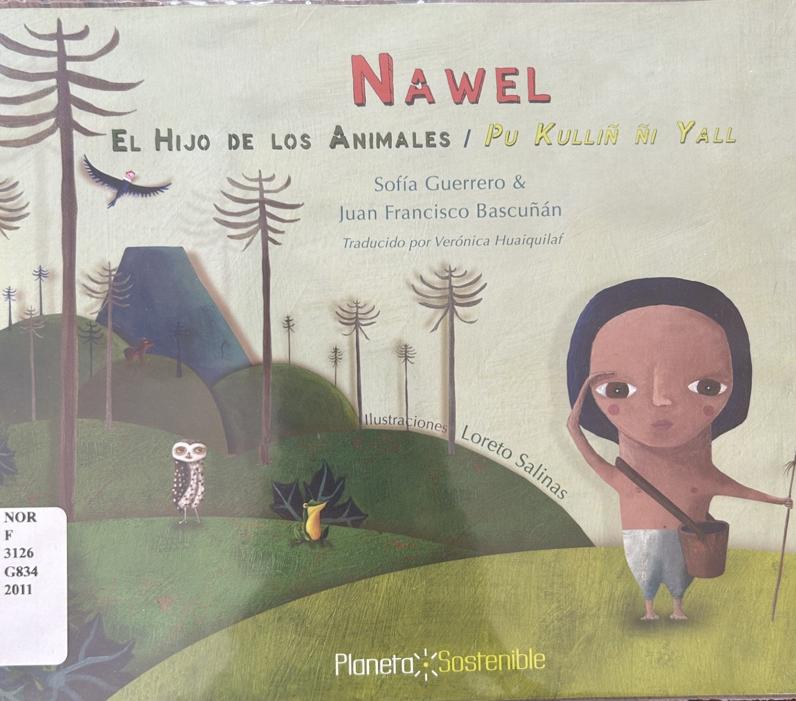
Cultural artifacts: narrative and art
Cosmovision in Text and Art
Clothing
Flora
Fauna
Feasts
Food
Instruments
Language
Objects
Places
Spirituality

Slide 9
Cultural artifact: Narrative & art
Cosmovision
  Reciprocity (harmony and duality)
  Kinship (interconnectedness & relationality to land, animals, humans, natural, cosmos, and supernatural worlds)
  Knowledge sharing via storytelling
    Ancestral wisdom
    Orality
Cultural objects
Adult appealing topics and some kiddie ones too
Unseen collaboration and decolonized perspective

Slide 10
Cultural artifact narrative: Places
Macro‑regions: Puelmapu, Los Andes, Lima, Huamanga, Pisco, New York, Pachacámac, San Salvador.
Rural zones: La Guajira, San Andrés de los Pescadores, Chincha Baja, Huachihue, Chol Chol, La Vega, Xo'lsaqmajja, Oqobamba, Tunas Patas, Tlalocan (mythical place).
Topographic features: altiplano, montes de Saywa, Cumbres del Markaqasa, montañas, lomas, lomitas, pendiente, Cerro San Jacinto, desierto, pastizal, campos de col, selva, bosque, tierra.
Hydro‑geographic features: mar, la costa, río, arroyo, Laguna Yana Warmi, puerto, Río Hacha.
Human‑built spaces: Plaza del pueblo, iglesia, escuela, corral, chacra, huerta, quinta, troje, mercado, Cárcel de Cangallo, Calle 24.

Slide 11
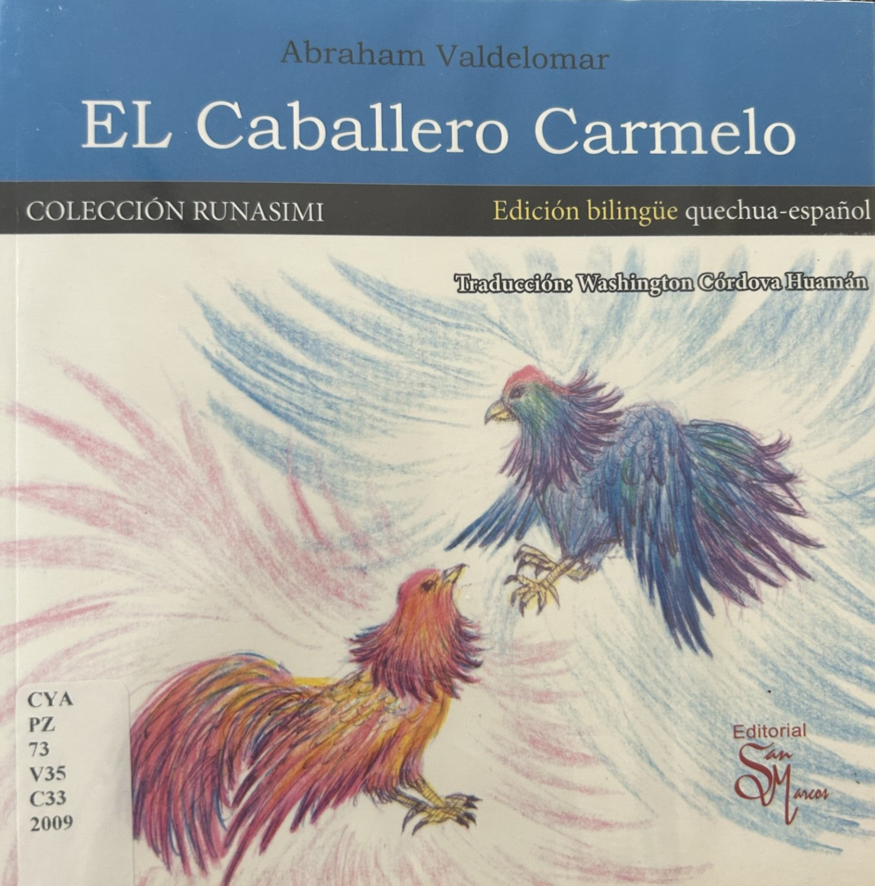
Cultural artifact narrative: Food
El Caballero Carmelo
Baked goods: pan hogazas; pan francés; pan mantecado; rosquillas; bizcochuelos
Dairy: quesos frescos envueltos por la cintura con paja de cebada de la quebrada de Humay
Legumes & grains: frijoles colados en sus redondas calabacitas, pintadas encima con un rectángulo del propio dulce; mazorcas.
Fruit & vegetables: sandía, calabacitas.
Seafood: corvinas frescas, Pescado fresco asado en brasas y anegado de cebollones y vinagre
Sweets : manjar blanco, chancacas hechas con coco, nueces, maíz y almendras; tejas rellenas.
Drink & fermentation: café, chicha.
Sandwiches: butifarras.

Slide 12
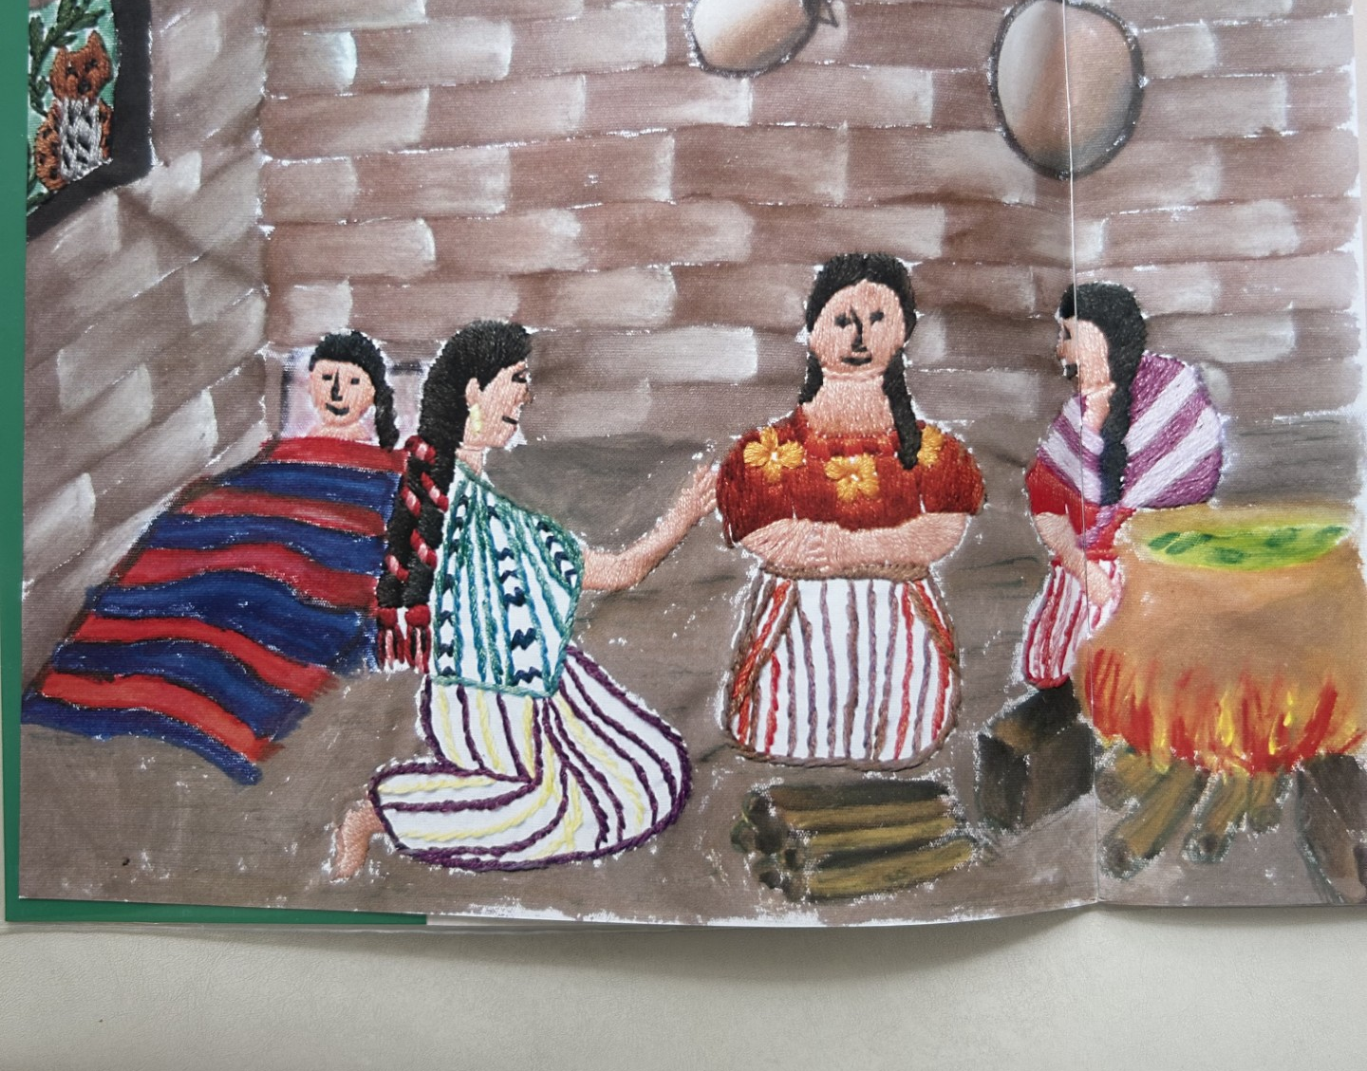
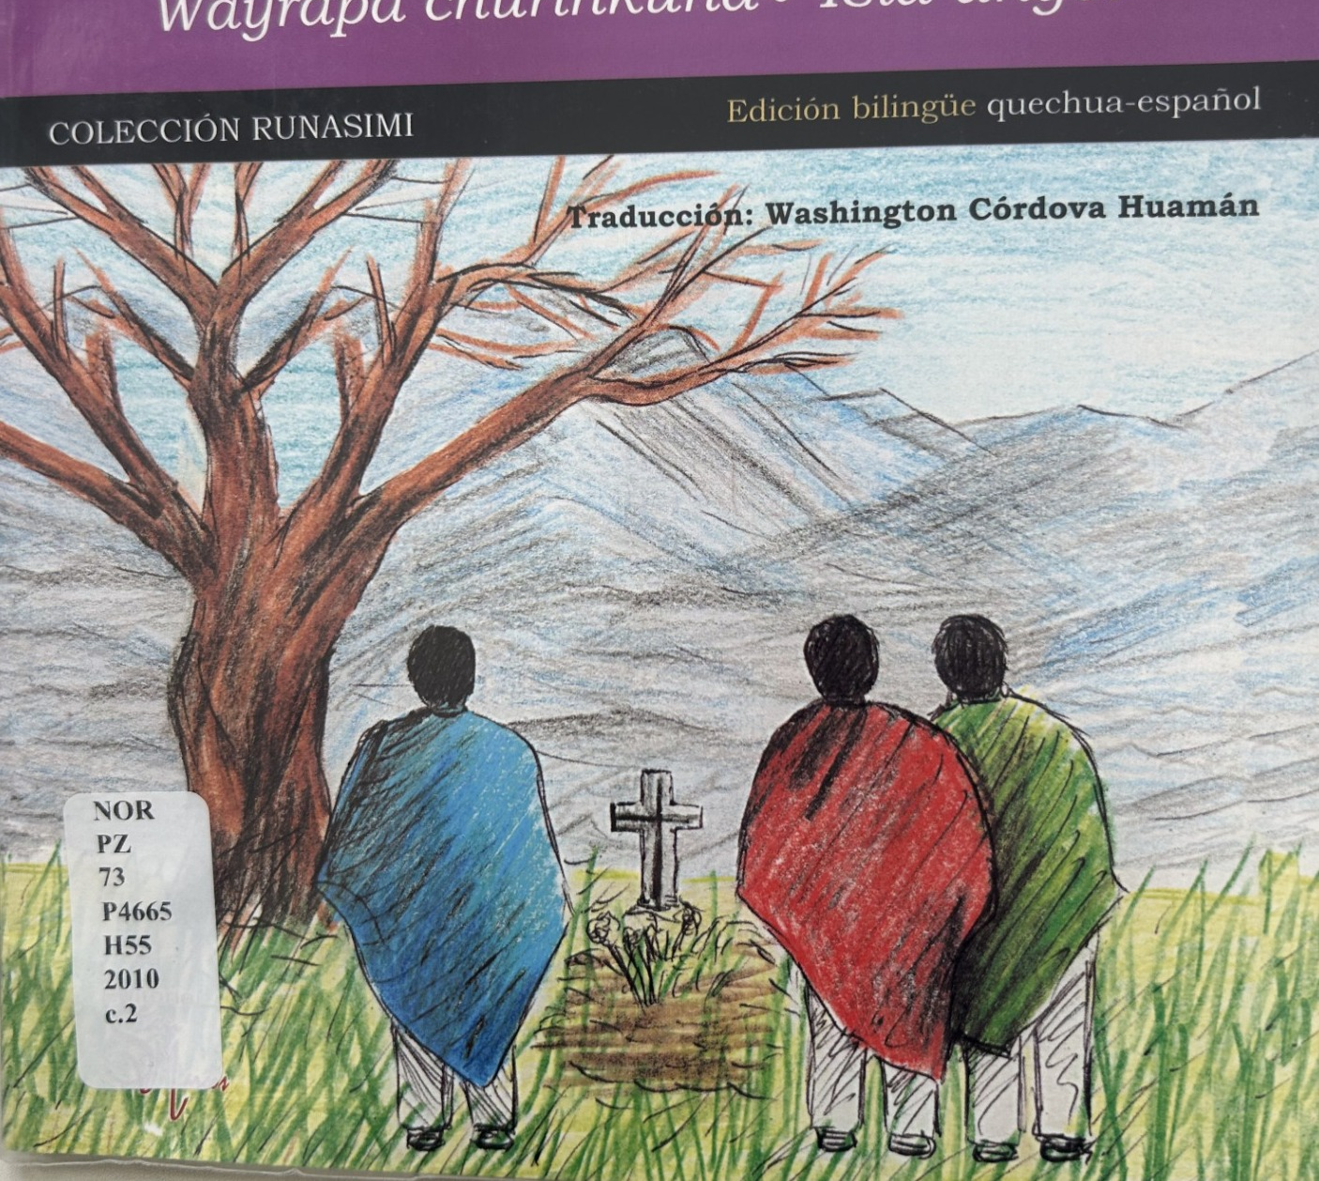
Cultural Artifacts: Art
“Los Animales de la Montaña” by Maya K’iche’ grandparents
“Los Hijos del Viento” by Julián Pérez

Slide 13
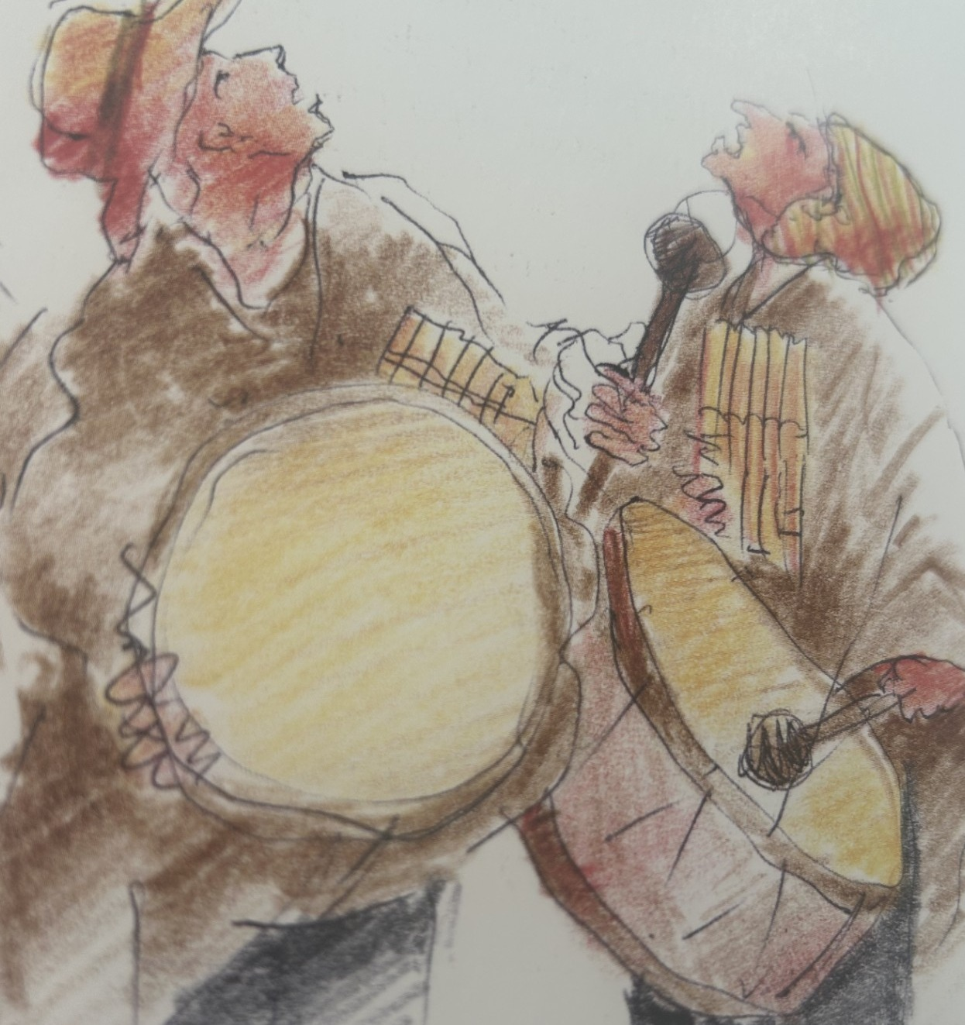
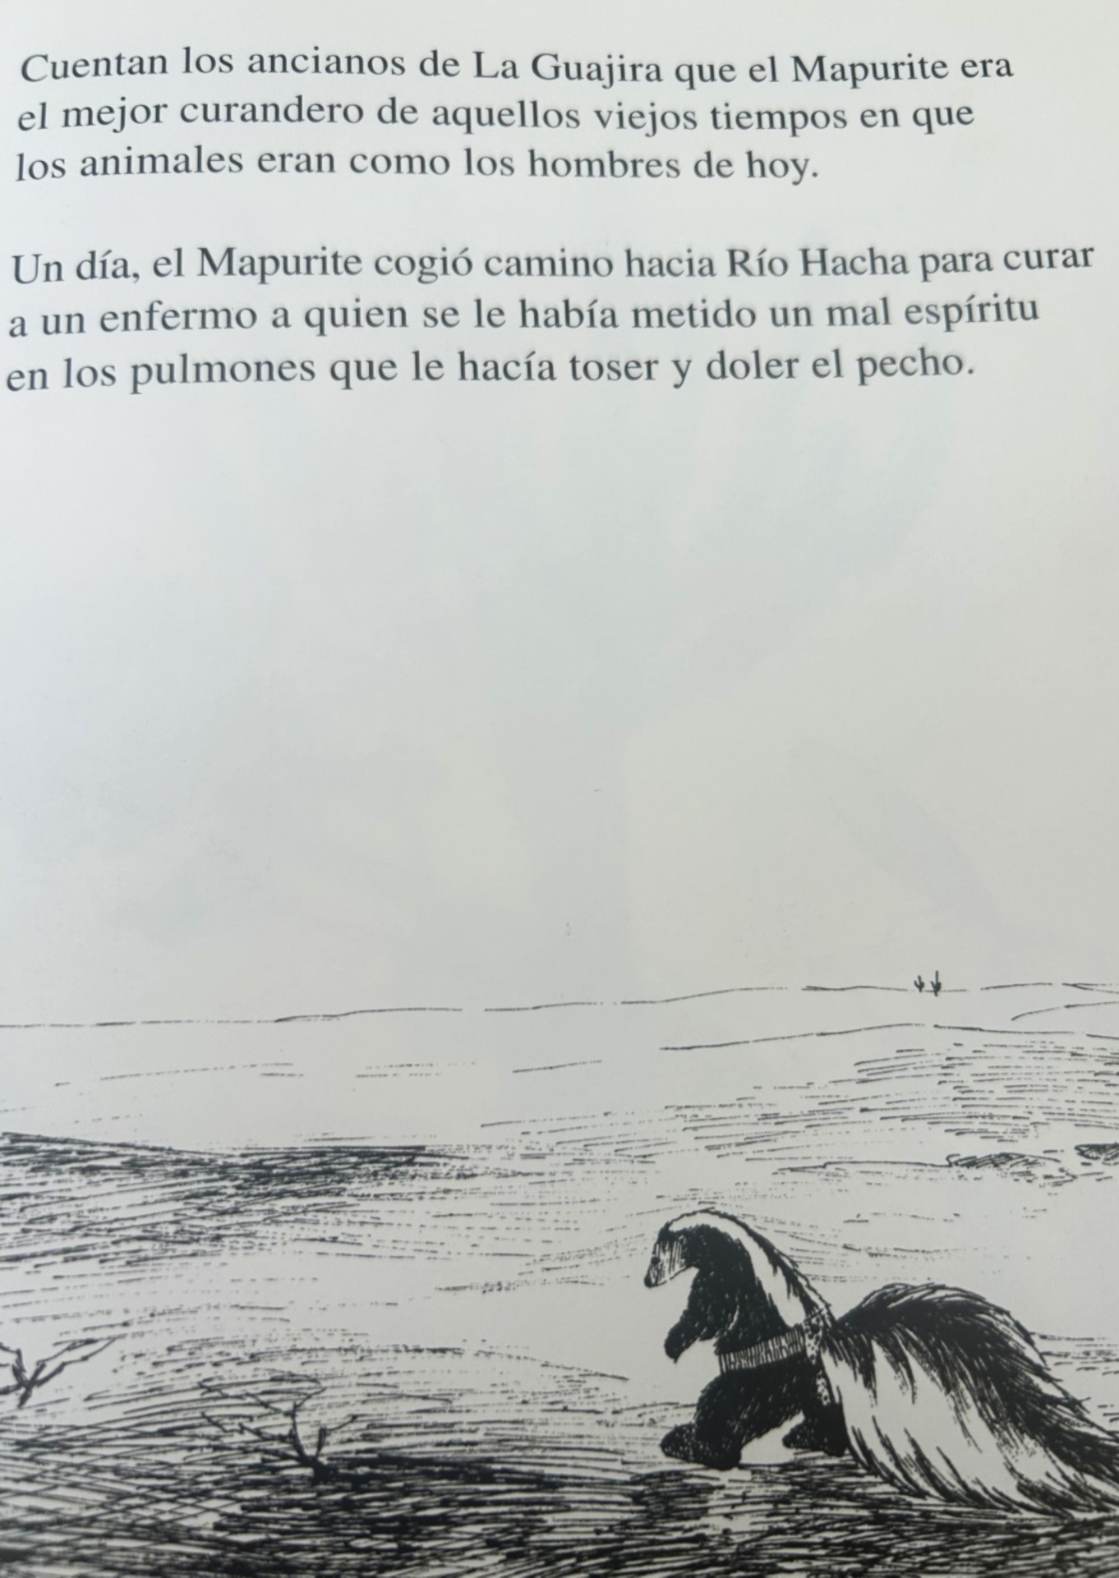
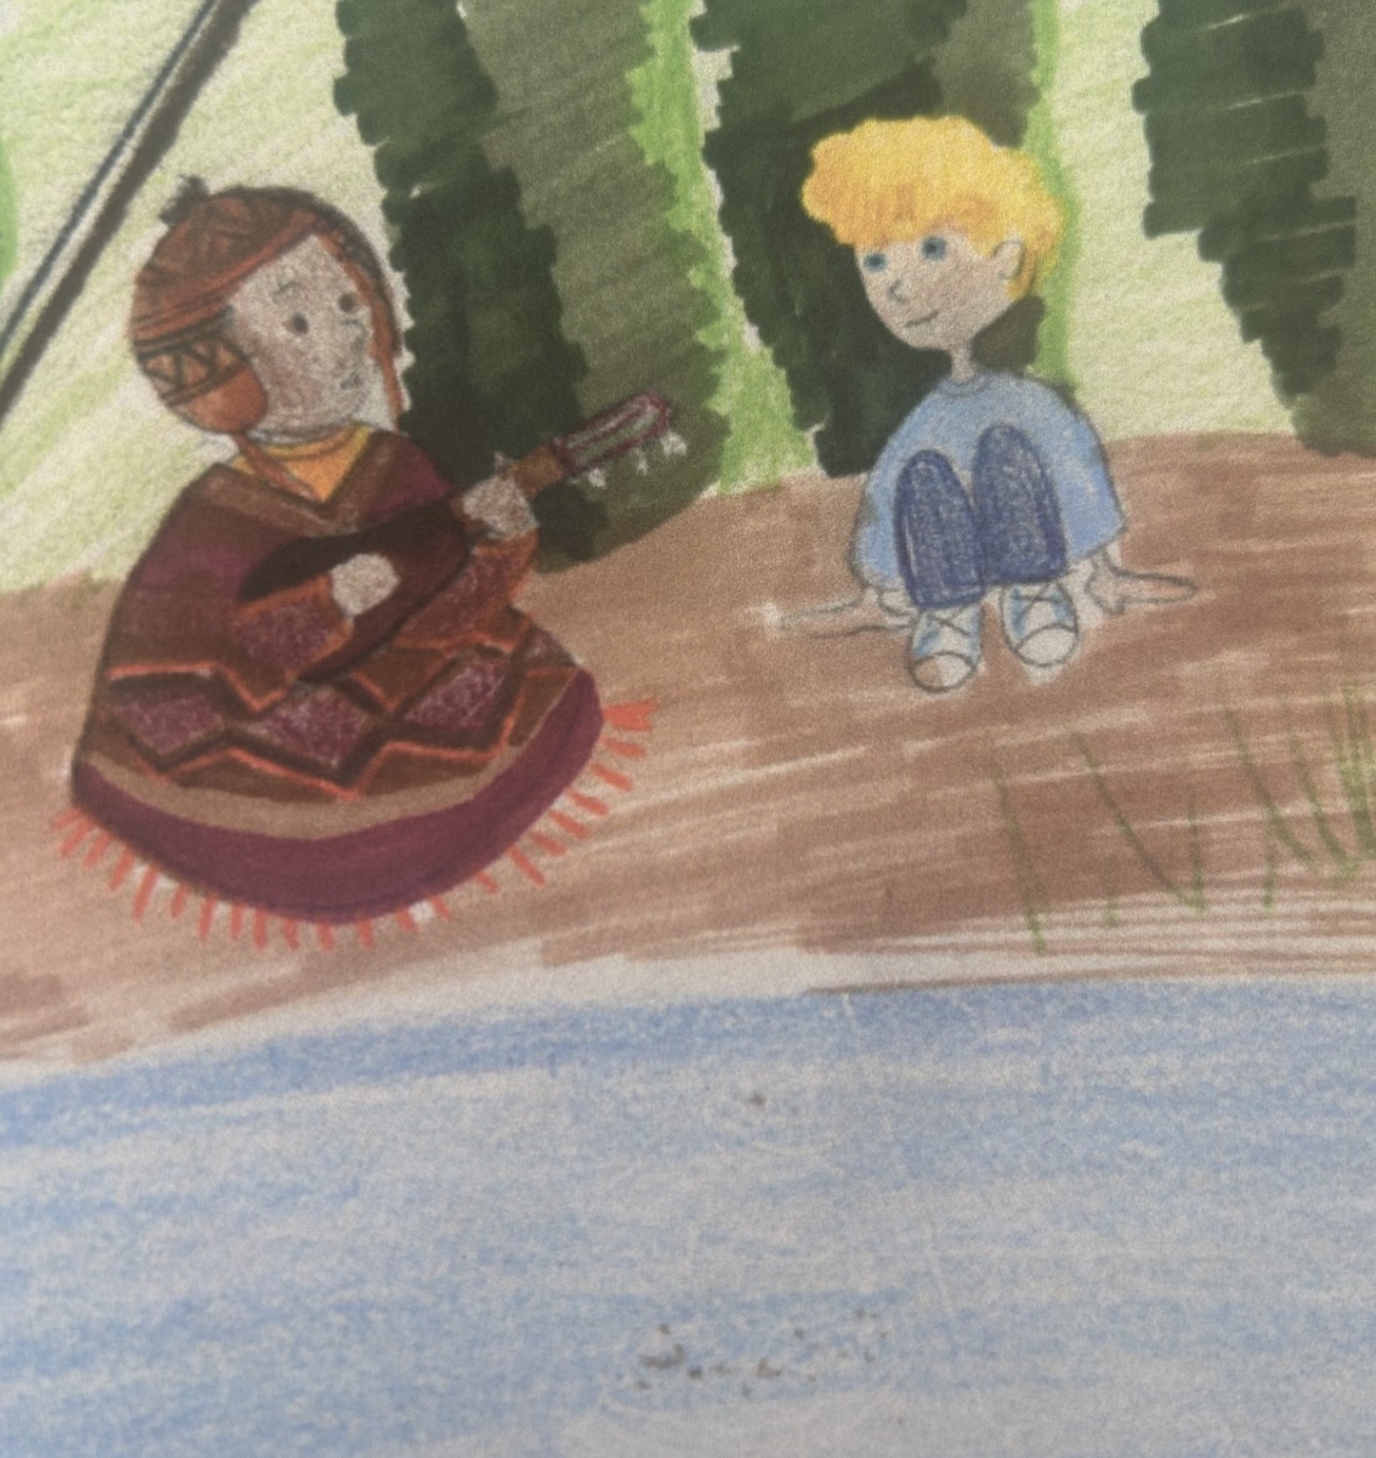
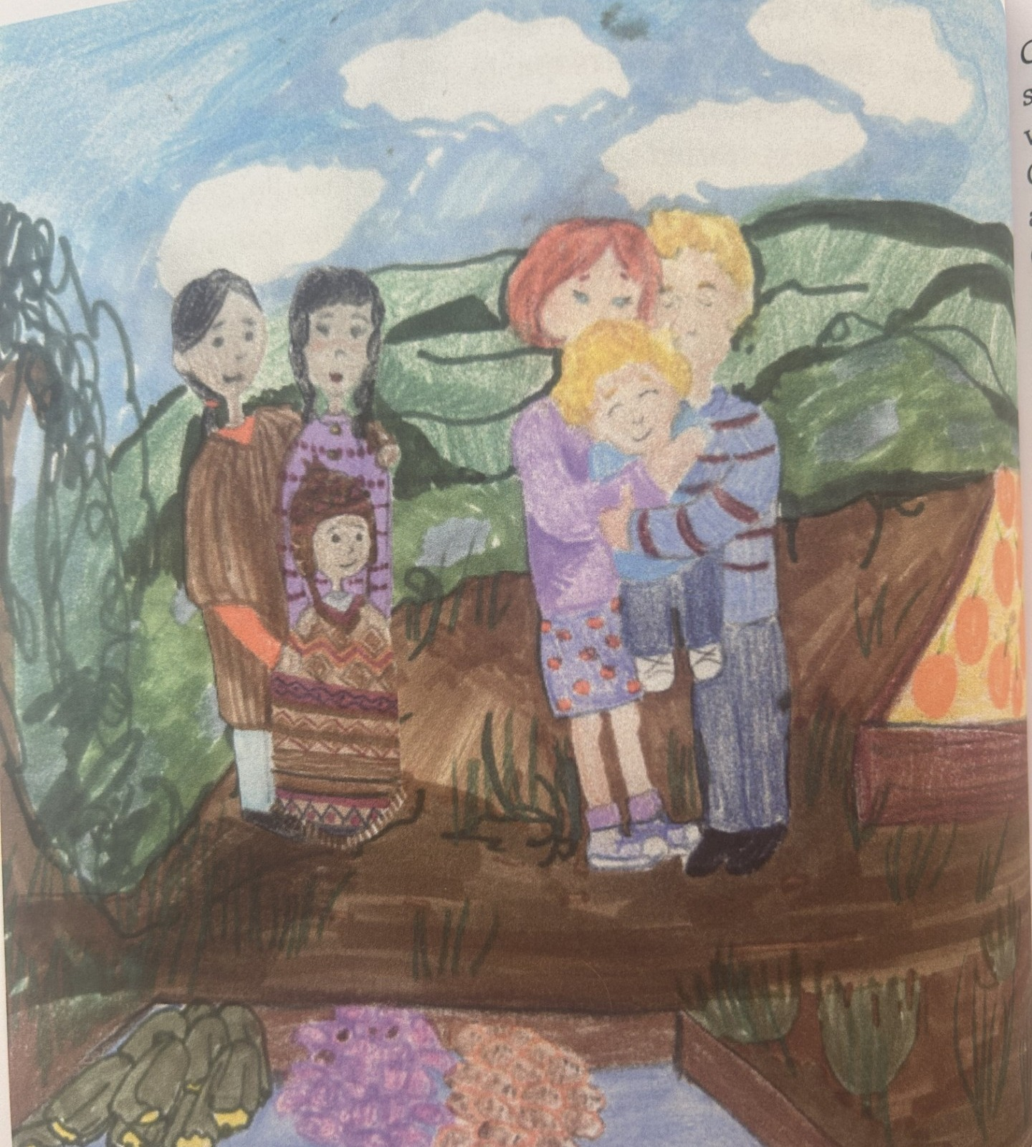
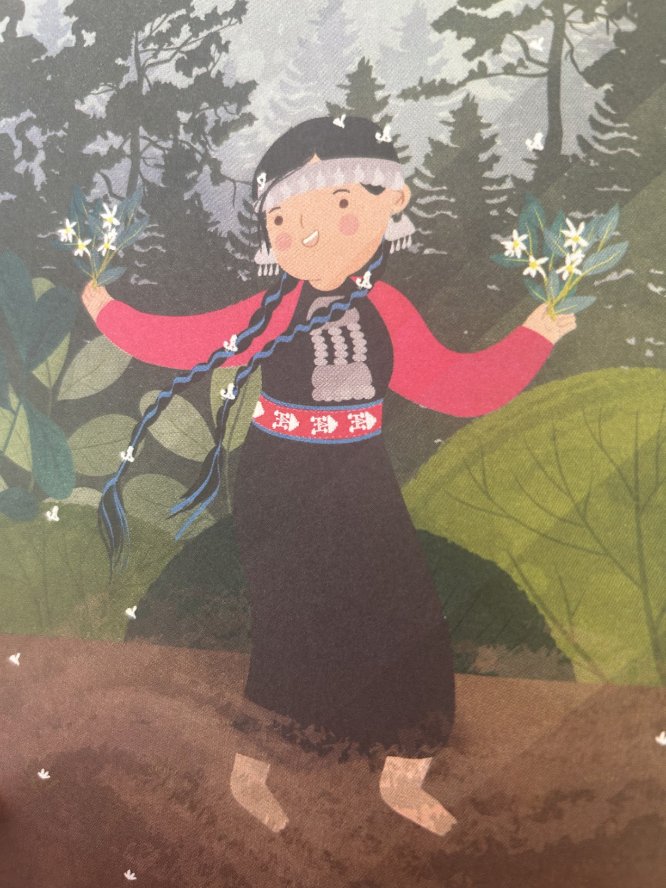
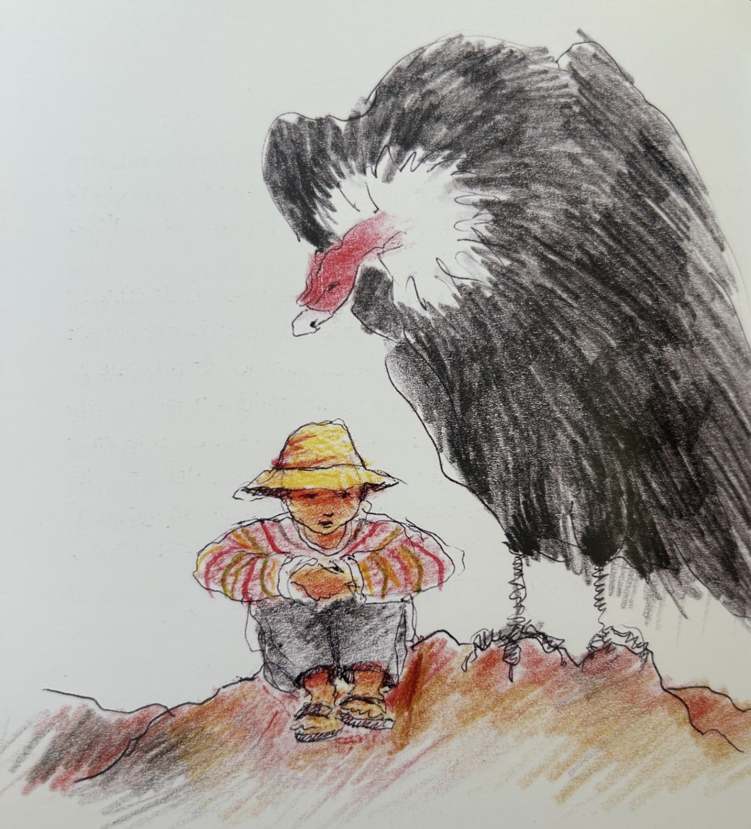
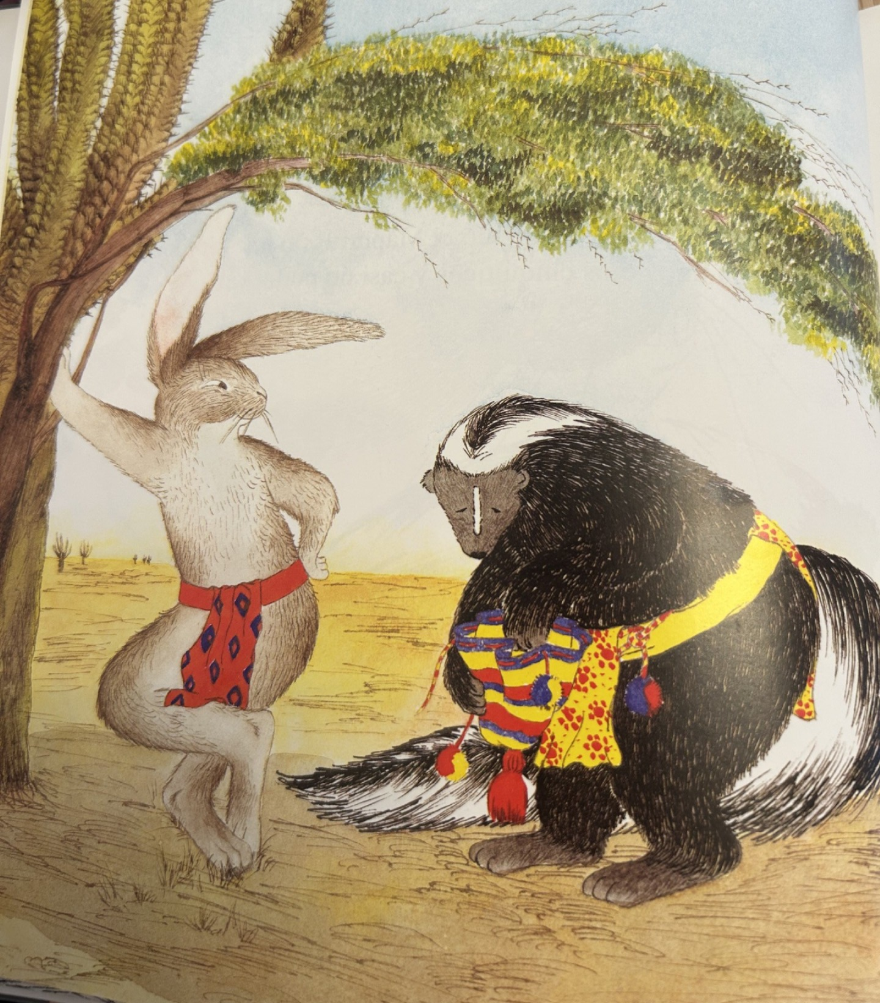
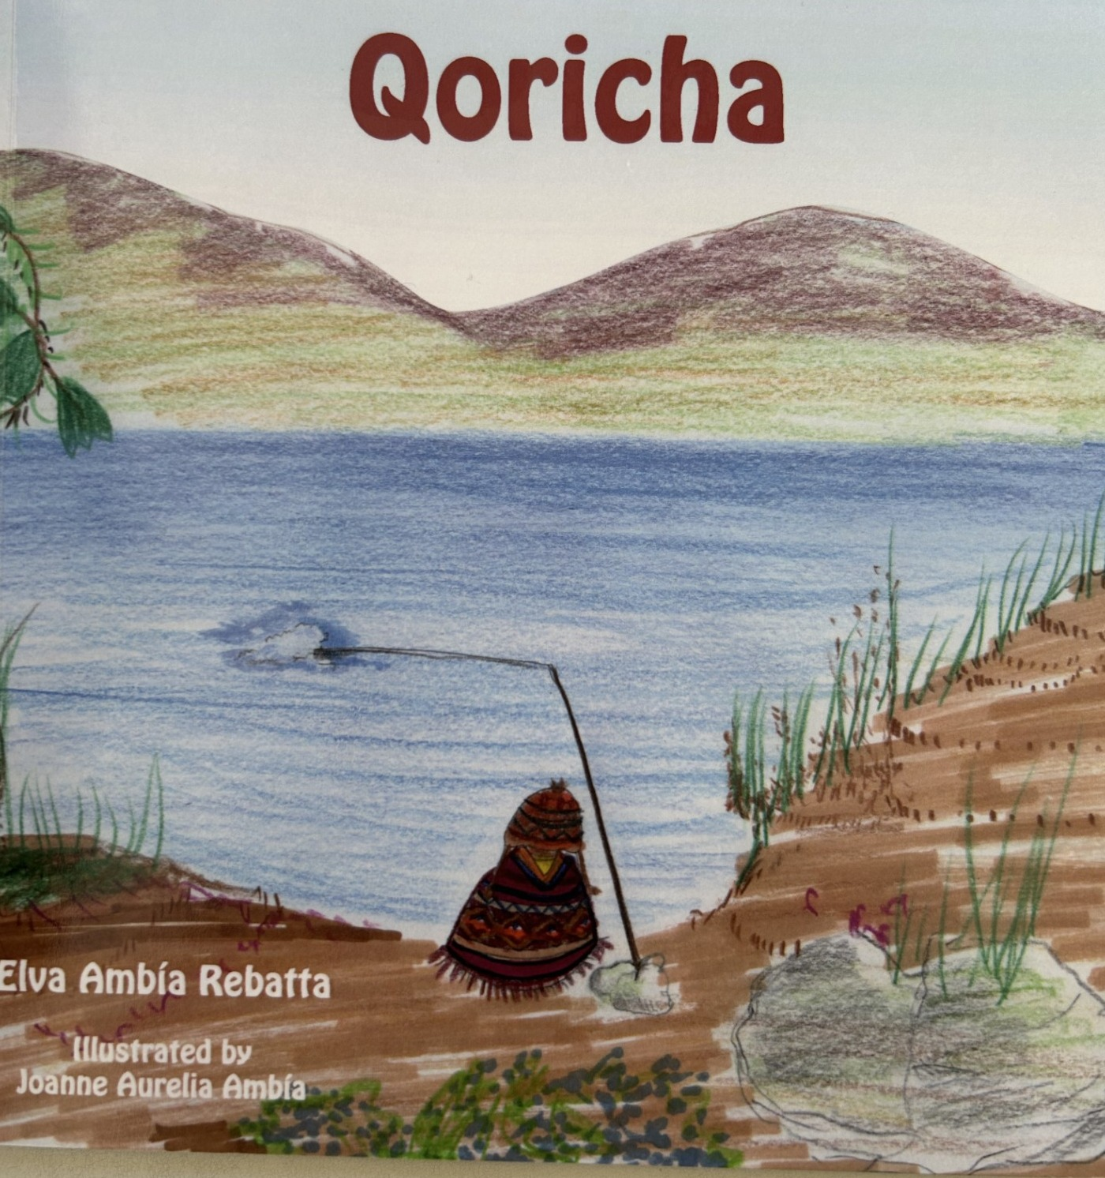
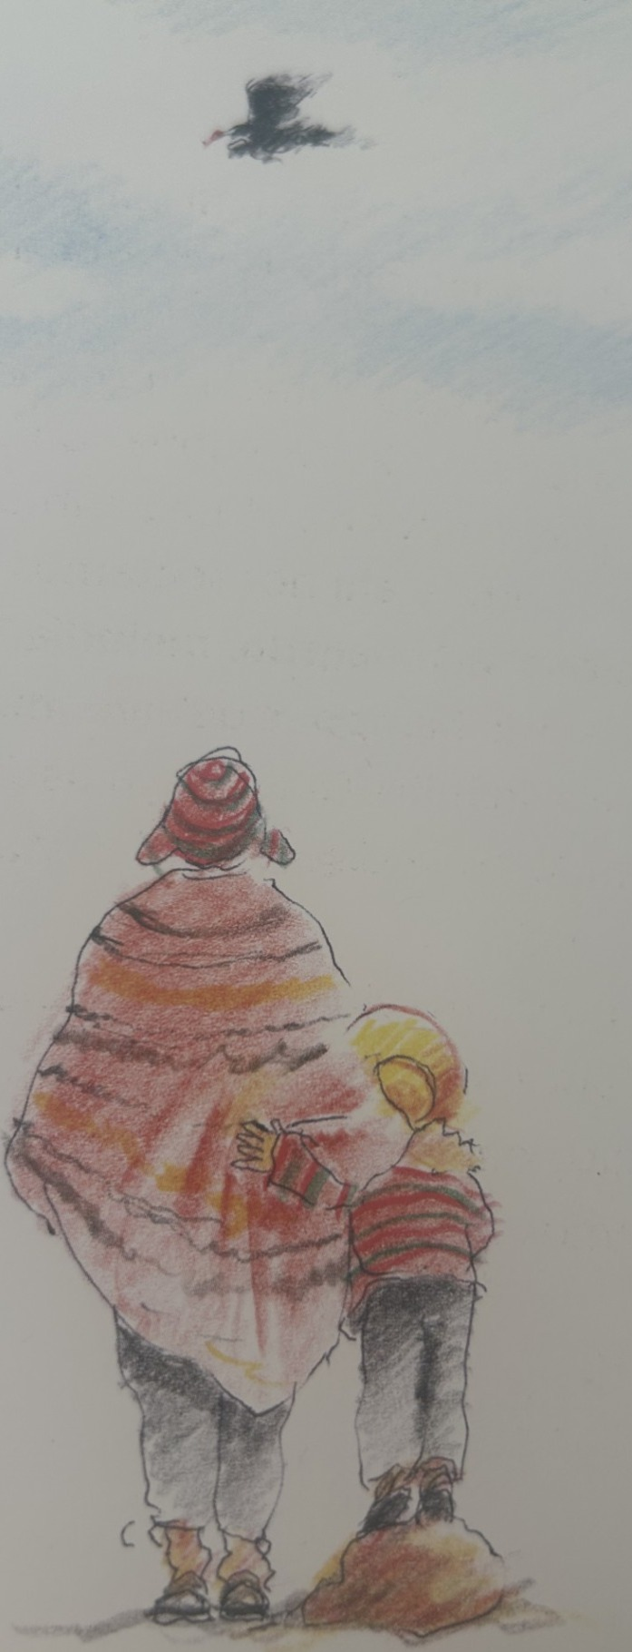
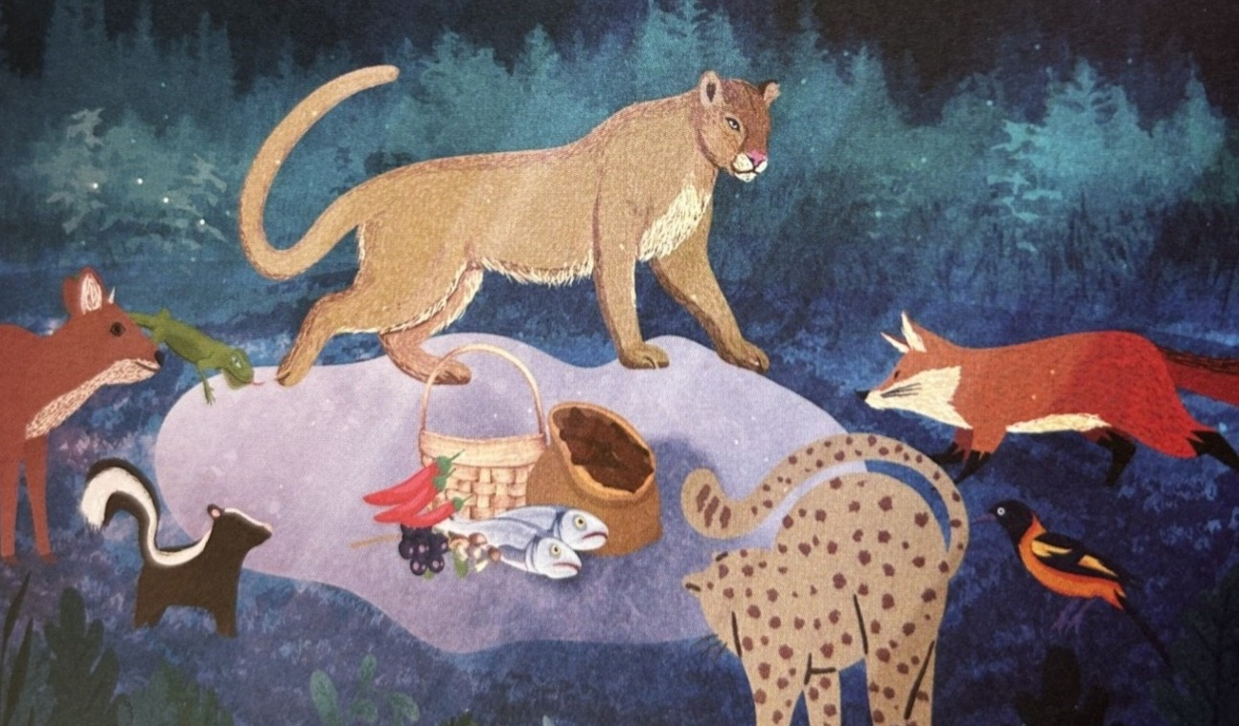
Cultural artifact: Art
“Condor Mallku” by Aymara author Osvaldo Torres
“El Conejo y el Mapurite” compiled by Wayuu author Ramón Paz Ipuana
"Qoricha” by Quechua writer Elva Ambía Rebatta
“Tráeme un Arcoíris” by Mapuche author Jaime Huenún

Slide 14
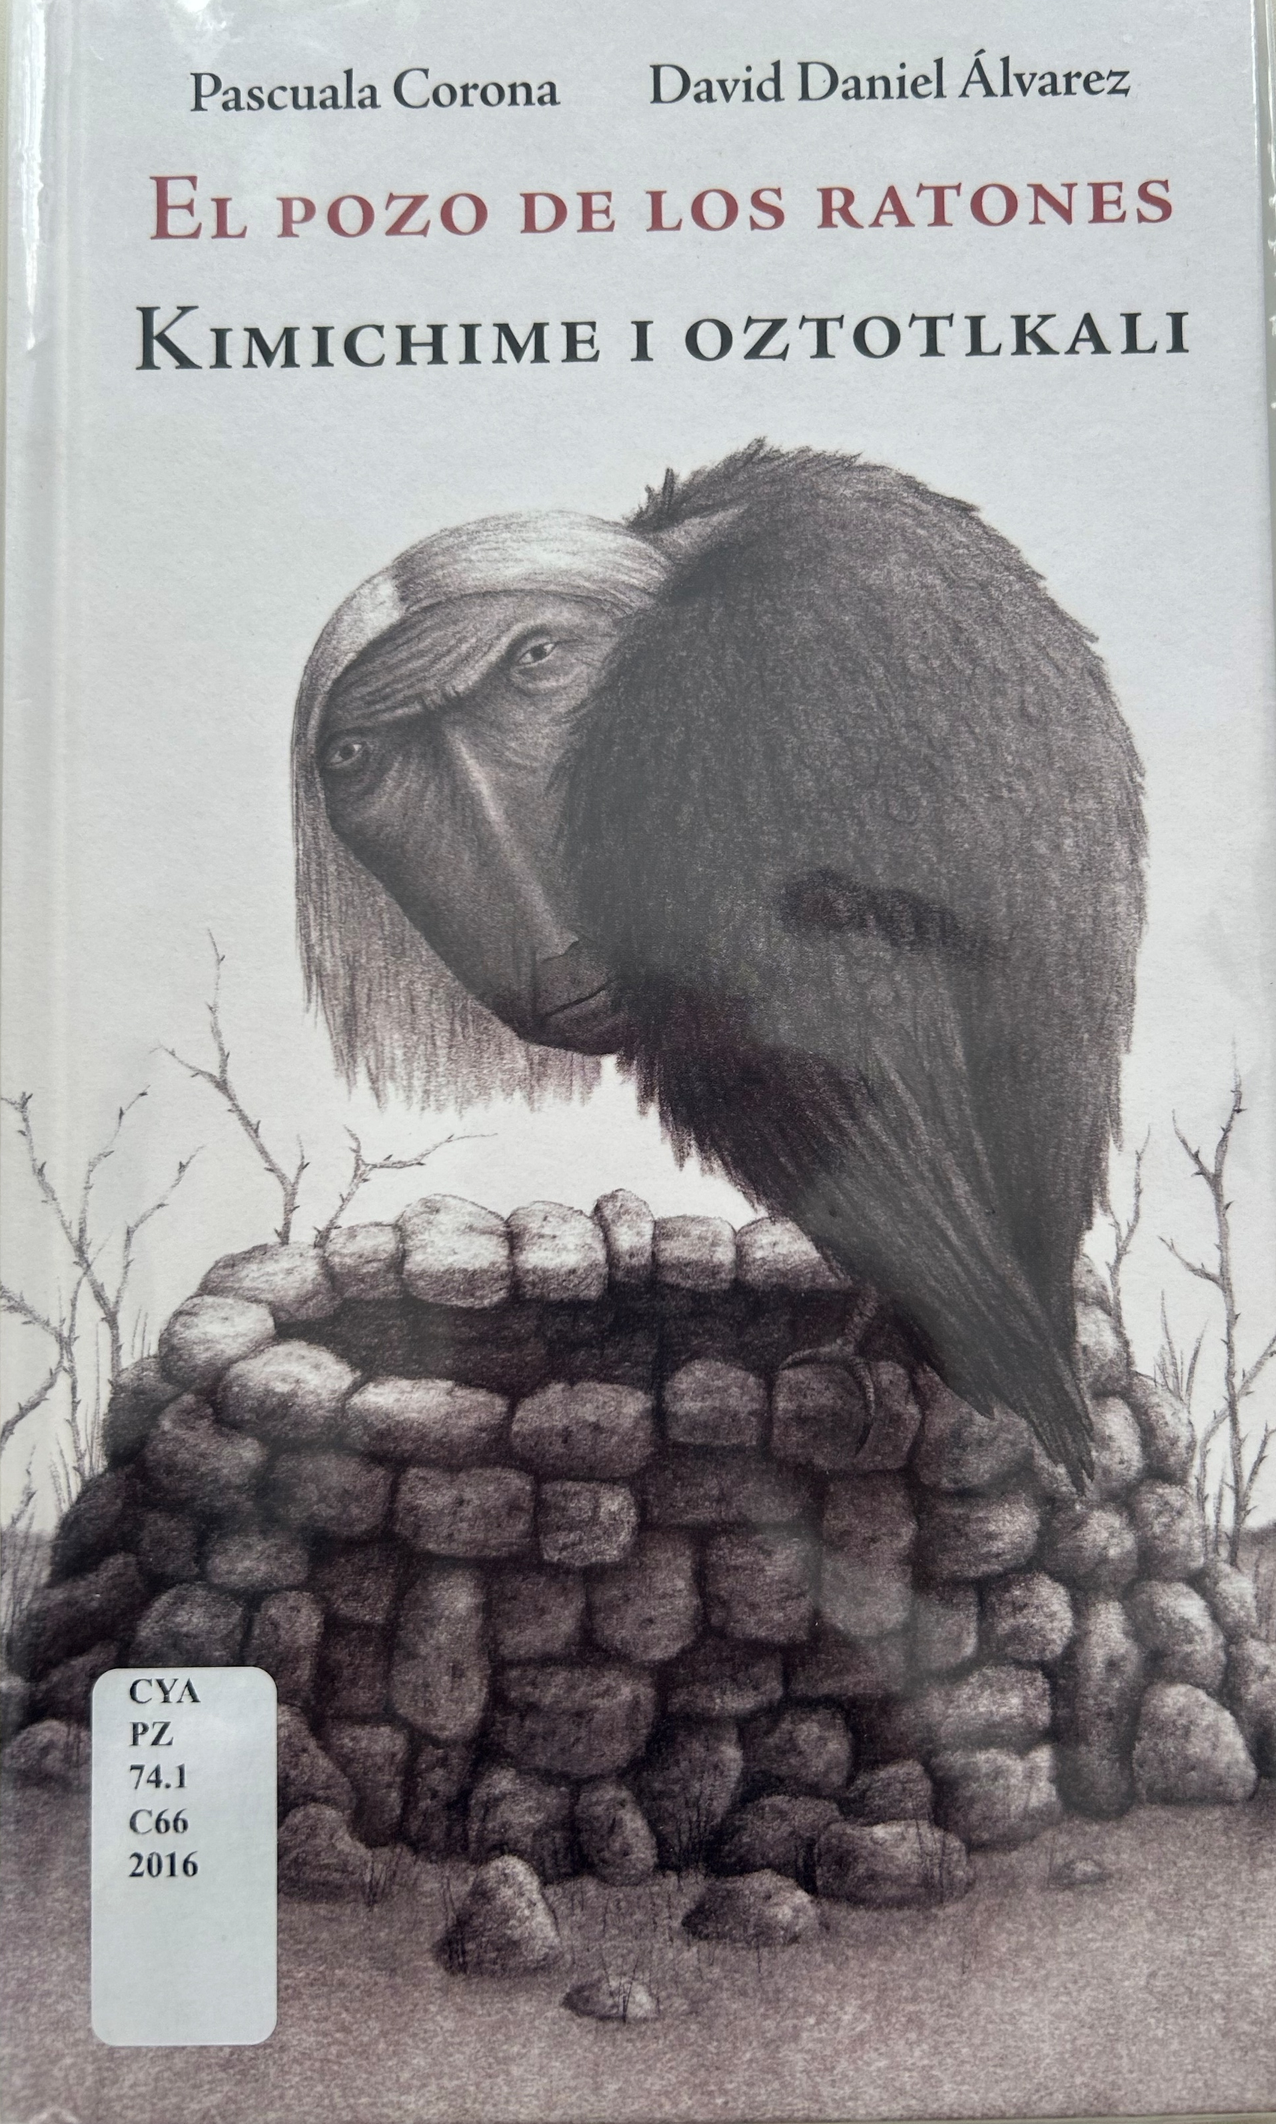
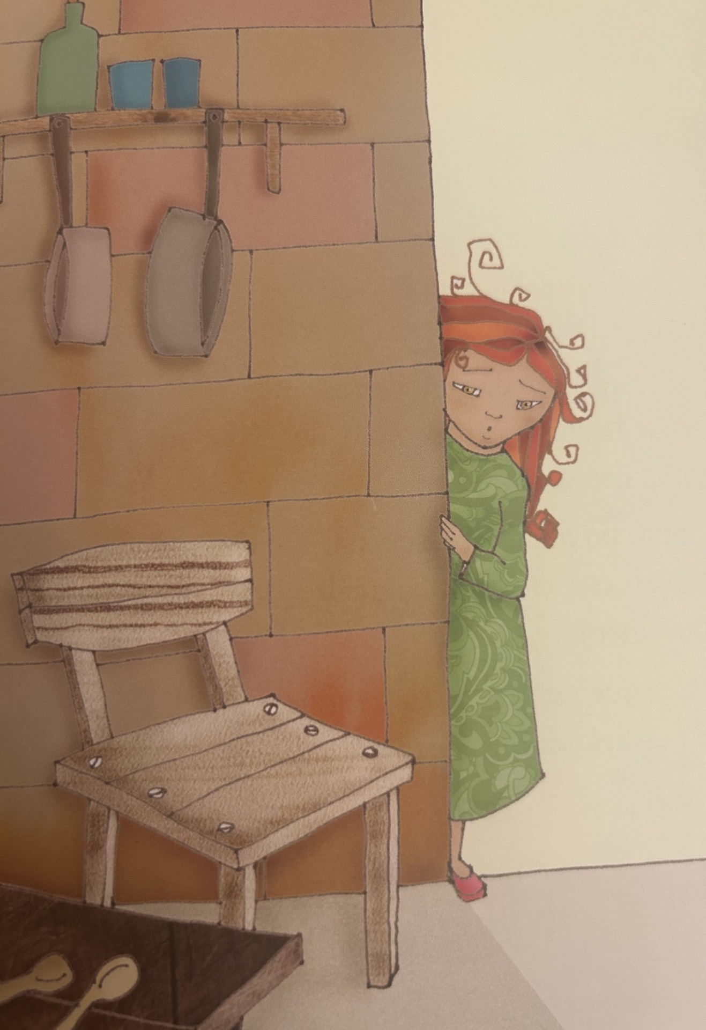
By/With mainstream publishing
Collaborative, but within a colonized perspective
Kiddie target audience based on the market economy
Historical omission
“La Fiesta de las Tortillas” by Jorge Argueta

Slide 15
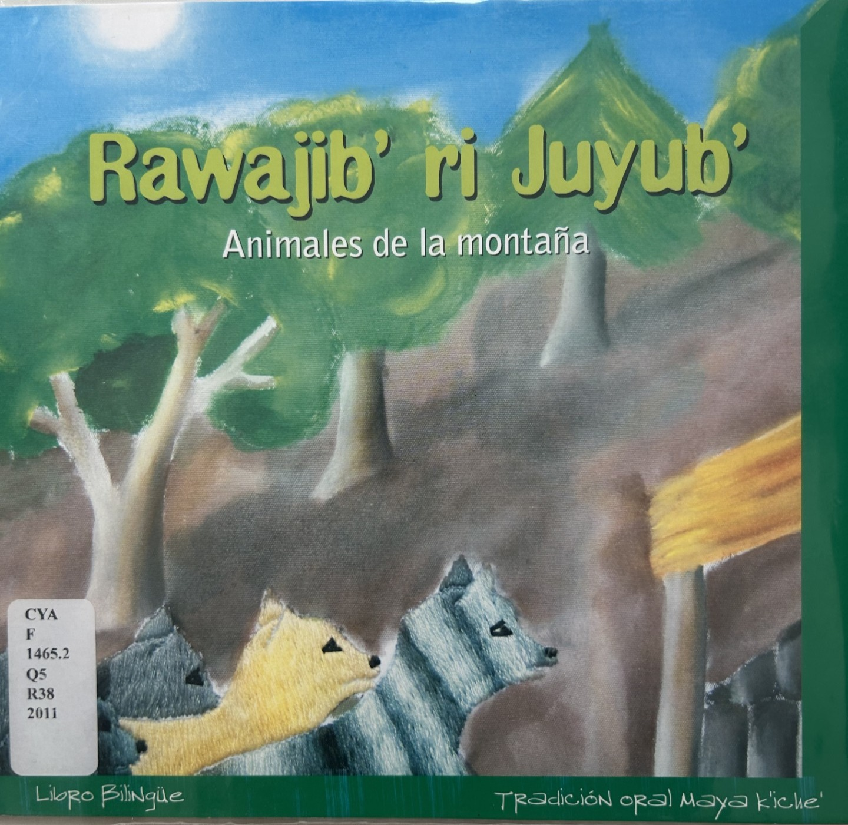
Challenges
Highly formal Spanish
High-level vocabulary
Regional language vs. contemporary writing
May lack visual appeal
Cultural variations in what is "appropriate" for children's literature
  Violence towards women
  Imprisonment, massacres, human suffering
  Tobacco use

Slide 16
Acquisition: Moving beyond the peripheries
Metasearches
Conversations with acquisition platforms (GOBI)
Approval plan specificity
Rejecting the “niche,” tokenism, and the illusion of culturally diverse books.
Authenticity vs. market view
Intentional transcultural acquisitions rationale
Intentional cross-cultural acquisition

Slide 17
In conclusion
Cross-cultural and transcultural
Moving beyond the peripheries acquisition
  Make connections across academic disciplines and vendors
  Funding
  Reciprocity
  Kinship

Slide 18
Q&A: Reflections
Why engage in these labor-intensive practices for acquisition beyond the peripheries?
How do we balance the time constraints by leveraging vendor relationships?
Are we contributing to tokenism?
Are we providing an authentic representation?

Slide 19
References
American Indians in Children's Literature. 2014. "NOT RECOMMENDED: Paul Goble's THE GIRL WHO LOVED WILD HORSES (updated re Goble's identity)". Accessed May 11, 2026. https://americanindiansinchildrensliterature.blogspot.com/2014/06/paul-gobles-girl-who-loved-wild-horses.html
American Indians in Children's Literature. 2017. "Not recommended: STOLEN WORDS by Melanie Florence" . Accessed May 11, 2026. https://americanindiansinchildrensliterature.blogspot.com/2017/12/not-recommended-stolen-words-by-melanie.html
Gonzales, Patrisia. 2012. Red Medicine: Traditional Indigenous Rites of Birthing and Healing. University of Arizona Press.
Javier Munoz-Diaz, Kathia Ibacache and Leila Gomez. Indigenous Materials in Libraries and the Curriculum: Latin American and Latinx Sources. Routledge Focus (2024): 20, 26)
Milton Bernardo López Bueno. “La Literatura Indígena y su Presencia en el Ecuador, Bajo la Sombra del Indigenismo.” (2024) CIEG, Revista Arbitrada del Centro de Investigación y Estudios Generales (2024): 54.
Nicole Sault. “Condors, Water, and Mining: Heeding Voices from Andean Communities. Ethnobiology Letter 9, no. 1.(2018). https://ojs.ethnobiology.org/index.php/ebl/article/view/1079/614.
Vicky Galloway. “Constructing Cultural Realities: ‘Facts’ and Frameworks of Association.” In The Coming of age of the profession: issues and emerging ideas for the teaching of foreign languages. Edited by Jane Harper, Madeleine Lively, and Mary K. Williams. New York: Heinle & Heinle (1998): 133.

Slide 20
Thank you
Kathia.Ibacache@colorado.edu
Natalia.umana@colorado.eu

