Slide 1
THE STATE OF PLAY
European Vendors & US Librarians Building Diverse Collections
Brian Vetruba, Sarah Hoke, & Paloma Barraza [in absentia]
May 2026 |Acquisitions Institute
Notes:
BV

Slide 2
Introduction
Notes:
BV

Slide 3

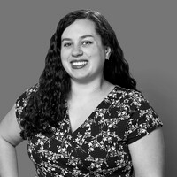
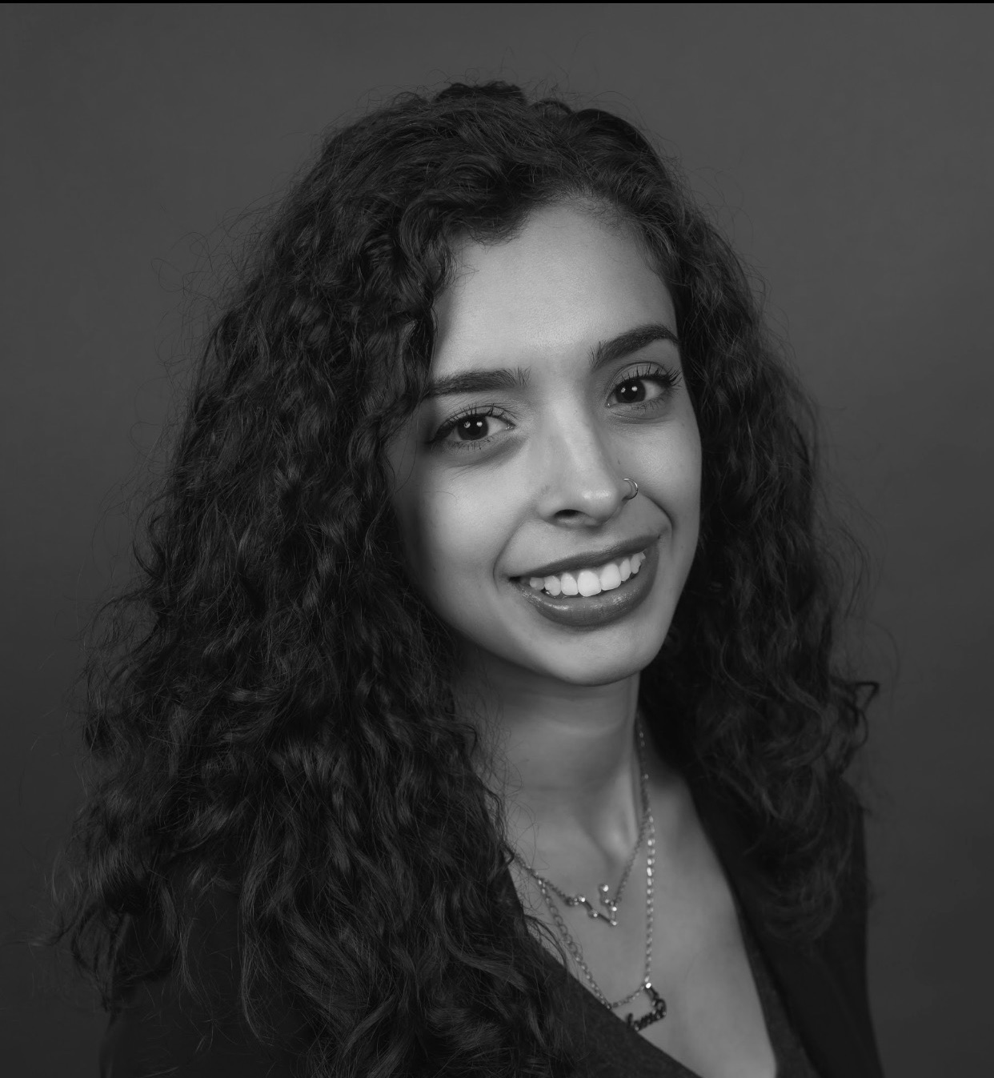
Panelists
Brian Vetruba
Sarah Hoke
Paloma Barraza
European Studies, Jewish Studies, and Linguistics Librarian
University of Minnesota
Librarian for Collection
Development Management
Harvard University
History, Iberian, and Latin American Studies Librarian
[in absentia]
University of Minnesota
Notes:
BV

Slide 4
Quick Poll
Who currently works with vendors in Europe?
Do you specifically look for DEI content?
Notes:
SH
Let’s take a quick poll for folks in this room- what is your experience with these vendors and this type of material?
Has that been successful?
How do you acquire DEI material in your library?

Slide 5
Framework
Notes:
5

Slide 6
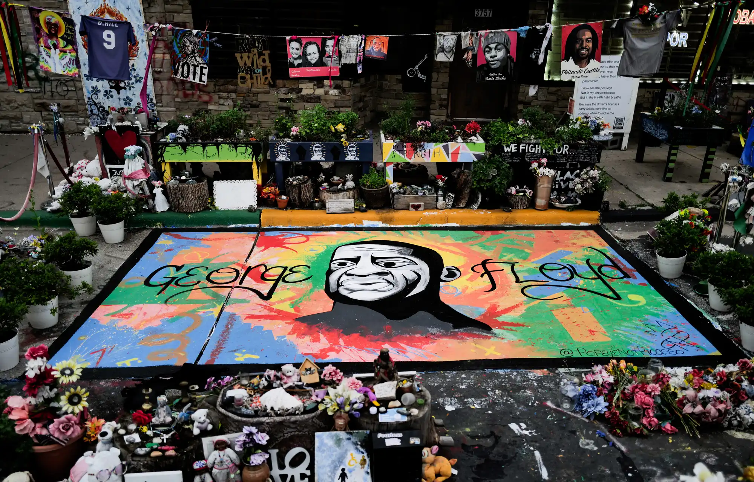
2020–Present
Evaluating the increase of DEI initiatives in academic library collections since the murder of George Floyd in 2020
Assessing the landscape of European vendors supplying DEI materials to US academic libraries in the last 6 years
Where are we now?
A view of the site where George Floyd was murdered at George Floyd Square in Minneapolis, Minnesota on May 25, 2024.
Notes:
SH
How is DEI different in European countries?

Slide 7

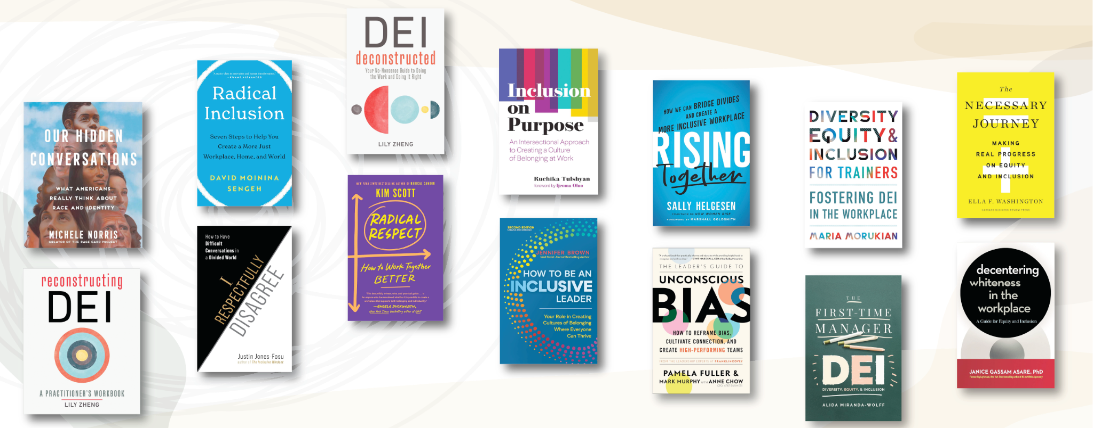
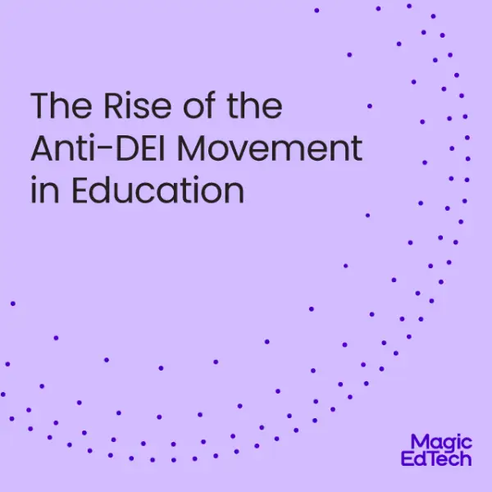

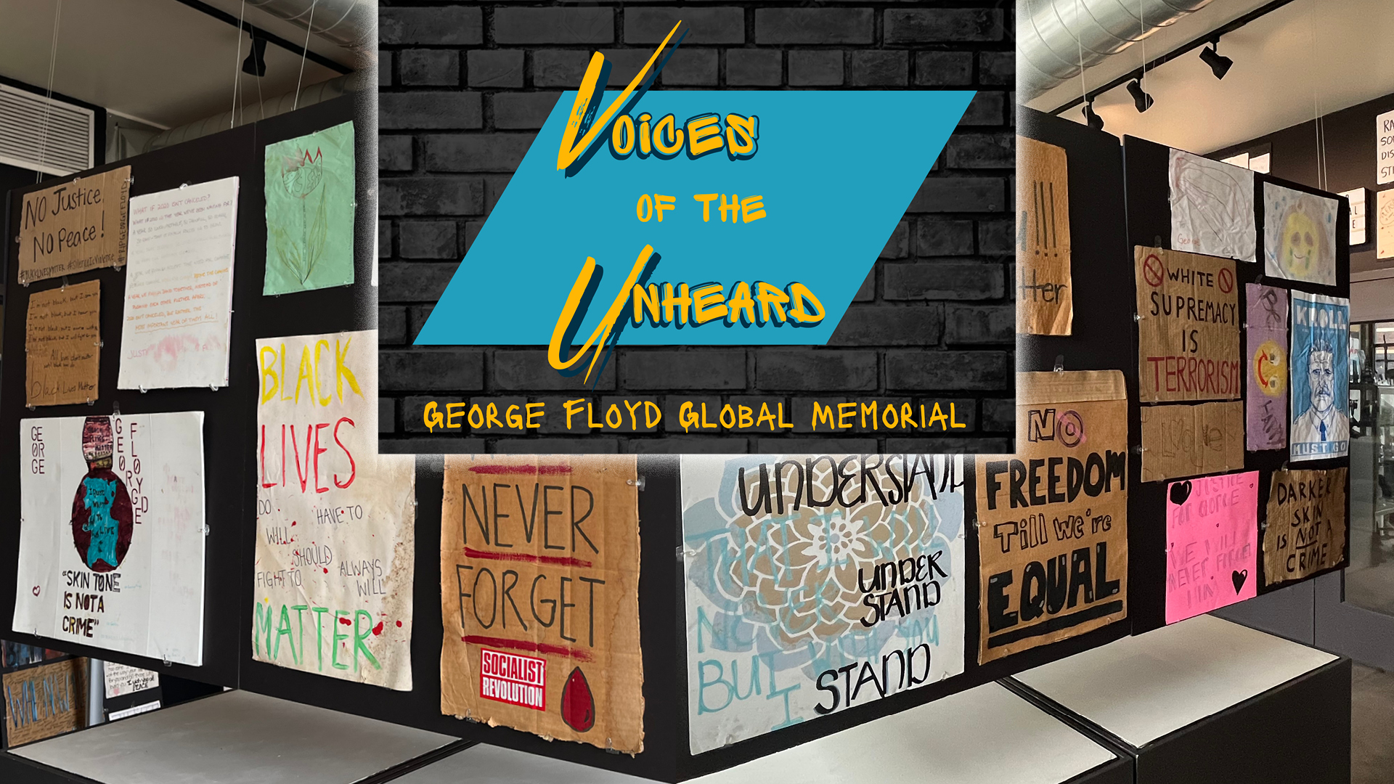
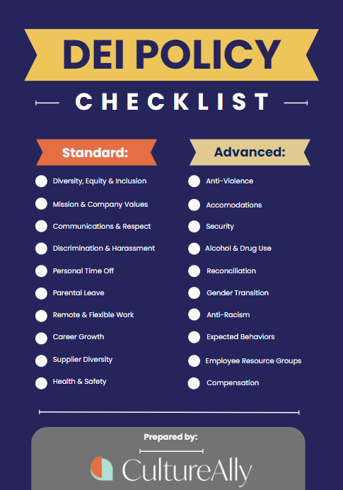
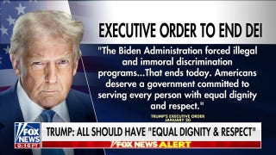

Notes:
SH
Timeline
-images are all that have been circulating in the library world since 2020
https://www.infodocket.com/2021/06/02/acrl-webinar-video-recording-cultures-of-collecting-sustaining-diversity-equity-and-inclusion-in-collection-development/
https://www.mprnews.org/story/2025/05/22/timeline-what-happened-in-minnesota-after-police-murdered-george-floyd
https://www.ala.org/acrl/aboutacrl/strategicplan/stratplan
https://www.ala.org/sites/default/files/advocacy/content/diversity/ALA%20ARL%20Cultural%20Proficiencies%20for%20Racial%20Equity%20Framework.pdf
https://www.umaryland.edu/news/archived-news/october-2024/the-anti-dei-landscape-how-we-got-here-and-how-we-fight-it.php
https://www.ala.org/advocacy/diversity/odlos-blog/Forming-DEI-Collections

Slide 8
Timeline
April 2011
“ACRL Plan for Excellence”- DEI strategic plan
May 25, 2020
Minneapolis police murder George Floyd
Nationwide protests
Late May-June 2020
Protests spread to over 60 countries
  Against police brutality and systemic racism
Increase of DEI-centered strategic plans in libraries
August 2022
Joint ALA/ARL Building Cultural Proficiencies for Racial Equity Framework
Fall 2024
Rise of anti-DEI legislation, censorship in US libraries
Notes:
SH
Timeline
-images are all that have been circulating in the library world since 2020
https://www.infodocket.com/2021/06/02/acrl-webinar-video-recording-cultures-of-collecting-sustaining-diversity-equity-and-inclusion-in-collection-development/
https://www.mprnews.org/story/2025/05/22/timeline-what-happened-in-minnesota-after-police-murdered-george-floyd
https://www.ala.org/acrl/aboutacrl/strategicplan/stratplan
https://www.ala.org/sites/default/files/advocacy/content/diversity/ALA%20ARL%20Cultural%20Proficiencies%20for%20Racial%20Equity%20Framework.pdf
https://www.umaryland.edu/news/archived-news/october-2024/the-anti-dei-landscape-how-we-got-here-and-how-we-fight-it.php
https://www.ala.org/advocacy/diversity/odlos-blog/Forming-DEI-Collections

Slide 9







European Vendors Interviewed
Notes:
SH
Here are the vendors that were interviewed. To encourage them to speak candidly, we are aggregating their responses and will not be providing information that is specific to a single vendor. Mainly pulling key themes here.

Slide 10
Interview Questions
Vendors received the same 8 interview questions in advance
Handling DEI materials
  Visibility/discoverability on databases/websites
  Promoting/incorporating DEI materials for selections/plans
  Impacts on company due to changes in US since 2020
DEI in their countries
  Publishing changes
  Political landscape
Notes:
SH
How can librarians find DEI materials in your database or on your website? How do you promote DEI materials to librarians for selection?
Can you tell us about the DEI landscape for the European/Eurasian countries you supply for?
How does your company work to highlight these materials or incorporate them into regular purchasing plans?
Have you seen any impact on your company with libraries in North America based on this inclusion of material?
Do you have plans for further solutions or opportunities for libraries to discover DEI content through your company or associated platforms?
Have you seen a shift or change in the landscape regarding publishers or demand for this material outside of North America?
As experts in the places you cover, do you have any suggestions for how librarians can discover DEI content in general and how to keep up on this topic?
Is there anything else related to this topic that you would like to mention? Can we answer any questions for you?
The questions, listed on this slide, fell into three major categories:
The existing content each vendor has for DEI material, and how to find it
Impact of this content on their business, both in North America and in Europe
The change of this landscape, including future plans

Slide 11
The Landscape
of DEI
Notes:
BV

Slide 12
US Libraries and DEI Materials
No vendors stated libraries were telling them they did NOT want DEI materials
  Some specifically asked for no more titles by majority authors
    (e.g. straight, white, cisgender men)
Recently, there has been a decrease in DEI materials but this is due to an overall decrease in collections budgets
No pull back by vendors in supplying or providing infrastructure for DEI materials
Notes:
BV
The questions, listed on this slide, fell into three major categories:
The existing content each vendor has for DEI material, and how to find it
Impact of this content on their business, both in North America and in Europe
The change of this landscape, including future plans

Slide 13
DEI Landscape changes in Europe
More books covering:
  Right-extremism (flagged as another aspect of DEI)
  Far-left
  Immigration
  Disability studies
  National identity (e.g. German, French, Italian)
Underrepresented groups vary by country or region
DEI materials often published by smaller publishers
Notes:
BV
Publishing output aligns with changes in societal and political landscape
Many vendors noted that content that falls under DEI often is already included in cultural studies for different parts of the world.
That being said, there definitely has been a publisher shift in different countries to cater to this content, as it also becomes more visible in those countries and shapes research that is occurring.
As topics have more visibility in the world, that is reflected in the publishing.
However, there are groups that are still struggling given the general environment of publishing- some small shops struggle to survive even as their topics become mainstream. The library market alone is not enough to save them.
Competitive industry
Fewer publications
More inclusion/redefining categories
“Religious Studies” in France now includes: Islam, Christianity and Judaism

Slide 14
DEI Resources
from Vendors
Notes:
SH

Slide 15
DEI in Vendor Databases
Organizational DEI Structure
Most had subject categories
  Some searchable
  Categories created from:
    Librarian feedback
    Vendor desire for content visibility
DEI Tags/Terms
US DEI terms do not reflect their entire customer base
Use of broader tags
  Cultural Studies
  Women Studies
Customer Demand
Specific requests from librarians/institutions
  Natural increase of topics in recent publications
Approval plan/Firm orders
Notes:
SH
For those that have databases, almost all had some sort of category system.
Some searchable, but not all
Some used just for approval plan material
Variation across vendors because phrasing in North America doesn’t match their entire customer base
Often using broader tags, like “cultural studies” or “women’s studies” that will include more specific material of interest.
Categories came to be in a variety of ways
Often based on customer demand
A natural progression of important topics in the published material

Slide 16
DEI Materials in Profiling
Types of profiles:
  Approval plans (automatic shipments)
  New title announcements (firm orders)
Integrated into regular workflows
  In separate profiles to target content
  Often within existing approval plans, expanding focus
  High discoverability through new terms
Vendors offer customized list, by request
Notes:
SH

Slide 17
Sample DEI Categories
VENDOR 1
VENDOR 2
VENDOR 3
Africana Studies
Judaica Studies
Women Studies
Gender Studies
Postcolonialism
LGBTQIA+ Studies
Islam Studies
Afropean
Francophone Studies
Haiti
Maghreb
Black culture Studies
Diversity, Equity, Inclusion
Foreign belles lettres authors
LGBTQ
Gender Studies
Immigration/Migration
Indigenous Peoples
Islamophobia
Postcolonial/Decolonization
Racism
Antisemitism
Political Extremism
Culture
Émigré literature
Ethnic studies/Ethnology
Islamic Studies
Jewish Studies
LGBTQ+
Women’s Studies
Notes:
BV
For those that have databases, almost all had some sort of category system.
Some searchable, but not all
Some used just for approval plan material
Variation across vendors because phrasing in North America doesn’t match their entire customer base
Often using broader tags, like “cultural studies” or “women’s studies” that will include more specific material of interest.
Categories came to be in a variety of ways
Often based on customer demand
A natural progression of important topics in the published material

Slide 18
Vendor/Customer Relationship
Notes:
BV

Slide 19
Getting and Discovering DEI Materials – It’s a Two-way Street
Vendors want feedback from their customers!
  Database changes
  Approval plan structure
  Depth and breadth of content
  Topics to target
  Category suggestions
Notes:
BV/SH
about what material they want, and how they want it served to them.
Just because it isn’t happening now, doesn’t mean they aren’t willing
Often library feedback has shaped the structure of what they currently offer.
Isn’t a one-time process, always evolving.
Conversations with vendors were encouraged by every vendor we interviewed.
We can shape the future of this content availability with our vendors.
.We can shape the future of this content availability with our vendors.

Slide 20
Questions?
Let’s discuss!

Slide 21
Thank you
Contact us:
Brian Vetruba | University of Minnesota | bvetruba@umn.edu
Sarah Hoke | Harvard University |sarah_hoke@fas.harvard.edu
Paloma Barraza | University of Minnesota | barra142@umn.edu

Slide 22
References
Association of College & Research Libraries. "ACRL Plan for Excellence." American Library Association. Approved April 20, 2011, effective July 1, 2011, reaffirmed September 2013, revised november 2022. https://www.ala.org/acrl/aboutacrl/strategicplan/stratplan.
Birch, Stephanie, Alexandra Howard, Mary Schiavone, and Michelle Nolan. “On Defense: Academic Librarians in DEI Battleground States.” Journal of Library Outreach & Engagement 4, no. 1 (2024): 104–8. https://doi.org/10.21900/j.jloe.v4.1650.
Joint ALA/ARL Building Cultural Proficiencies for Racial Equity Framework Task Force. Cultural Proficiencies for Racial Equity: A Framework. Chicago and Washington, DC: American Library Association, Association of College & Research Libraries, Association of Research Libraries, and Public Library Association, August 23, 2022. https://www.ala.org/sites/default/files/advocacy/content/diversity/ALA%20ARL%20Cultural%20Proficiencies%20for%20Racial%20Equity%20Framework.pdf
MPR News. “The Murder of George Floyd.” Last modified April 14, 2026. https://www.mprnews.org/crime-law-and-justice/killing-of-george-floyd
Likowski, Alex. “The Anti-DEI Landscape: How We Got Here and How We Fight It!.” University of Maryland-Baltimore News, September 25, 2024. https://www.umaryland.edu/news/archived-news/october-2024/the-anti-dei-landscape-how-we-got-here-and-how-we-fight-it.php
Notes:
BV/SH
about what material they want, and how they want it served to them.
Just because it isn’t happening now, doesn’t mean they aren’t willing
Often library feedback has shaped the structure of what they currently offer.
Isn’t a one-time process, always evolving.
Conversations with vendors were encouraged by every vendor we interviewed.
We can shape the future of this content availability with our vendors.
.We can shape the future of this content availability with our vendors.

