Slide 1
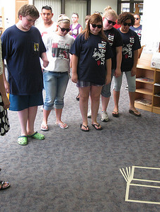
Disappearing Ebooks and How the Wiley Situation was Different
Karen kohn
Temple University Libraries
Acquisitions institute
at Timberline Lodge
May 21, 2023
https://www.flickr.com/photos/45011551@N00/17049080737
Notes:
This presentation uses as its starting point a specific incident that got worldwide attention. I will go both narrow and broad in my discussion of it. Narrow in that I will tell you how we handled it at my own library, and broad in discussing larger problems with the ebook marketplace that this situation highlights.

Slide 2
What Happened
At the end of August 2022, Wiley removed 1,379 ebooks from EBook Central (EBC) subscription collections.
These are aggregator packages, containing ebooks from many publishers.
The packages are subscription-based, no guarantee of continual access to these books.
EBC is owned by ProQuest, now Clarivate.
Temple University Libraries was informed in June 2022 by ProQuest
Many libraries say they were not informed.
Wiley says they told ProQuest in June 2020.

Slide 3
How Removals Usually Work (at Temple)
EBook Central and EBSCO subscription collections remove books twice a year
June and December
EBC sends us lists, EBSCO posts online
I review the lists
Identify highly used books
Check catalog for duplicate copies with stable access
Purchase perpetual access
Usually 2 books per cycle
Notes:
At Temple we tried to respond to it based on how we usually deal with ebook removals, which I think is a good process.
If you are not getting lists from your ProQuest/Clarivate rep, you should be able to ask.
If we don’t have alternate access, and it’s highly used, I will buy perpetual access. Single-user license. We have some arbitrary criteria, used 12x over last 2 years in 4 different months.
While our patrons sometimes feel concerned about the idea of ebooks disappearing, in practice usually the books that disappear were not heavily used, and if they were, we are able to buy another copy. But …

Slide 4
How the Wiley Situation Was Different
These books were heavily used.
Most-used title had 2151 Unique Title Requests over two years
Thirty books had 50+ Unique Title Requests over two years
The books were not available for libraries to buy as perpetual access ebooks.
“these are all Textbooks which we generally do not sell via [Wiley Online Library]” – email from Wiley
Removal occurred at the end of August.
Second week of the semester!
Notes:
Note that I learned about this in June and contacted our Wiley rep

Slide 5
How the Wiley Situation Was Different (at Temple)
We receive a list from our bookstore of texts assigned in courses.
In fall 2022, for the first time, we used a mail merge to email all faculty whose texts we had as ebooks.
Twelve of the deleted Wiley books were assigned in courses
and had been announced via the mail merge.
Notes:
I had to quickly put together a communications plan for re-notifying faculty, explaining the situation to our subject liaisons, wrote a blog post.

Slide 6
Reaction: Twitter
Notes:
Starting with my own reaction.
I wanted to speak up in some way, didn’t have a formal action plan. I was nervous about making a public statement as an individual, so I tried to keep it really factual. [read the tweet] I did feel pretty comfortable stating that I think Wiley removed these books *because* they were heavily used, i.e. they knew the books were assigned in classes and expected if they didn’t make them available to libraries students would be forced to buy their own copy. They did make the books available on VitalSource, which is a site that sells or rents etextbooks to students.
I don’t tweet a lot, and I don’t have a lot of followers. This was liked 800 times and retweeted almost 300. Has been mentioned or shown in multiple conference presentations. So I think it played some role. I just wanted to get a conversation started, have people think about the fact that this was happening to many of us so we’d have company if we want to push back.

Slide 7
Reaction: Official Statements
“Irish Librarians and library-related organisations wish to express our grave dissatisfaction …” https://www.libraryassociation.ie/irish-librarians-condemn-publisher-wileys-removal-of-hundreds-of-titles-from-ebook-collections/
“Library Futures and SPARC strongly condemn this action by Wiley …”
https://sparcopen.org/news/2022/library-futures-sparc-statement-wiley-e-textbook-withdrawal/
Notes:
Official statements from organizations came next. There was also one from George Washington University

Slide 8
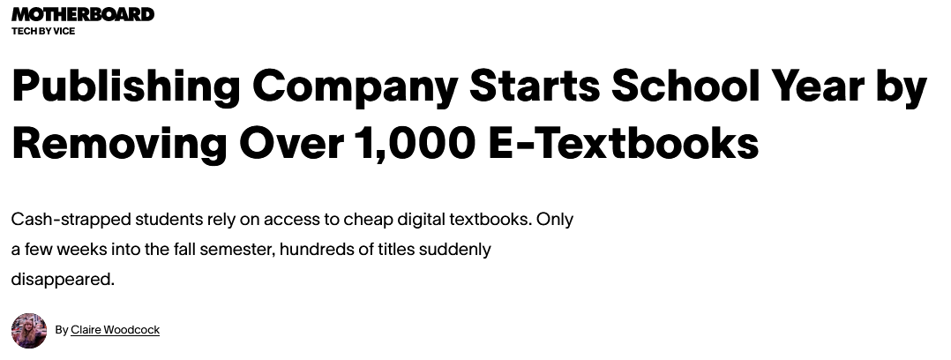
Reaction: News Stories
https://www.vice.com/en/article/3ad5x8/publishing-company-starts-school-year-by-removing-over-1000-e-textbooks
https://www.insidehighered.com/news/2022/09/28/publisher-blocks-access-ebooks-students-faculty-scramble
Notes:
Followed by news articles. (just read the headlines)

Slide 9
Outcome
On October 5, 2022, Wiley restored access
through June 2023.
https://newsroom.wiley.com/press-releases/press-release-details/2022/Statement-on-Wiley-eBooks-Featured-in-ProQuest-Academic-Complete-Library/ fault.aspx
Added a note to our catalog
Temple University Libraries will lose access to this book at the end of June 2023. The publisher, Wiley, will no longer be making it available to libraries as an ebook. Faculty, please contact coldev@temple.edu if you are or will be assigning this text for a class.

Slide 10
What is the Heart of the Problem?
Notes:
What I found most interesting about this experience was the different things people focused on as “the problem,” especially in the responses I saw on Twitter. So I started thinking, what is the heart of the problem.
I will show several examples of tweets or published quotes that either explicitly state or hint at a specific angle of viewing this situation.
Note that most of these tweets are from people I don’t know, and I did not research them to find context for their comments. They are meant to illustrate the range of issues that this situation touched on.

Slide 11
Subscriptions and Licensing Terms
Notes:
This is a good example of one category of response. (read it) I should add some of the responses did seem to be opposed to ebooks, e.g. “this is why we need print” or “this is why we don’t buy etextbooks.”
Problem may be the terms of the license, the fact that libraries agreed to these terms, the fact that we subscribe rather than owning.
We are usually able to replace books that get removed from subscriptions, if usage warrants.

Slide 12
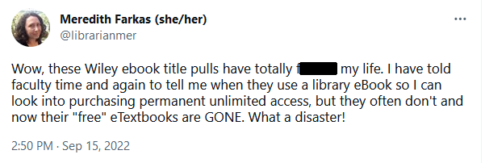
Notification and Communication
Notes:
This person works for the National Association of College Stores. He sees it as a communication issue. If we had notified faculty, maybe it would be ok. I’m not sure we would have known what to do with the information in 2020. Even in June 2022 it was hard for us to understand the impact. Rich Hershman is unaware of an ongoing problem that libraries have [next slide]

Slide 13
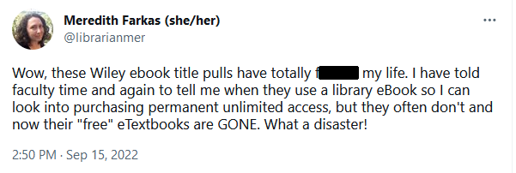
Notification and Communication
Notes:
A very frustrated text from Meredith Farkas points out what the previous text missed. We don’t usually know which books are assigned in which courses. At Temple we do, but our situation is very rare.
I doubt Meredith thinks the *heart* of the problem is that we didn’t know who was using these books in class. Even if she had known, she would’ve had to pay a lot to purchase the books or faculty would have had to change their courses. In the case of these books, libraries were not able to purchase perpetual access. So this is definitely not the heart of the problem, but it is A problem.

Slide 14
Courses Should Use Open Educational Resources
Notes:
These were both quote retweets of my tweet, and this is what they said when they retweeted.
I think this is an important solution to a different problem. Textbooks aren’t the only books that libraries have trouble buying electronically. Plus I think it’s fine to use a library-licensed ebook as your course text if access is stable.

Slide 15
Lack of Availability for Purchase
“Increasingly libraries cannot get access to ebooks, are offered prices which are multiples of the print edition and/or are subject to onerous and restrictive terms and conditions. These trends represent an existential threat to the vital role libraries play in making information available to citizens and urgent action is required before it is too late.”
-- Cathal McCauley, President of the Library Association of Ireland
https://www.ul.ie/library/about/news-events/irish-librarians-condemn-publisher-wileys-removal-hundreds-titles-ebook
Notes:
Just read.
Clearly closer to the heart – it’s an existential threat. I will be talking more about this.

Slide 16
Profit Motive
“Publishers who manipulate the academic market in order to maximize their profits at the expense of students' financial well-being hinder the university's ability to create an equitable learning environment for all.” https://library.gwu.edu/Wiley-ebook-removal
Notes:
This one is going upstream. It’s about a system where publishers make decisions based on what they think will maximize profits.

Slide 17
Library Futures: State Legislation
Actions
“The Library Futures model ebook bill … frames the discussion in terms of how publisher contracts restrict libraries’ abilities to perform their fundamental duties.”
https://www.libraryfutures.net/post/library-futures-ebook-bills-are-on-the-move
Laws proposed in 6 U.S. states
None are yet in effect, due to veto, injunction, or vote still forthcoming
https://www.ebookstudygroup.org/
Notes:
Some actions that are being taken. Most of these began before the Wiley debacle and relate to the ebook marketplace, so those last two slides. Idea is that publishers shouldn’t be able to solely make decisions based on profit, there should be regulation for the public good.
Library Futures is a research and advocacy organization trying to strengthen the rights of libraries to own, access, and lend books in the digital age. (my words) “standing up for the technology-positive future of libraries.” “Championing the right to equitable access to knowledge.”
They would like the legislation to state that a publisher that sells ebooks to the general public must sell to libraries, but some states have had trouble passing bills with this language.
Ebook Study Group is a newly launched website run by two people who were involved in drafting the model legislation.

Slide 18
#ebooksSOS Open Letter
Actions
The Campaign to Investigate the Library Ebook Market wrote an open letter in 2020 “calling on the UK parliamentary Education Select Committee, to launch an investigation into the unfair sales, pricing and licensing practice of academic publishers.”
The Committee declined to investigate. The campaign has shifted to an international focus with a letter that anyone can sign.
“Publishing practices are making ebooks unaffordable, unsustainable and inaccessible to libraries. We call for urgent regulation of the market.”
https://academicebookinvestigation.org/
Notes:
Note that they are not calling for an overthrow of capitalism.

Slide 19
Letter from Wiley Authors
Actions
Co-written by Authors Alliance and #ebookSOS, signed by authors whose works Wiley removed from the Academic Complete collection.
“[W]e are writing to express our strong disapproval of Wiley’s decision to eliminate electronic access to our books from libraries …
“We find aggressive, profit-maximizing decisions like this to be antithetical to our interests and motivations as authors.”
https://www.authorsalliance.org/2022/10/14/authors-speak-out-an-update-on-the-wiley-ebook-situation/
Notes:
Authors Alliance was getting contacted by authors whose books were among the 1379 removed, and they wrote this letter based on what they were hearing. The signatories are specifically those who wrote books published by Wiley that were removed.
(“The mission of Authors Alliance is to advance the interests of authors who want to serve the public good by sharing their creations broadly. … promote policies that make knowledge and culture available and discoverable.)

Slide 20
#ebookSOS Guidance for Authors
Actions
Explains why libraries cannot always purchase ebooks
Offers questions prospective authors can ask publishers
Sample language to include in a publishing contract
https://cdn.hd4.uk/sites/academicebookinvestigation.org/2021/05/ebooksos-guidance-for-authors-2.pdf
Notes:
This one was done in response to the Wiley ebook debacle

Slide 21
Fight for the Future: Authors for Libraries letter
Actions
“We write to ask that all publishers, distributors, and trade associations:
Enshrine the right of libraries to permanently own and preserve books, and to purchase these permanent copies on reasonable terms, regardless of format.”
https://www.fightforthefuture.org/Authors-For-Libraries
Notes:
Organization with campaigns related to digital rights, privacy, net neutrality, various technology issues.
This letter is very clear and detailed about the ways the current ebook market challenges libraries. It includes some lovely quotes by authors whose names you’ll recognize. (Neil Gaiman, Mercedes Lackey, Cory Doctorow – skewed towards sci-fi/fantasy authors) I can’t tell when it was written, probably shortly before the Wiley brouhaha. It’s not clear to me how to sign. It was an open letter but may no longer be accepting signatories.

Slide 22
Comments?
Thank you
karen.kohn@temple.edu
Notes:
I deliberately wrote “comments” on this slide rather than questions, because the main focus of my presentation was summarizing an ongoing discussion. You can add to it here.

