Slide 1
Acquisitions Supporting Diversity and Equity
Karen Venturella
Acquisitions Librarian
Union CoLlege of Union County, NJ

Slide 2
Diversity: A Core Value of Librarianship
“The foundation of modern librarianship rests on an essential set of core values that define, inform, and guide our professional practice... Among these are: access, confidentiality/privacy, democracy, diversity, education and lifelong learning, intellectual freedom, preservation, the public good, professionalism, service, social responsibility, and sustainability.”
Diversity
“We value our nation's diversity and strive to reflect that diversity by providing a full spectrum of resources and services to the communities we serve. ”
https://www.ala.org/advocacy/intfreedom/corevalues

Slide 3
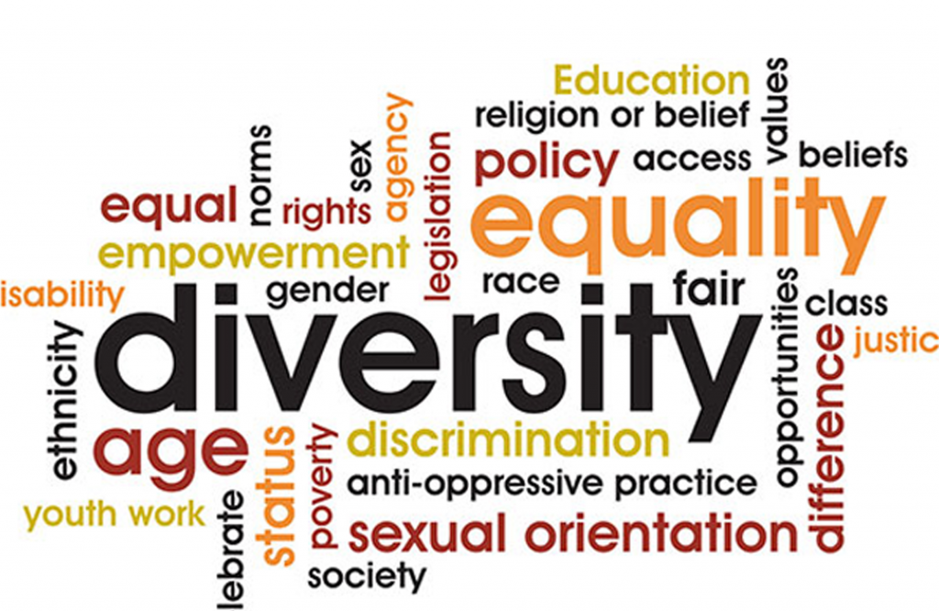

Slide 4
Diversity at Union College
Mission: Union College – Transforming Our Community One Student at a Time.
Values
Diversity – We are committed to a diverse environment that supports an equitable education for all of our students and emphasizes respect for various cultures and individual differences. Globalization – We seek to establish connections and relationships locally, nationally, and globally

Slide 5
DIVERSITY, EQUITY, AND INCLUSION (DEI) SCORECARD FOR LIBRARY AND INFORMATION ORGANIZATIONS April 2021
Developed by the ALA Committee on Diversity
Scorecard measures:
●…Integration of diversity, equity, and inclusion into the organization which ensures that DEI is a priority.
● Training and Education
● Recruitment, Hiring, Retention, and Promotion.
● Budget Priorities for DEI: Funding that demonstrates investment in diversity, equity, and inclusion in the organization and community, including staff, collections, programs, and services.
● Data Practices: Plans and procedures for acquiring or collecting, analyzing, disseminating, and applying data to monitor and achieve organizational DEI goals and objectives. The DEI Scorecard can be used as is or adapted to accommodate local context.

Slide 6
At Union College, a medium size community college in New Jersey, The library has increasingly been working to support the diversity and equity initiatives of Union College
To support the focus on diversity and equity initiatives, Acquisitions handles monthly book displays that highlight the diversity of the collection.
Collection development has focused on adding resources focused on diversity
Acquisitions has been involved in library programs in collaboration with other college divisions. For example, a poetry event for national poetry month that featured poetry from a multitude of cultural groups and included the Humanities faculty.
Libguides have been created on open access resources as well as issues of social justice like racial justice, policing and protest.

Slide 7
Library Diversity Plan
Library focus on supporting College’s diversity, equity inclusion
Offer DEI displays and programming
Build collection with focus on DEI
Propose using vendors with DEI focus
Conduct an internal survey to identify problems and to determine where we are and what we should be working on

Slide 8
Collection Development
Recently added:
Diversity eBooks EBSCO eBook Subscription Diversity & Ethnic Studies
EBSCO Ethnic Diversity Source A resource for diversity and ethnic studies that includes journals, newspapers, primary sources, and other materials.
Gale OneFile: Diversity Studies Diversity Studies prepares researchers for social science, history, and liberal arts coursework. This collection explores cultural differences, contributions, and influences in the global community.
Other Library Resources
Proquest Ethnic NewsWatch …full-text newspapers, magazines, and journals of the ethnic and minority press, providing researchers access to essential, often overlooked perspectives. The database now also contains Ethnic NewsWatch: A History, which provides historical coverage of Native American, African American, and Hispanic American periodicals from 1959-1989.
Gender Watch…historical and current perspectives on the evolution of gender roles as they affect both men and women. Gay, lesbian, bisexual, and transgender (GLBT) studies; family studies; gender studies, and women's studies are included coverage areas. With hundreds of academic, gray, and popular literature titles from voices seldom heard in the mainstream media, researchers have access to robust collections of articles on wide-ranging topics from over three decades of gender studies.
Trialing – Primary resources like Newspaper Archives

Slide 10
Diversity in the catalog
666 books with keyword diversity
535 books with title has word diversity
1102 books with title justice
3814 books with keyword justice
1148 books with keyword racism
168 books with title racism
252 books with keyword transgender
58 books with title transgender

Slide 11
Monthly Displays
January Poverty Awareness
February Black History Month
March Women’s History month
May American Asian and Pacific Islander Heritage
October LGBTQ+ display.

Slide 12
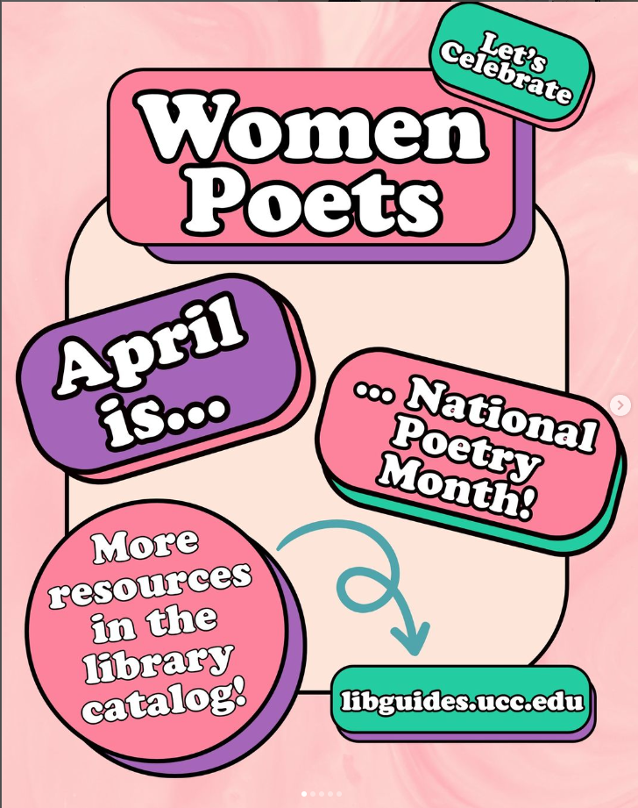

Slide 13
April is Poetry Month
Large circ display | small circ display
Women in Politics | Women of the Supreme Court
Black poets | Harlem Renaissance
Hip Hop | Modern Poetry
Women Poets | Poetry from antiquity
Hispanic poets | Beat poets

Slide 14
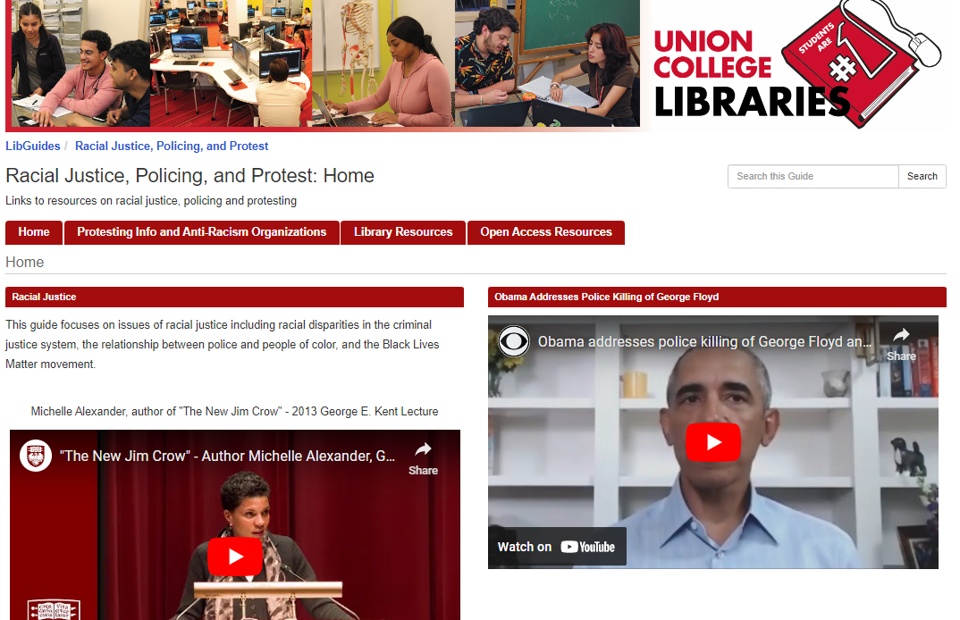
LibGuides on Diverse Topics
Example Racial Justice, Policing and Protest
https://ucc.libapps.com/libguides/admin_c.php?g=1049244&p=7614865

Slide 15
White Board Diverse topics

Slide 16
Professional Development Activities
Recommended Diversity Award for NJLA
Mentoring Program
Reviews on topics related to affordable housing, the un-housed, social justice

Slide 17
NJLA Equity, Diversity, and Inclusion Award
The award will recognize and honor outstanding contributions to equity, diversity, and inclusion by an institution or individual in 2022. The recipient(s) of the EDI Award will be selected by the Honors & Awards Committee.
In accordance with the guidelines and definitions adopted by the ALA Council, recommended by the ALA Task Force on Equity, Diversity, and Inclusion:

Slide 18
ACRL Dr. E.J. Josey Spectrum Scholar Mentor Program
”The goal of this program is to link participating library school students and newly graduated librarians who are of American Indian/Alaska Native, Asian, Black/African American, Hispanic/Latino, Middle Eastern and North African, and/or Native Hawaiian/Other Pacific Islander descent, with established academic librarians who will provide mentoring and coaching support, serve as a role model in academic librarianship, and provide guidance in seeking a career path and opportunities for leadership in the profession. …”

Slide 19
Reviews for Choice & Library Journal
Venturella, Karen. “The New Urban Crisis: How Our Cities Are Increasing Inequality, Deepening Segregation, and Failing the Middle Class—And What We Can Do About It.” Library Journal, vol. 142, no. 5, Mar. 2017, p. 132.
Venturella, Karen. “The Health Gap: The Challenge of an Unequal World.” Library Journal, vol. 140, no. 17, Oct. 2015, p. 104.
Venturella, Karen. “Evicted: Poverty and Profit in the American City.” Library Journal, vol. 141, no. 1, Jan. 2016, p. 122.
Venturella, Karen. “The Reproach of Hunger: Food, Justice, and Money in the 21st Century.” Library Journal, vol. 140, no. 14, Sept. 2015, p. 124.

Slide 20
Works Cited
ACRL Dr. E.J. Josey Spectrum Scholar Mentor Program https://www.ala.org/acrl/membership/mentoring/joseymentoring/mentorprogram
Core Values of Librarianship (2019 Jan.). https://www.ala.org/advocacy/intfreedom/corevalues
DEI Scorecard for Library and Information Organizations (2021, April) https://www.ala.org/aboutala/sites/ala.org.aboutala/files/content/2021%20EQUITY%20SCORECARD%20FOR%20LIBRARY%20AND%20INFORMATION%20ORGANIZATIONS.pdf
New Jersey Library Association Equity, Diversity, and Inclusion Award https://www.njla.org/index.php?option=com_content&view=article&id=426:diversity-award-0&catid=31:honors-and-awards&Itemid=170

