Slide 1
Patron Driven DEI Acquisitions: Using education students and the Diverse Book Finder to diversify a children’s picture book collection
Mitchell Scott
Coordinator of Collections
Indiana University Southeast

Slide 2
What we’ll talk about
1. Library collection need
2. The Diverse Book Finder
3. Grant funding opportunity
3. EDUC 339 course and project integration
4. Classroom Instructional Session
5. Purchasing results
6.Pre and Post test survey data
7. What’s next

Slide 3
Children’s picture books & academic libraries
Often part of education or curriculum libraries & support teacher ed
More assignments around selecting & using diverse titles
Collection development has been “award winner” based.

Slide 4
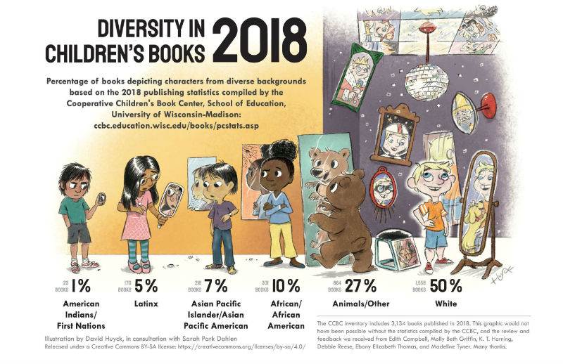
Diversity in Children’s Books
https://www.slj.com/story/an-updated-look-at-diversity-in-childrens-books

Slide 5
State of IUS Children’s picture book collection (09/01/2022)—Its old!
Publication Years | # of Unique Titles | % of Collection
1990-1999 | 2816 | 39.66%
2000-2009 | 2133 | 30.04%
1980-1989 | 1042 | 14.67%
2010-2022 | 569 | 8.01%
1970-1979 | 400 | 5.63%
1960-1969 | 217 | 3.06%
1950-1959 | 97 | 1.37%
1940-1949 | 47 | 0.66%
Pre-1930 | 17 | 0.24%
1930-1939 | 17 | 0.24%
Grand Total | 7101 | 100.00%

Slide 6
Appearing in Library research (Collection Management articles)
2021 Best Digital Tool by AA of School Librarians
Created by Professor Krista Aronson @ Bates College
More than just “diverse” vs. “non-diverse.”
Considers how diverse characters and themes are represented
Collection and Assessment tool
https://diversebookfinder.org/

Slide 7
DBF Collection
Feature BIPOC human characters
Suitable for K-3
Published since 2002
Have illustrations (picture books)
Divided into 9 unique categories
Categories capture dominant messages in BIPOC children’s picture books
All books have on or more assigned category
Example: Oppression and Resilience
https://diversebookfinder.org/our-collection/

Slide 8
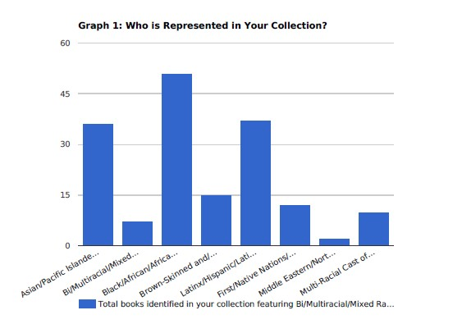
DBF IUS Assessment
Compares your titles to DBF titles (2002 to present)
Input ISBNs and Titles and match you collection against DBF collection
IUS Collection (09/01/2022)
Submitted ISBN and/or titles for 2170 items in PZ range
142 matches to DBF titles
6.8% of collection features BIPOC characters
https://cat.diversebookfinder.org/?_ga=2.65923950.1740444253.1677511674-1200799685.1673987579

Slide 9
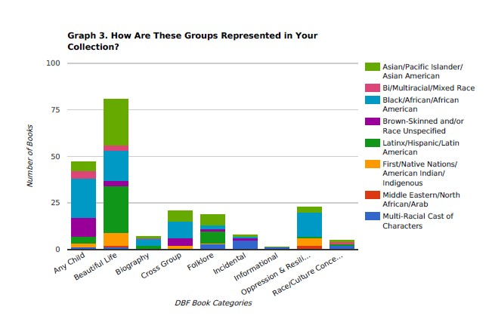
IUS Collection & DBF categories (09/01/2022 )

Slide 10
DEI Grant Funding & opportunity
Original idea: recruit students to help use DBF to purchase diverse children's books
$2,500 for DEI research or creative work. Preference for student participation.
Worked with education faculty members to identify course and develop research plan
EDUC 339 “Methods of Teaching Language Arts; 25-30 preservice learning, sophomore ed students
During library led session, students will identify 5 books for library to purchase
Integrated with existing assignment (select diverse book, develop plan, teach in clinical, and video)
Pre & Post test survey on diversity in curriculum, learning objectives, and experience.

Slide 11
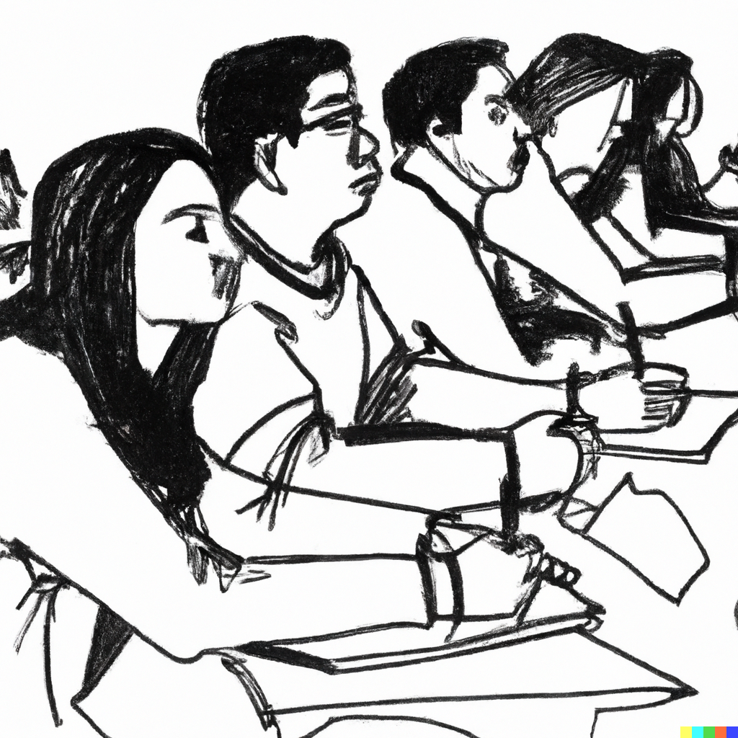
Instructional session
1.5 HR session in Library instruction lab.
Students divided into 9 DBF Categories
Discuss diversity of library collections, school libraries, and within school curriculum
Demo DBF and start selecting

Slide 12
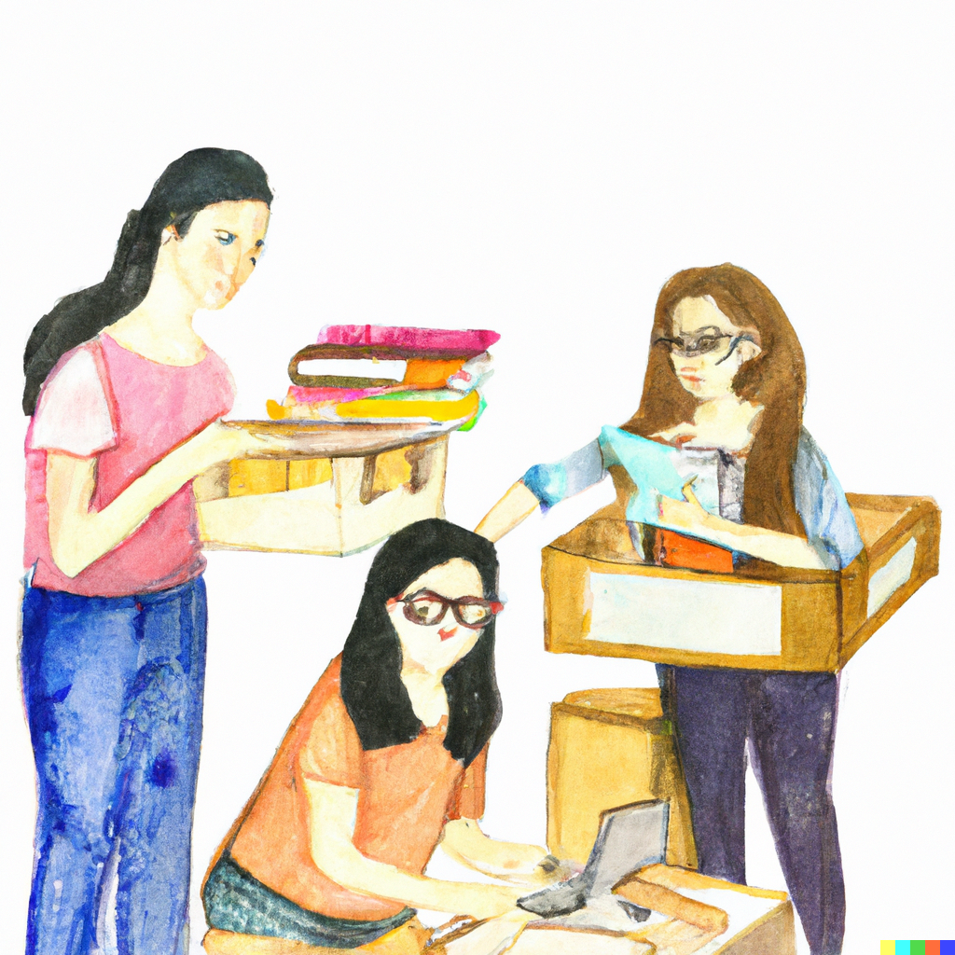
Acquisitions & Delivery
All ordered via Amazon for turnaround
129 books ordered by 27 students for $1,748.18
Rush cataloged and held for students to pick up

Slide 13
Purchasing Data—The Highlights
46 students selected 220 books for the collection
33% Multi-Racial cast, 28% Black or African American
Content on disability, activism, bi/multilingual, economic struggle
Our collection got newer
73% purchases published 2019-2022

Slide 14
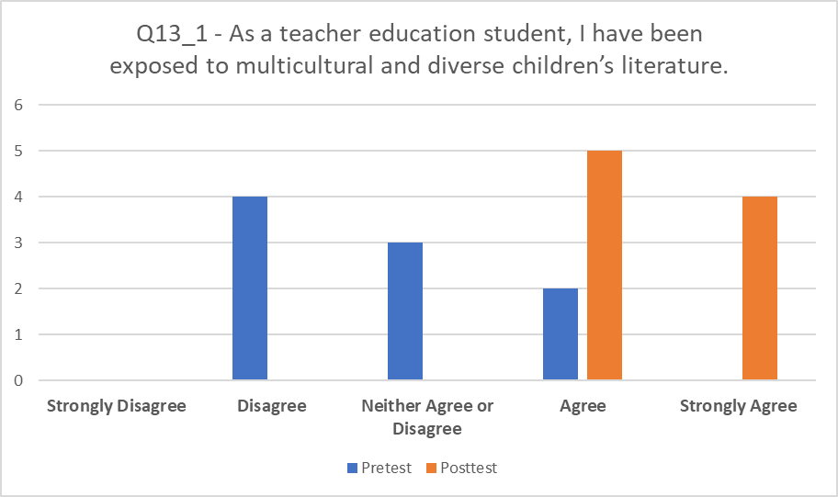
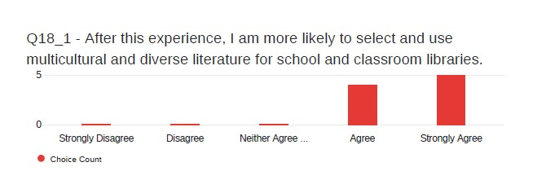
Pre & Post test data
Waa-waa: N=9 (from Fall 2022)
ALL showed an improved understanding of “themes” that exist in diverse books.
ALL indicated they felt more exposed to diverse materials after this experience.
ALL more likely to select and use diverse materials after this experience.
7 of 9 used a book they selected for classroom activity

Slide 15
Faculty feedback & future
Students had a better understanding of what a diverse book is
Students had a better understanding of “themes” that existed in diverse books
Rerunning in Fall 2023
Looking for other potential ways to incorporate purchasing into courses
Leverage existing instruction partnerships
Tie it to Assignment: Research methods, capstones, etc.
Use ILL as selection/request mechanism

Slide 16
Questions

