Slide 1
Acquisitions for the Sciences: Using a Diversity Audit to Serve BIPOC Students in STEM
Janet Calderon
Student Success Librarian
Central Washington University

Slide 2
CONTENTS
What is Collections Diversity?
Why a BIPOC author representation assessment?
Methodology
Results
Discussion
Activity and Wrap-up

Slide 3
WHAT IS COLLECTIONS DIVERSITY?
The Ithaka S+R US Library Survey 2020 found that “...most libraries have not developed criteria for evaluating and making decisions related to the diversity of their collections.”
Notes:
This is because of how diversity itself is defined can depend on the context of its employment, such as through the direct interpretation of providing variety, which libraries have traditionally valued through the acquisition of various perspectives across various subjects. However, due to the institutional structures that uphold white supremacy within academia, publishing, and scholarship as a whole, this straightforward approach ultimately fails as it sets up knowledge curation of diverse perspectives as the same as knowledge contribution from diverse perspectives (Jimenez, Beckert, & Lee and Low Books, 2020; Santamaria, 2020; Harris, 2019; Espinal, Sutherland, & Roh, 2018; Hathcock, 2015)

Slide 4
WHAT IS COLLECTIONS DIVERSITY 2.0?
Recent scholarship argues that “…diversity as it relates to library collections is an ongoing pursuit that requires… critique and re-evaluation of methods. To curate diversity in a collection also requires actively seeking underrepresented peoples and voices…”
(Jahnke, Tanaka, & Palazzolo; 2022)
Notes:
Publications from the 1990s saw the need to “take seriously the ethnic and racial dimension of the collection” through the gathering of empirical data on the matter and via the treatment of such collection building as a specialized approach (Trujillo and Weber, 1991)
This field of focusing on collections diversity through identity representation has been talked about for a long time but we are still seeing slow progress.

Slide 5
WHY A BIPOC AUTHOR REPRESENTATION ASSESSMENT?
To center a Reparative Approach
To Make it Student-Centered
“...a way of thinking about justice (a mindset) that centers those who have been harmed, and focuses on repairing past harms, stopping present harm, and preventing the reproduction of harm”
https://nebhe.org/reparative-justice/
From 2019-2021, BIPOC students made up an average of 47% of total students enrolled
https://pine.humboldt.edu/~anstud/humis/demo-AAFHEV.html
Notes:
I was the College of Natural Resources and Sciences Librarian under a temporary contract from 2022 to early 2023 at Cal Poly Humboldt University, where this audit took place.
I knew I wanted to do something with science collections and I knew I wanted to target BIPOC student needs. I started by looking for research from the sciences that addressed the call for more diverse perspectives in science and how to serve BIPOC student needs in STEM.
Across the research I found, I saw that again and again that the lack of diverse faculty of color in STEM also correlated with a lack of diverse perspectives being valued in the sciences. This in turn can affect BIPOC students in STEM, through their sense of belonging and from not being able to tie their STEM work to personal and cultural perspectives that students in the humanities have an easier time addressing.
This is where it started coming together to me. As a Librarian, I could address the need to provide more diverse perspectives in STEM through library collections. I could also follow it up by promoting these items to students and reach out to faculty to consider collaborating on programming around said materials. I hypothesized that because STEM collections are rarely audited for diversity, something that I was seeing corroborated in the collections diversity literature, that the findings of such an audit would show a huge disparity in author racial/ethnic representation.
So, all of that gave me the push to begin. The next thing I was coming against are the multiple ways you can approach a diversity audit, such as whether you are looking at content or authorship for markers of diversity, I wanted to make sure that whatever methodology I chose to follow, that there was also space to make it student-centered and to able to seek suggestions through a reparative lens.
This is where I draw your attention to the screen. To make the diversity audit student-centered, I decided to compare the representation of BIPOC authors in a specific STEM collection against the representation of BIPOC students on campus. (read)
This data is pulled from institutional research, which goes back to 2014 on the website. From 2014-2021 the average was about 45% so more recent years shows the average improving.
I also wanted to center a reparative approach.
The New England Board of Education’s website defines reparative justice as “...a way of thinking about justice (a mindset) that centers those who have been harmed, and focuses on repairing past harms, stopping present harm, and preventing the reproduction of harm” (2023)
Again, what I mean by centering a reparative approach here is that I wanted to keep this in mind when I looked for suggestions on how to address this issue. I didn’t just want to look at what other libraries were doing to repair gaps that are there because of historical exclusion but to think critically on what measures libraries are taking or could take to prevent future harm.
This is important to note because it calls attention to the dominant structure in which navigating how to serve BIPOC students is situated- that using a library collection to serve BIPOC students would need to center reparative justice measures to effectively combat the patriarchal and white supremacist structures that are entrenched within the relational systems of academia, scholarly publishing, and librarianship.

Slide 6
Refining the collection and sample size
METHODOLOGY Part 1
Returned
508 books, over 500 authors
26% of that specific collection
Why a sample size?
Time limit and individual limit
Modifiers used
Subject Heading: natural resources
Physical books held by library
Publication date: 2000-2022
Notes:
This brings us to the methodology. Here’s the big picture approach.
First, refining the collection and sample size.
I was a librarian on a temporary contract. I put out feelers for interest in working on this project but no one else in the library took me up on it, so I went at it alone, amongst all my other duties.
I played around with subject headings, until I found one that met a science need and didn’t bring back too many results for me to work off of.
I chose physical books because I wanted to specifically bring in new books that students could actively engage with.
And narrowed the publication date for the same reason as the subject heading, to limit results.
This returned just over 500 books and over 500 individual authors. Without the limit of the publication date, this amounted to 26% percent of the overall collection of physical books under the Natural Resources book collection.
This gave me a good sample size to work with, and the why, again, is because of the time limit with my contract and my individual limit as a solo project.

Slide 7
How were authors assessed for representation?
METHODOLOGY Part 2
Author self-identification primarily through
Bios, personal websites, interviews, social media
Limitations
Pre-determined racial and ethnic categories through institutional research
Notes:
The next part to figure out was how to assess authors for representation.
This I drew directly from examples of what other libraries had done. (read)
The limitations of this however came through the (read). Because I wanted to match author demographics to student demographics it meant using the same categories the institution provided to students, which are limited. I’ll talk about this more when I show you the findings in just a bit.

Slide 8
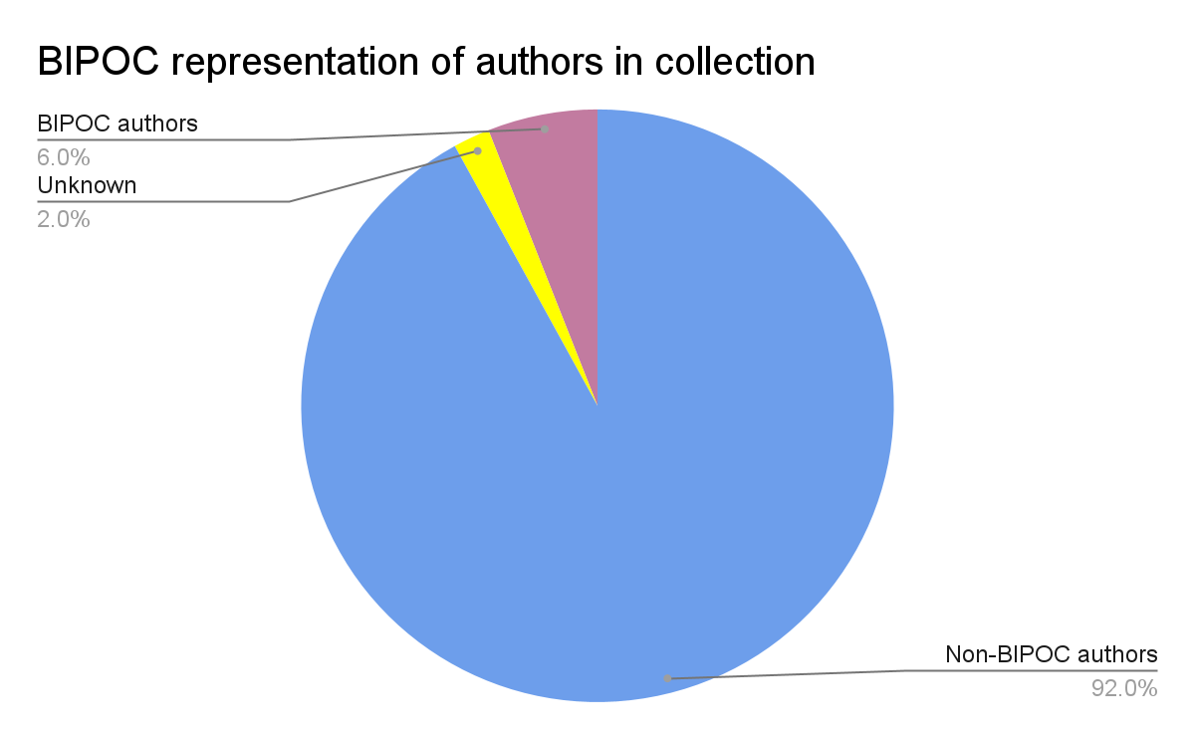
RESULTS
BIPOC authors make up 6% of the 506 authors in the subject of Natural Resources, published 2000-2022
VENUS
JUPITER
MARS
Notes:
If the 26% of the collection pulled is seen as an accurate sample size of the collection of monographs under the subject of “natural resources” as a whole, we can assume that at the most BIPOC authors make up about 6% of the entire collection. “At the most” is stated due to the fact that the sample size was pulled from monographs published since the year 2000 and under the assumption that BIPOC authors may have an even smaller representation within the titles published from the year 1868 to 2000. This percentage for BIPOC representation is also liable to be slightly inaccurate due to the “unknown” category which makes up 2% of the authors assessed. Though even if the 2% was added to the 6% of BIPOC authors’ representation it would still ultimately delineate a poor representation when compared to BIPOC students making up about 47% of the students on campus.

Slide 9
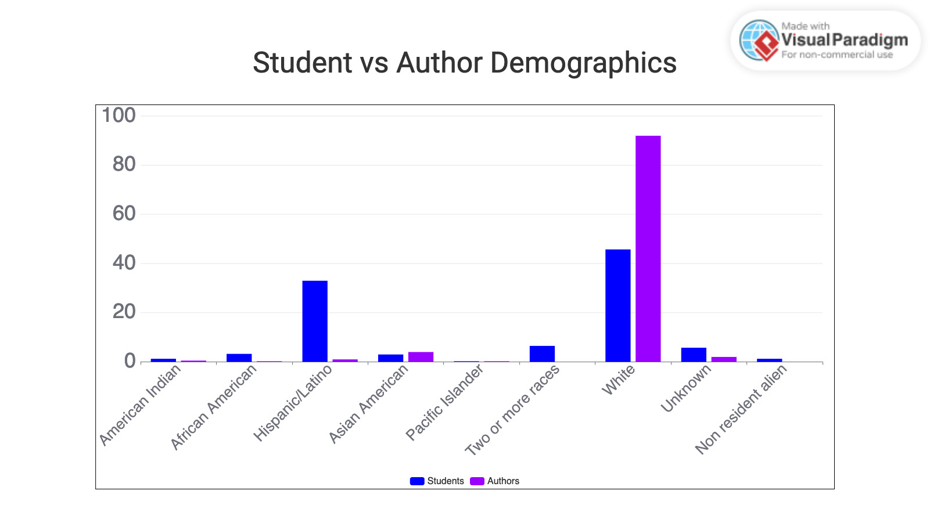
Notes:
Here’s the demographic breakdown
Student demographic is in blue and the authors in purple
Student demographic population pulled from 2019-2021 averages from Enrolled Student Demographics Report, https://pine.humboldt.edu/~anstud/humis/demo-AAFHEV.html
I put this chart up so you can see the visual but let me also read out the numbers for you
American Indian 1.25% 0.50%
African American 3.25% 0.25%
Hispanic/ Latino 33% 1%
Asian American 3% 4%
Pacific Islander 0.25% 0.25%
Two or more races 6.50 %0%
White 45.75% 92%
Unknown 5.75% 2%
Non resident Alien 1.25% 0%
So, there are some limits here as far as representation go.
For example, there is a category used for Asian-American but not for middle-eastern. This means that by default, any others who I came across that identified as middle-eastern would be categorized as Asian. There’s also the fact that all the institutional data added the “American” part of the demographic to the BIPOC racial categories.
It made me wonder if an international student for example would categorized themselves under “non resident alien” or if they were from, lets say Japan, would they categorize themselves as “Asian American” as the closest category.
It’s clear though, that these are limited.

Slide 10
UNDERSTANDING THE PROBLEM
Why the poor representation?
Academic publishing, academia representation in general, vendors used, lack of resources (especially personnel and slashed budgets)
Why does this matter?
Curating BIPOC students' sense of belonging in the STEM field, in academia, on campus, and in the academic library

Slide 11
WHAT CAN WE DO AS AS LIBRARIES?
Best Practices
Policy-making
Diversity line item
Increase discoverability- internal tags and/or Subject Headings
Create a minimum % goal of representation we want to hit and then exceed it
Set up a framework for selection to increase diversity

Slide 12
Think-Pair-Share
Notes:
So, that was a whole lot of background on the audit and its findings.
Now we want to switch gears to what comes after that- highlight the new collection through programming.
Think about what your library has done, plans to do or that you would like your library to do concerning collections diversity.
It does not have to be for the science focused collections, but bonus points for those of you that do.
Take a minute or two to yourself, then find a partner or a small group and share your ideas with one another.
Especially consider sharing complications and ways around them with one another.
We will come back and share together after 8 minutes.

Slide 13
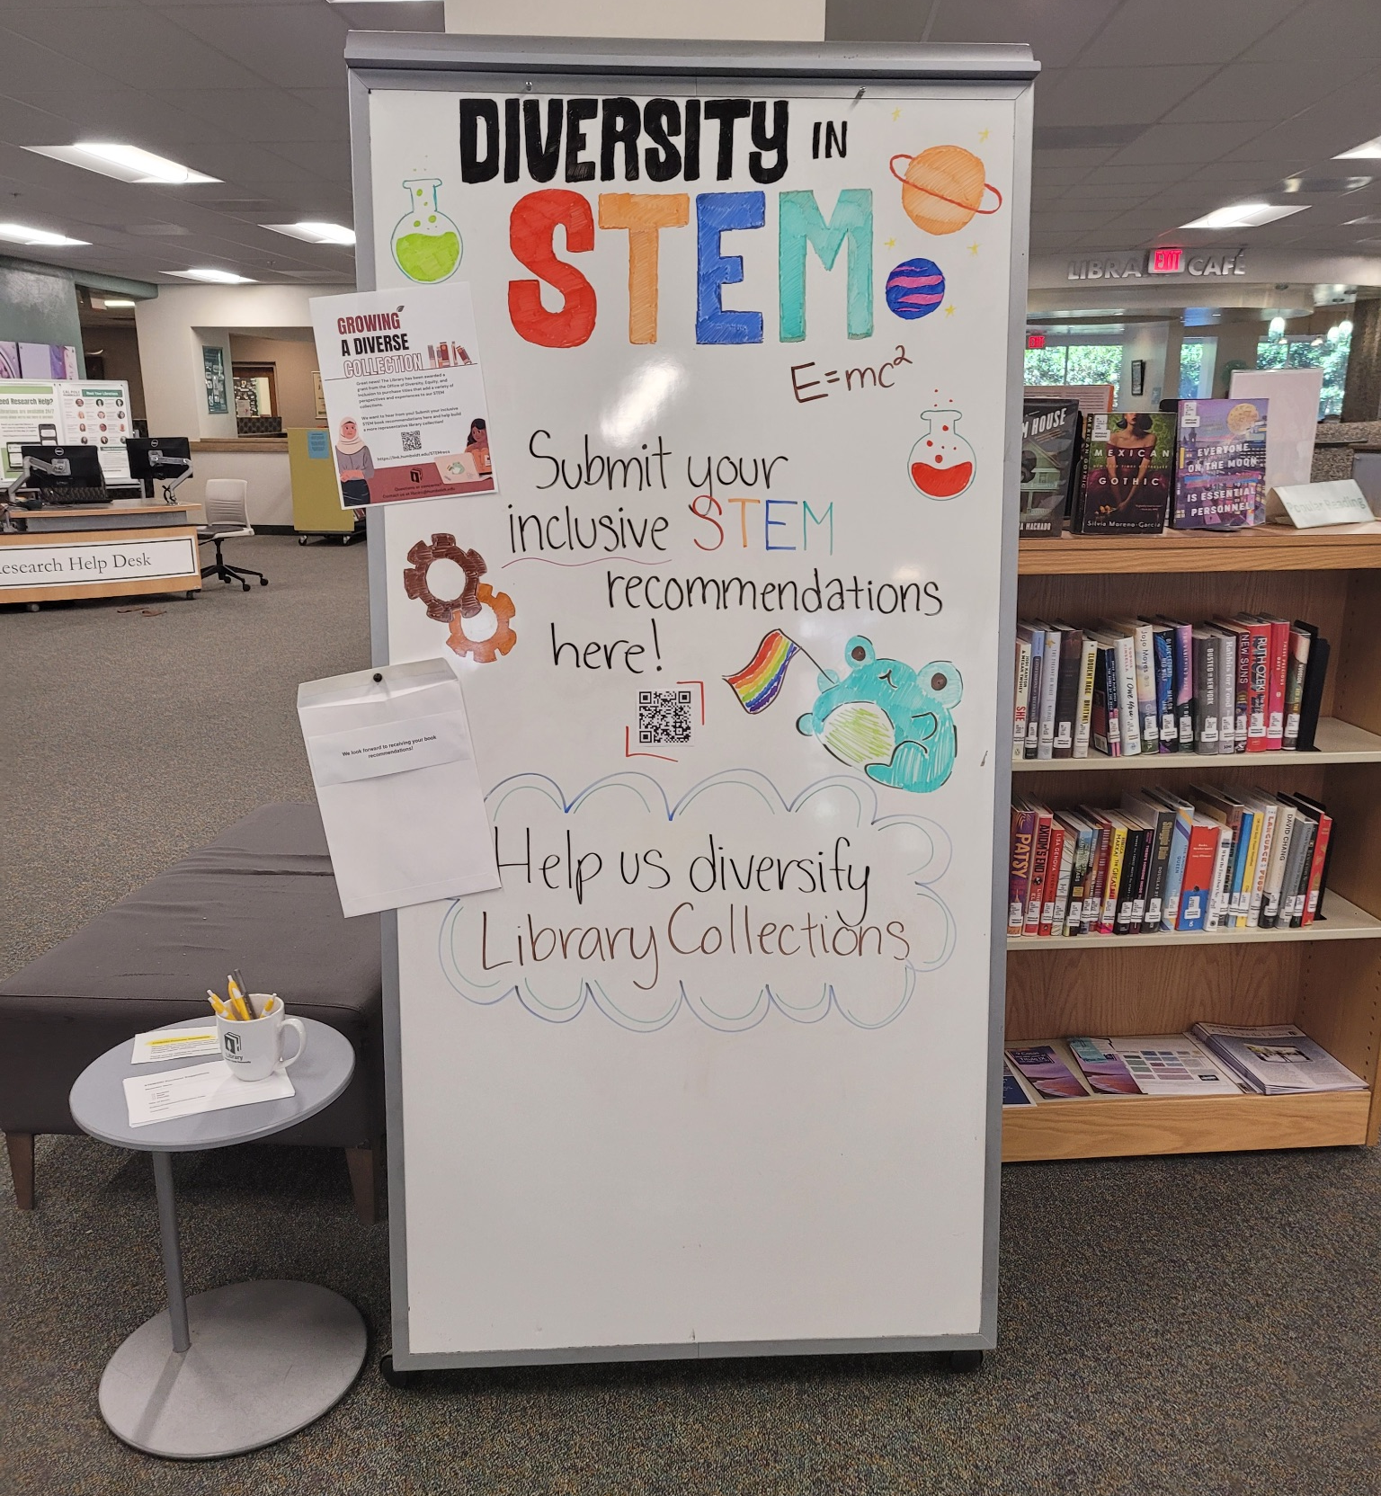
How the library shared and connected with students
Wikipedia + Libraries:
Better Together
Using a Wiki-edit-a-thon to add diverse sources to STEM articles
https://www.webjunction.org/explore-topics/wikipedia-libraries.html
Notes:
Here’s what my previous library did.
First off, because we got a grant we wanted to market the opportunity to suggest new purchase of diverse titles in STEM.
This was done through flyers, displays like the one pictured, social media, and listservs
Students could suggest purchases on slips of paper, like in the paper, or through filling out a google form that was generated into a QR code
There was also a planned Wiki-edit-a-thon that would be focused on diversity in STEM
The library had previously run a session on Art and feminism- so I was working with that librarian to outline a similar event for diversity in STEM.
Unfortunately, the event was set to take place after I pursued a new job so I wasn’t able to finish all the planning for it or oversee it myself.
I wanted to point out this here “Wikipedia+Libraries: Better Together” as a wonderful resource that teaches librarians how to edit Wiki and run wiki-edit-a-thons.
For me, I love events best when it feels like students can walk away with something they accomplished. Being a part of editing Wikipedia is one of those things because it’s something they can see out there in the world and know that they did it.

Slide 14
Thanks!
Please keep this slide for attribution
Janet Calderon
Student Success Librarian
Central Washington University
]]
janet.calderon@cwu.edu

