Slide 1
Creating and Executing a Small-Scale Diversity and Inclusion Audit Project at an Academic Library Using Graphic Novels
Bridgette Whitt
MSLS, MA (She/Her)
Acquisitions Institute at Timberline Lodge
May 22, 2023
Notes:
Hello everyone, I'm Bridgette Whitt and I’m excited to speak to you today about creating and executing a small-scale diversity and inclusion audit project at an academic library using graphic novels. I am from the Paul Meek Library at the University of Tennessee at Martin.

Slide 2
Goal: Increase Diversity and Inclusion in Collection
Initiative to add greater diversity and inclusion to the library’s collection
Identify area with greatest potential to achieve goal
Focused on the library’s print graphic novels collection
Notes:
At our library we wanted to start an initiative that would add greater diversity and inclusion to our libraries collection. To do this, we had to start by first identifying an area within our library's collections that would have the greatest potential to achieve this goal. After we looked at all of our different areas, we decided to focus on our libraries print graphic novels collection as we felt this area would have the most potential to achieve our goal.

Slide 3
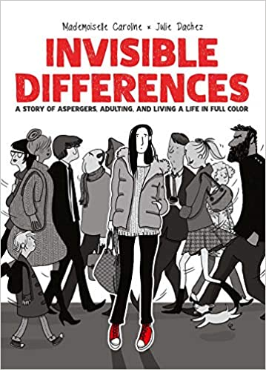
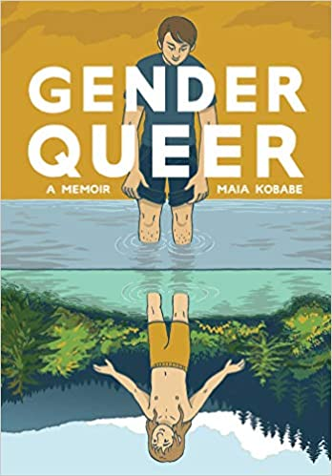
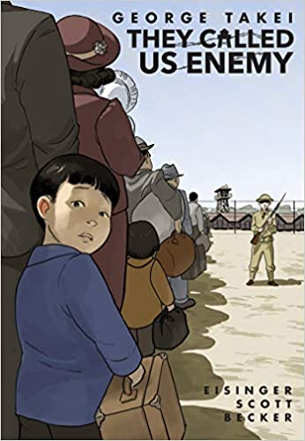
Why Graphic Novels?
Publishing trend toward more diverse stories, perspectives, narratives, and voices (Watts, 2015)
Provide deeper understanding of different lived experiences and cultures (Domyancich-Lee et al., 2022)
Explore sociocultural and human rights issues like homophobia, racism, immigration, and violence against people of color (Domyancich-Lee et al., 2022)
Provide underrepresented protagonists (Watts, 2015)
Can be used to teach critical skills, social justice and provide other historical accounts (Domyancich-Lee et al., 2022)
Notes:
So why did we decide to focus on the area of graphic novels. The publishing of graphic novels has trended towards being a platform for more diverse stories, perspectives, narratives, and voices in the past few years. Graphic novels tend to provide deeper understanding of different lived experiences and different cultures. Graphic novels often explore sociocultural and human rights issues like homophobia, racism, immigration, and violence against people of color. Graphic novels can provide a platform for under representative protagonists in their stories. We can use graphic novels to teach critical skills and social justice, and to also provide access to other historical accounts from those that you typically see published. Included here are some examples of the diverse offerings of graphic novels. We have the most banned book of 2022, the memoir Gender Queer, and the graphic novel Invisible Differences that discusses life with Asperger’s, while the outdated term is still used in France but would now be part of the Autism Spectrum in the United States. We also have George Takei’s (Ta-Kay’s) They Called Us Enemy where he describes his childhood as a Japanese- American being imprisoned within American concentration camps during World War II.

Slide 4
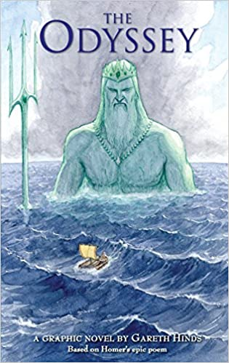
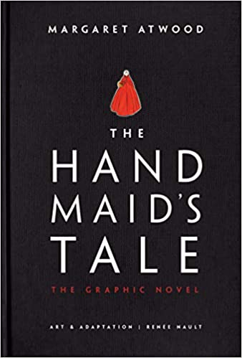
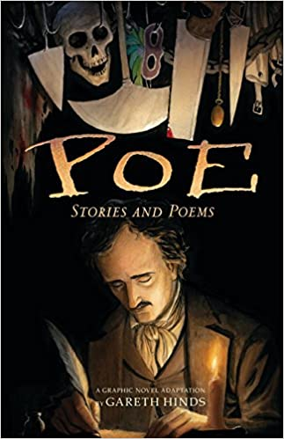
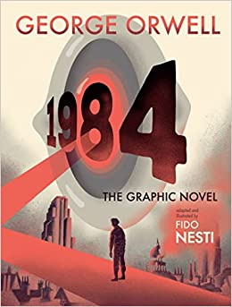
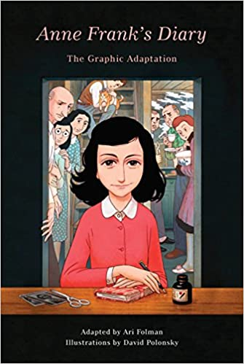
Graphic Novels in Academia
Increase reading and reading comprehension
Studies show that they help facilitate reading and increase reading comprehension and can also be used by English as a foreign language learners (Wong et al., 2017)
Can be used in instruction and in courses as they are much more than superhero stories and literary fiction.
There are now biographies, non-fiction, manga, historical fiction, and even classic literature adaptations (O’English et al., 2006)
Notes:
So why are we interested specifically in graphic novels in academia? They have been shown to increase reading and reading comprehension. Studies have shown that graphic novels help actually facilitate reading and increase reading comprehension, and additionally they can also be used by English as a foreign language learners. Graphic novels can be used in instruction and in university courses as they have become much more than just superhero stories, and just literary fiction. Graphic novels now include many biographies, nonfiction, manga, historical fiction, and even classic literature adaptations. Here we see examples such as George Orwell’s novel 1984 and Margaret Atwood 's The Handmaid's Tale. some other examples are the works of Edgar Allan Poe, The diary of Anne Frank, and classics such as The Odyssey.

Slide 5
Focused Purchasing Project
Developed a purchasing strategy to add greater diversity to the collection by targeting selections which include:
Minorities & Multicultural (Hispanic/Latino, Black/African Americans, Asian Americans, Native Americans, Middle Eastern Americans, Pacific Islanders)
L.G.B.T.Q.I.A.+
Disabilities, Mental Health, Neurodiversity
Special focus where author shares the same character identity
Notes:
So, I took this initiative that was very important to me, and turned it into a focused purchasing project where I developed a purchasing strategy to add greater diversity to our collection. I wanted to specifically target material selections which would include minorities and multicultural populations such as Hispanics, Latinos, Blacks, African Americans, Asian Americans, Native Americans, Middle-Eastern Americans and Pacific Islanders. I wanted to include the LGBTQIA+ communities. I wanted to make sure that we were including and representing the topics of disabilities, mental health, and neurodiversity. I also wanted a special focus on where the author actually shares the same character identity as that in their graphic novel. For this project, funds of approximately $1500 were marked to spend on these new graphic novel purchases. To determine what to purchase, I consulted print and online reviews, websites, and made use of other libraries collections.

Slide 6
Creating the Audit
Plan started to be created for a diversity and inclusion audit
Small-Scale audit focused on one area of the collection
Assess and analyze the diverse areas that were lacking representation and inclusion
Implementable outcome that improves upon procedures
Goal: Measure the collection and improve purchasing procedures which increase the inclusion of various cultural and social identities, different backgrounds
Notes:
What ended up growing out of this project was a plan to create a diversity and inclusion audit of our collection. I knew because of the limits of our library and the number of staff who would be able to be involved, which often was basically me, that it would have to be a small-scale audit where I could begin just by focusing on one area of the collection. It had to be an audit that was manageable for me to complete that would also have a meaningful impact. Because of my work already with the graphic novels, I decided it was the perfect area to focus on as it was both small enough and had great potential for diversity and inclusion. I wanted to assess and analyze the diverse areas that were lacking representation and inclusion within the collection. I wanted an implementable outcome that actually improves upon our procedures. So, my goal for the audit ended up being to measure the graphic novel collection and improve purchasing procedures which would ultimately increase the inclusion of various cultural and social identities and different backgrounds.

Slide 7
Researching Audit Options
Explored audit products
Notes:
When I started researching different options for how I could actually conduct the audit, I explored several different audit products for a more automated process. Unfortunately, I needed to basically focus on free to low cost products because of the current budget situation at that time. What I found was that there does seem to be a lack of available products for academic libraries when compared to the collection audit and analysis products available for Public Library collections. Offerings for DEI type analysis products was very meager. While exploring I did find Mackin.com. They have a free online CAPS (Collection Analysis Plus Solutions) offering which stated it would help analyze your collection using an uploaded copy of your exported MARC records. Mackin has curated a collection of descriptive, curricular tagged resources within their database that can run a Tag Report, with one of the Tag categories being Diversity. So, I exported all our MARC records for our graphic novels collection and uploaded them to the Mackin CAPS product. However, of all our uploaded MARC records, only roughly 26 percent of the titles were matched in their database with only 12 percent of the title records being recognized for diversity title matches.

Slide 8
Development
Attended webinars and exploring published research
Infobase Webinar - Maria Emerson & Lauryn Lehman (2022)
https://infobase.com/resources/who-are-we-missing-diversity-audits-to-assess-academic-library-collections-workshop-2-part-webinar-series/
Emerson, M. E., & Lehman, L. G. (2022). Who Are We Missing? Conducting a Diversity Audit in a Liberal Arts College Library. The Journal of Academic Librarianship, 48(3), 102517. https://doi.org/10.1016/j.acalib.2022.102517
Notes:
After I basically struck out on finding a product that would be able to do this in a more automated way, I then started planning to create and develop my own audit for what I was needing. Since I was sure that others had done something similar in the past, I started attending any webinars on the subject that I could find and started exploring various published research. After attending many different webinars and reading lots of articles I was lucky enough to come upon and attend an Infobase webinar by Maria Emerson and Lauryn Lehman in 2022. They also had a preprint of their article available at the time that was titled the same as the webinar. Who are we missing? Conducting a diversity audit in a liberal arts college library.

Slide 9
Emerson, M. E., & Lehman, L. G. (2022) Diversity Audit Template
Notes:
Their webinar was extremely informative, with many tips, and they were also evaluating many of the areas that I was currently wanting to evaluate in our collection. They also made available some of the materials that they used along with a diversity audit template document. Here are some screenshots from their diversity audit template, and I basically ended up modifying this template for the categories that I was evaluating and how I was going to use it.

Slide 10
MAIN CHARACTER(S)
Race / Ethnicity:
White, Non-Hispanic or Latinx
Black/ African-American/ African-Caribbean
Latinx/ Latino/ Hispanic
American-Indian/ Alaskan Native/ First Nations/ Native American/ Indigenous
Asian/ Native Hawaiian/ Pacific Islander/ Asian-American/East Indian
Middle Eastern/ North African/ Middle Eastern-American
Biracial/ Multiracial
Race/ Ethnicity Unknown
Notes:
For my audit I needed to decide what the different categories we're going to be, I wanted one section to be based on the main characters race and ethnicity. I decided to audit using the different race and ethnicity classifications of: White, Non-Hispanic or Latinx, Black/ African-American/ African-Caribbean, Latinx/ Latino/ Hispanic, American-Indian/ Alaskan Native/ First Nations/ Native American/ Indigenous, Asian/ Native Hawaiian/ Pacific Islander/ Asian-American/East Indian, Middle Eastern/ North African/ Middle Eastern-American, Biracial/ Multiracial, and Race/ Ethnicity Unknown. This last classification of race or ethnicity unknown was used whenever no details or specifics were given or it would have fell into a classification that I was not exploring. For example many graphic novels focus on non-human main characters.

Slide 11
MAIN CHARACTER(S)
Identity / Identities:
LGBTQIA+
Disability
Neurodivergent
Mental Health/Mental Illness/Trauma
Body Positivity/ Body Image
Immigrant
Set Outside United States
Genre:
Fiction
Nonfiction
Biographical
Notes:
For the audit I wanted one section to be based on the main characters identity, where I decided to use the classifications of: LGBTQIA+, Disability, Neurodivergent, Mental Health/Mental Illness/Trauma, Body Positivity/ Body Image, Immigrant. I also included a category called set outside the United states because I did want to also get data for those types of materials to compare the international scope of the collection. I also wanted one section to detail the genre of the items so I included the categories of fiction, nonfiction, and biographical.

Slide 12
Methods
Report of all items located in the Graphic Novels collection
Included: Title, Author, Description, Subheadings
Sorted by author
Each item had the main character(s) evaluated for:
Race / Ethnicity
Identities
Location / Genre
Evaluated and categories marked using:
Description, Summary, Online publication information (Publisher / Amazon), Hands-on inspection of item
Notes:
After I had developed the plan for the audit, I started working on the method of collection for the audit. It started with a report being run of all of the items that were located in our graphic novels collection and I wanted the report to include not only the title and author of the graphic novel but also wanted it to pull the description and subheadings from the MARC records. I then sorted the report by author as it seemed like similar material would be written by the same author and it would be easier to evaluate all of an author’s materials at the same time. Each item then on the report had the main character or characters evaluated, if there were multiple I would evaluate to consider if they were really main or secondary characters. I would evaluate the main character or characters by their race and ethnicity, their identities, and the location, and genre. I evaluated and marked the categories using the items description, summaries of the item, online publication information that I would look up if I needed additional information such as from the publisher or from Amazon. And sometimes actual hands-on inspection of the item would be necessary to determine the categorizations.

Slide 13
Notes:
This is a screenshot from the excel worksheet that I used for the audit with the different categories up at the top and it started with title and author on the left which is cut off in this shot and then all the different classifications. I found it helpful to use the different color schemes to keep the categories straight as the template used. I did use X’s as tally marks and set up the statistics to tabulate the data by tally. I did a separate sheet for the tallies and the charts.

Slide 14
Notes:
This audit is still in process with a little over half completion at this point so the final data results will change some from what we currently see here. Currently I have found that our graphic novel collection’s main characters race and ethnicity is with 45 percent of the items having a white, non-hispanic or latinx main character. 30 percent of the items had a main character whose race or ethnicity was unknown. Black/African-American/African-Caribbean was found to be 4 percent. Latinx/Latino/Hispanic was 2 percent. American-Indian/Alaskan Native/First Nations/Native American/Indigenous was also 2 percent. Asian/Native Hawaiian/Pacific Islander/Asian-American/East Indian was 9 percent. Middle Eastern/North African/Middle Eastern-American was 1 percent. And Biracial/Multiracial was 7 percent.

Slide 15
Notes:
Our graphic novel main character’s identities which involved mental health, mental illness, or trauma were found at 37 percent. 27 percent were a part of the LGBTQIA+ community, 9 percent of the main characters identities were immigrants, 6 percent neurodivergent, 3 percent disabled, and 3 percent which featured body positivity or body image issue identification. I found that 15 percent of our graphic novels were set outside of the United states in our current results.

Slide 16
Notes:
The genres for our graphic novel’s collections were found to be 71 percent fiction, 12 percent nonfiction, and 16 percent biographical.

Slide 17
Analysis
Using audit data to recognize gaps in inclusion
Represent the community we are serving
Using the University of Tennessee at Martin 2022-2023 Fact Book of Student Data – Enrollment by Race
Using Race and Ethnicity data from the United States Census 2020 data for Weakly County, TN
One in five Gen Z adults identify as LGBT (Jones, 2022)
Adults who self-identify as other than heterosexual has increased to 7.1%, with Gen Z at roughly 21% (Jones, 2022)
Notes:
To conduct the analysis for our audit we will be using our completed audit data to recognize our gaps in inclusion. I do want to make sure that we are not only including minorities and other multicultural communities into our collection, but I also want to ensure that we are representing the community that our university is serving. To be informed about the community I am using the University of Tennessee at Martins 2022-2023 Fact Book of Student Data, specifically the section on enrollment by race. I am also using race and ethnicity data from the United States 2020 Census which includes the data for Weakley County Tennessee, where the university is located. Also using information from the 2021 Gallup poll, which indicates that one in five GEN Z adults identify as LGBT and also that adults who self-identify as other than heterosexual has actually increased to 7.1 percent, with GEN Z at roughly 21 percent.

Slide 18
Application of Results
Audit application goal improving our purchasing procedures – Represent but also introduce and acquaint with various cultural and social identities, different backgrounds
Allocate funds for targeted spending on underrepresented (low percentage audit results) Race/Ethnicity groups
Increase focus on producing author representation
Use of diversity and inclusion spreadsheet at the time of ordering to track representation
Future plans…
Notes:
I want to use that audit application goal of actually improving our purchasing procedures at our library to not only represent but also introduce and acquaint our students with various cultural and social identities and different backgrounds. I would like to annually allocate funds for targeted spending on underrepresented race and ethnicity groups which are indicated by low percentage results on our audit. I would like to increase the focus on purchasing material that represents the producing authors representation. Ideally, we would want the author of the material to be sharing their own perspective and experiences such as people of color telling their own stories. In publishing today we do still see that the voices of published authors are still predominantly white. I would like to make use of the diversity inclusion spreadsheet from the audit at the same time of ordering so that we can continue to track representation. As for future plans I would like to write an article on the completed audit’s results and possibly expand out to an audit of the authors of the works. I think that our fiction collection is another collection that would benefit from a DEI audit.

Slide 19
Audit Creation Tips
Know your goal
How and what does this improve?
Set realistic expectations and timelines
What collection(s)?
Is an automated product available? Costs?
What data can you collect?
What percentage is feasible?
What setbacks or priority shifts could occur?
Notes:
But having gone through this process what would be any creation tips I would have in case you were wanting to create your own audit at your library? As with any plan I would say the most important is you need to know your goal, why are you wanting to complete the audit, how and what would the audit improve at your library? I would set realistic expectations and timelines for your audit. This is a time-consuming process especially if you are limited by staffing. I would start by taking a hard look at what collection is realistic. I would also explore whether you have an automated product or software that is available to conduct the audit, or if you have the funds to purchase the product. Figure out what data that you plan to collect while also keeping in mind what percentage of that data is actually feasible to collect. I would also try to think of any setbacks that could happen or if you expect any type of priority shifts in the near future. It is of course hard to predict whenever staff is going to leave your institution, or a major project is going to just drop in your lap, but these are some things that you need to think of whenever you're considering a timeline. I would advise to pad your timeline a little just to offset some of the unknown. For example in our project I had several things that ended up coming up, along with various staff members and faculty leaving, which ultimately extended the timeline for the completion of the audit.

Slide 20
Purchasing Tips
Include non-centralized repositories, explore small publishers/booksellers that produce Black, Indigenous, and People of color stories
Arsenal Pulp Press – small press publisher who publishes diverse books & graphic novels (https://arsenalpulp.com)
Birchbark Books – Native-owned (https://birchbarkbooks.com)
Social Justice Books – critically reviewed selections of multicultural & social justice books (https://socialjusticebooks.org/booklists/graphic-novels)
Sign up for newsletters, emails
Use publications like ALA’s Booklist, Booklist Reader
Notes:
My advice for purchasing materials which include greater diversity and inclusion would be to first include non-centralized repositories and explore publishers and booksellers that specifically produce black, indigenous, and people of color stories. Arsenal Pulp Press is an example of a small press publisher who publishes diverse books and graphic novels. Birchbark books is actually native-owned. And I have included all the links on these slides. The website Social Justice Books is a great location for finding critically reviewed selections of multicultural and social justice books. I would recommend signing up for various newsletters and e-mail distribution lists from these small publishers and booksellers. I would use publications like ALA's Book List and I particularly enjoy their new Booklist Reader publication for details on new and upcoming publications. It often includes diversity selections in different categories which I have found very useful. They also sometimes do curated lists of items.

Slide 21
References
Domyancich-Lee, S. C., Cleeland, L. R., & McCleary, J. S. (2022). Teaching note—Comics in the classroom: Teaching with graphic novels. Journal of Social Work Education, 58(3), 579–585.
Emerson, M. E., & Lehman, L. G. (2022). Who Are We Missing? Conducting a Diversity Audit in a Liberal Arts College Library. The Journal of Academic Librarianship, 48(3), 102517
Jones, J. M. (2022). LGBT Identification in U.S. Ticks Up to 7.1%. Gallup News Service, https://news.gallup.com/poll/389792/lgbt-identification-ticks-up.aspx
Mackin Educational Resources, Collection Analysis: https://home.mackin.com/
Notes:
Here are my references that I use for my presentation today.

Slide 22
References
O’English, L., Matthews, J. G., & Lindsay, E. B. (2006). Graphic novels in academic libraries: From Maus to manga and beyond. The Journal of Academic Librarianship, 32(2), 173–182.
Watts, P. (2015). Graphic novels offer diverse perspectives, narratives. The Education Digest, 81(2), 38-41.
Wong, S. W. L., Miao, H., Cheng, R. W., & Yip, M. C. W. (2017). Graphic novel comprehension among learners with differential cognitive styles and reading abilities. Reading & Writing Quarterly, 33(5), 412–427.
Images:
Book cover images acquired from FOLIO ILS and Amazon.com
Notes:
Additional references.

Slide 23
Questions?
Bridgette Whitt
Acquisitions & Collection Development Librarian
bwhitt1@utm.edu
Paul Meek Library
University of Tennessee, Martin
Martin, Tennessee, USA
www.utm.edu/academics/library
Notes:
And here is my contact information, I can be reached by email at bwhitt1@utm.edu. Thank you so much for your attention during this session. I would now like to take any questions that you might have at this point.

