Slide 1
Even Flow Using Microsoft Flows to streamline library acquisitions work
Carissa Thatcher
Collections Acquisitions Team Lead
University of Cincinnati Libraries

Slide 2
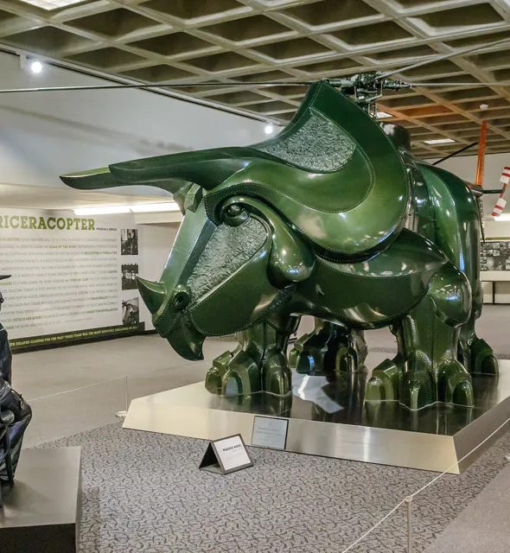
Automated in-house firm ordering
Used as communication and documentation tool between subject liaisons and acquisitions staff
Needed to be sustainable
Used applications that were readily available through Microsoft 365

Slide 3
What is Flow?
Attribute of Power Automate
Application through MS Office 365
Automates processes across applications and data both within and outside of Microsoft

Slide 4
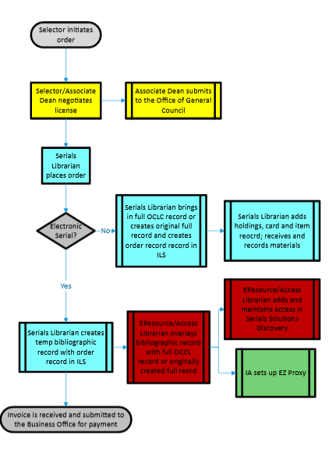
Before you flow

Slide 5
Terminology
Flow – user specified instructions for an action to be taken when an event occurs
Connectors – how you connect services to flow
Triggers – starts the flow
Manual
Automated
Scheduled
Actions – the job of the workflow
Conditions – a task(s) is performed only when a value is true
Expressions – a set of functions that can be used to perform specific actions in a flow
Variables – temporary storage of data within the flow

Slide 6
Let's Flow!

Slide 7
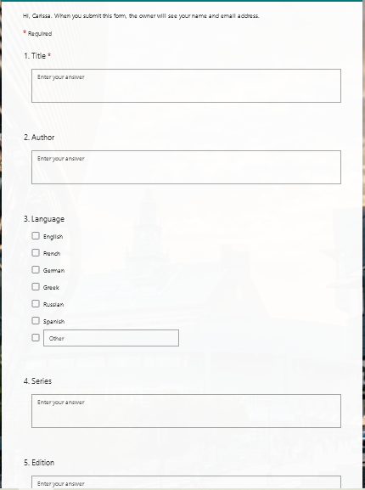
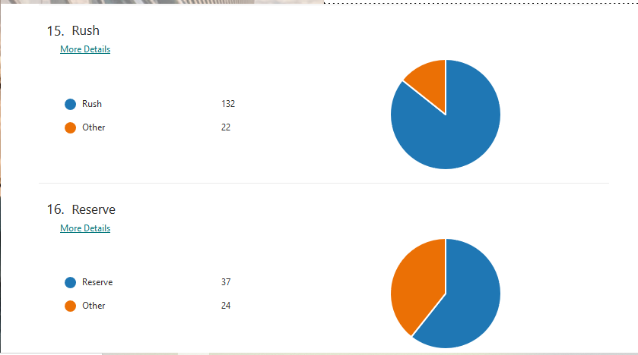
Request Form
Contact information is generated by MS Teams
21 field questionnaire
Fields based on information needed to populate records in Sierra

Slide 8
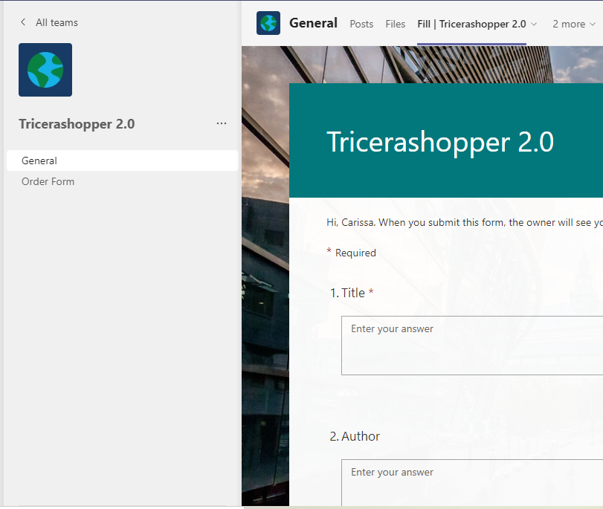
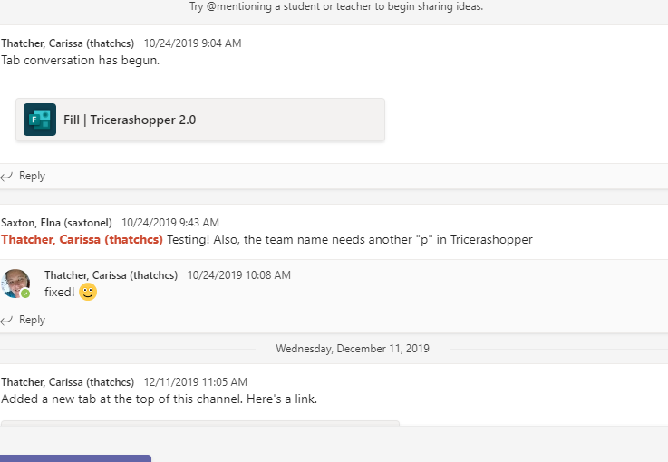
Microsoft Teams
Easily accessible
Repository for enhancements and maintenance

Slide 9
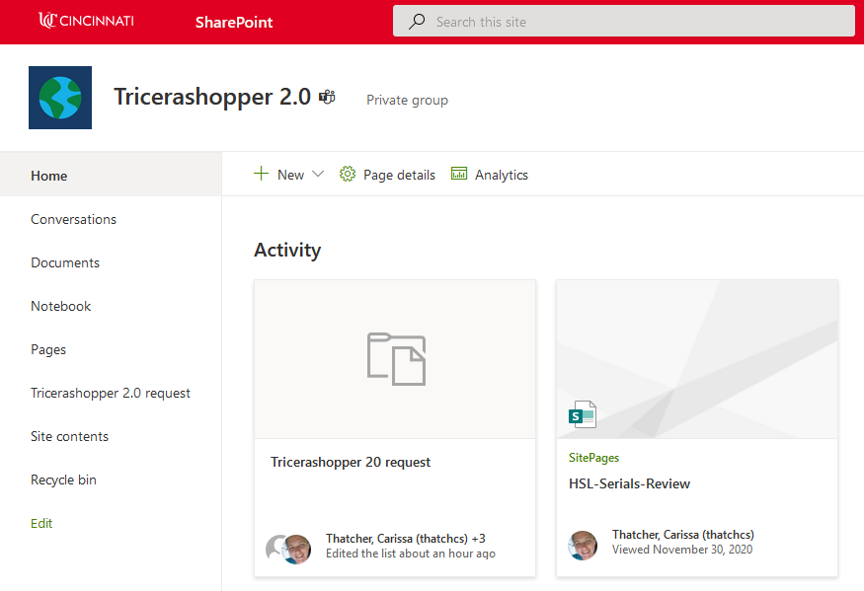
Microsoft Sharepoint
Requests are cumulated and stored
Selectors can filter to view their own requests

Slide 10
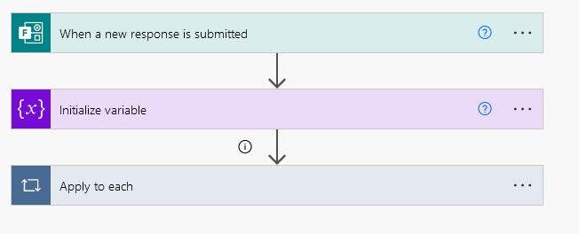
Microsoft Power Automate
Build the flow

Slide 11
Microsoft Power Automate Variable
Add comments to email responses

Slide 12
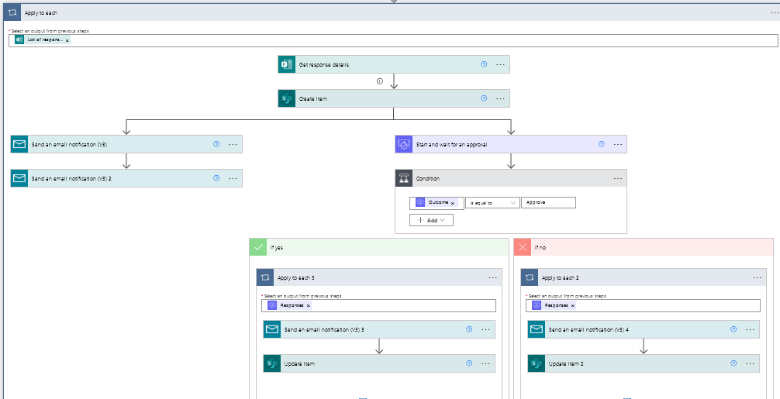
Microsoft Power Automate Loop
Creates entry in Sharepoint spreadsheet
Sends notification emails to selectors and those that order
Allows for automated communication of the process

Slide 13
Lessons learned
Approvals must be acted upon in 30 days
Use multiline fields in Sharepoint
Use nested conditions to direct specific material types to specific emails
Adding email ‘Config Run After’ to eliminate Flow fails

Slide 14
How I started
YouTube: Jon Levesque
https://youtube.com/playlist?list=PLN-cZRQeAiDVAtDyYTBKMuM22fQH1Khve

Slide 15
Questions?
Carissa Thatcher
University of Cincinnati Libraries
carissa.thatcher@uc.edu

Slide 16
Chain Will Keep Us Together: Using Power Automate to communicate eBook Approvals
CUNY Lehman College Leonard Lief Library
Stephen Walker

Slide 17
CUNY campus locations 25 campuses across 5 NYC boroughs
260,000 CUNY Students

Slide 18
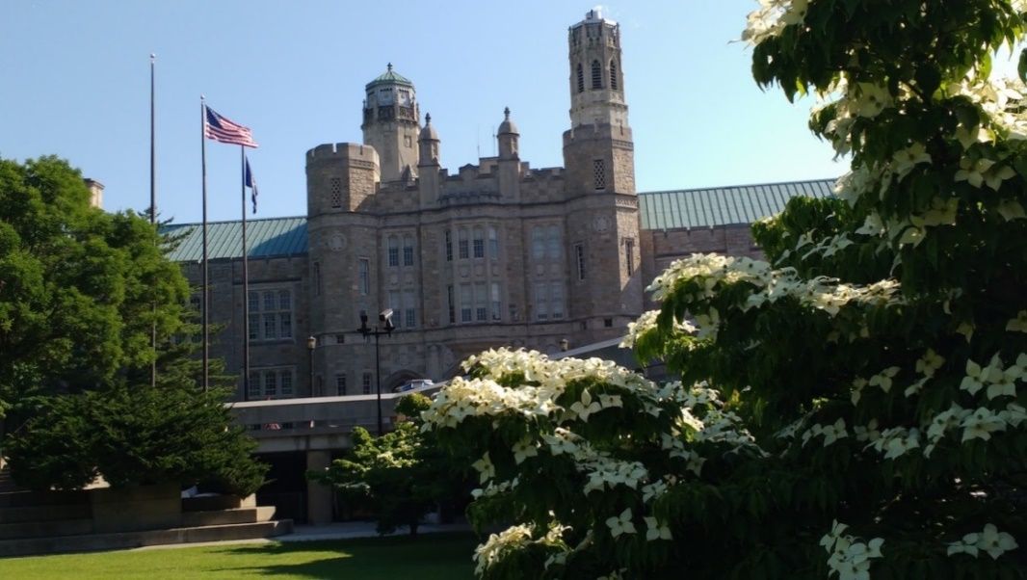
CUNY’s Senior College in the Bronx
Over 14,000 students

Slide 19
Shut Down and a Call for eBooks
Leonard Lief Library closed Spring 2020
Resignation of Head of Technical Services
Library Faculty began plans for closed Library Fall 2020
Messaging campaign to the Faculty for eBooks

Slide 20
First attempt for Gathering Requests
Email Requests were sent to the Head of Access Services
Textbook Requests input into a Google Doc
Departmental lists of Textbooks were received

Slide 21
Fall 2020/Spring 2021eBook Requests
$ 10,000 for eBooks and Streaming Media
Chief Librarian secured an additional $15,000
Fall 2020 81 Submission via Google Doc form
List of 736 requests form various Departments
Spring 2021 53 Submissions via Google Doc form

Slide 22
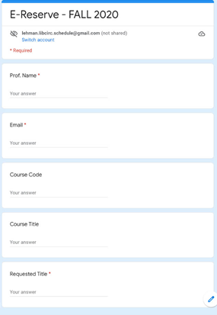
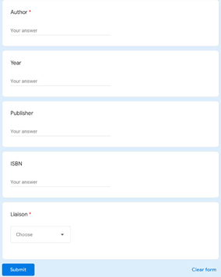
Google Form Fall 2020
Original Form updated by Access Services.
General Bibliographic information of request.

Slide 23
Fall 2020 Google Backend – Sample Request, Cost, Availability
GOOGLE BACKEND FORM FALL 2020

Slide 24
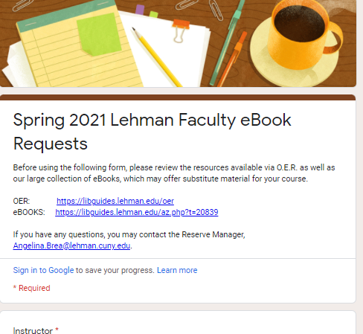
Google Form Spring 2021
Public Form Sent to the College Community.

Slide 25
First year Takeaways
Submissions were sent into Head of Access Services Email
Emails then had to be confirmed and submitted to the internal form
Fall 2020 (88) titles were ordered for $6,184.43
Spring 2021 (9) eBook titles were ordered for $1,488
Selection process became complicated

Slide 26
MS fall 2021 eBook form

Slide 27
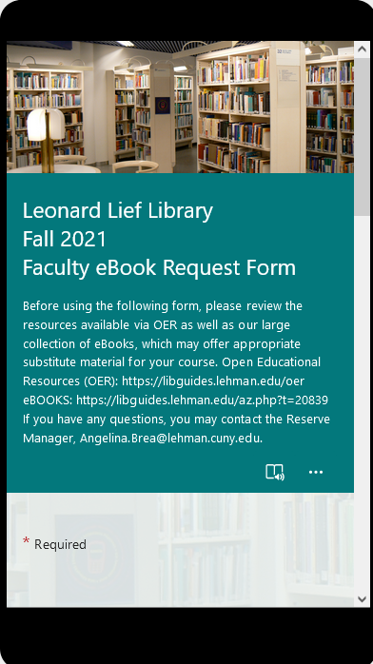
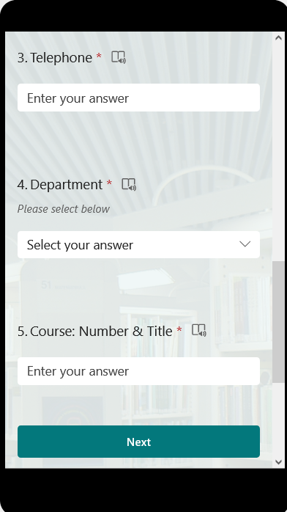
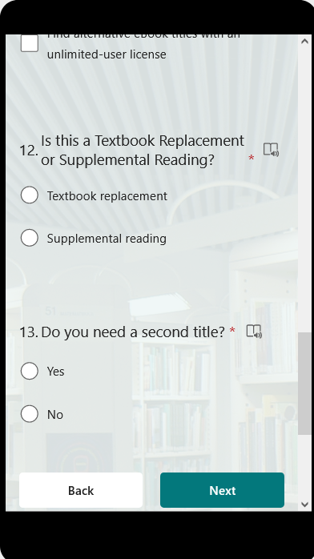
MS fall 2021 eBook form
Convenient mobile form option

Slide 28
Fall 2021 – power automate : form to list and email notification

Slide 29
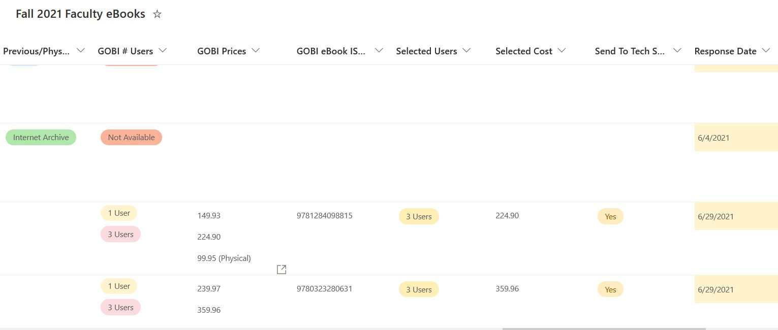
Fall 2021 e-book list

Slide 30
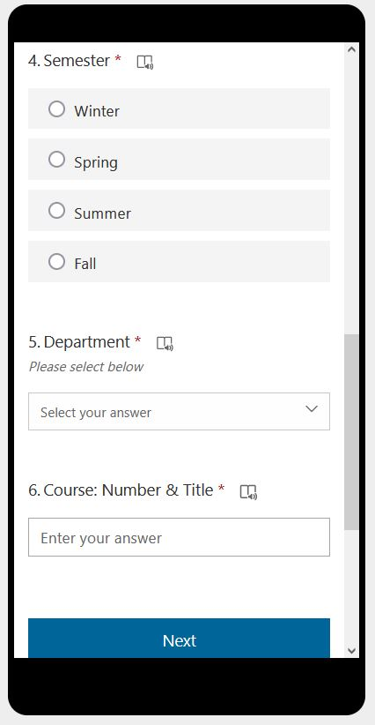
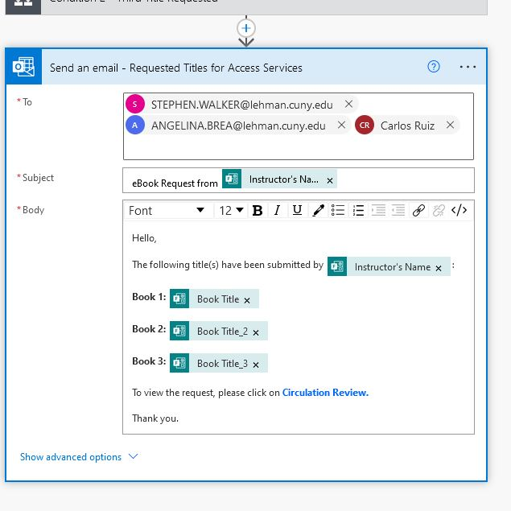
New form with semester option and email Notification

Slide 31
Status list for shared view

Slide 32
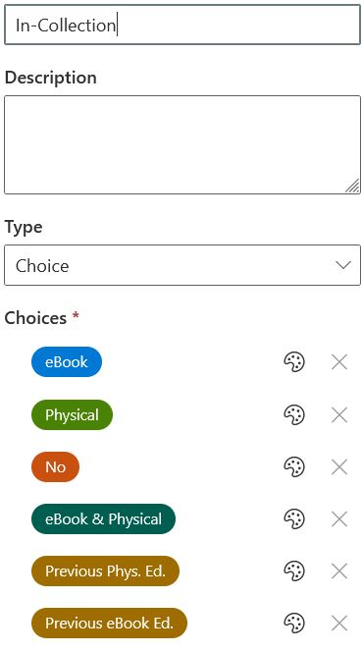
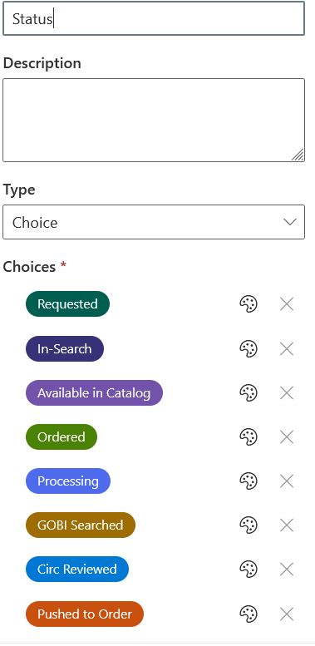
Status list – column choice options

Slide 33
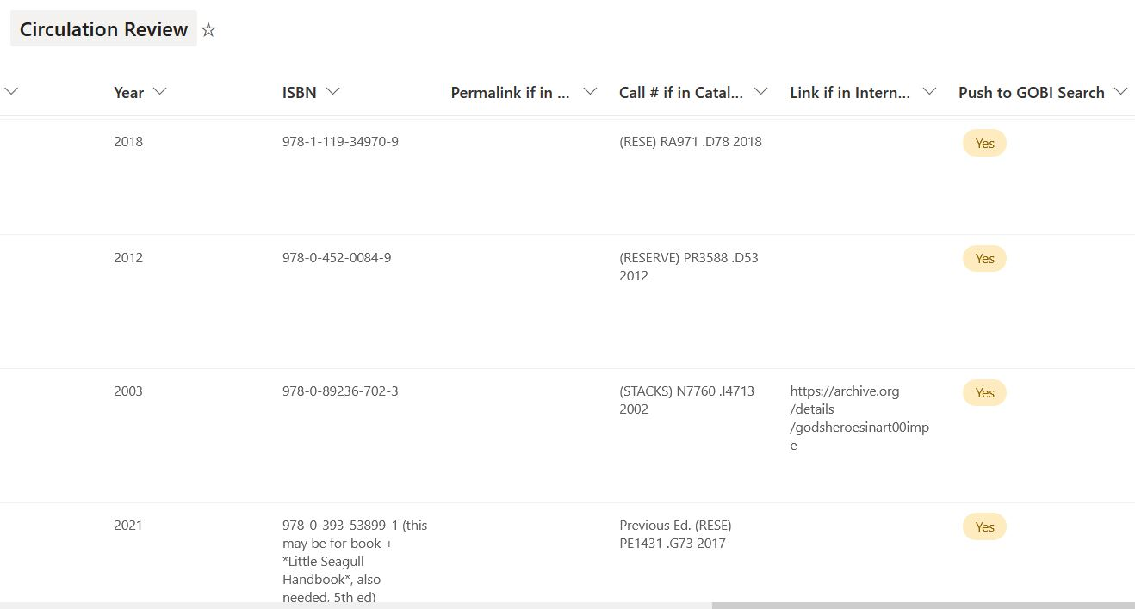
Circulation review – power automate push to search

Slide 34
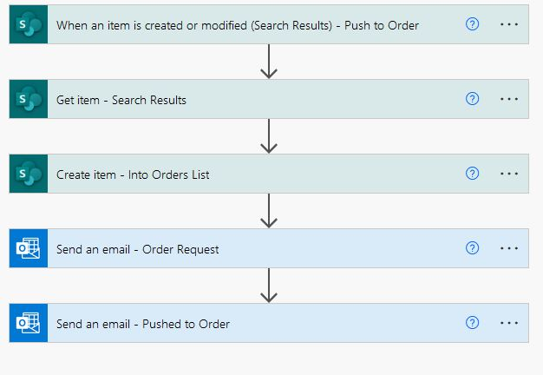
Search results and push to order

Slide 35
Donations

Slide 36
Donation Backlog
Access Services were tasked to accept physical donations.
Circulation clerks were assigned to input data into forms.
Subject Librarians were able to receive the Bibliographic information.

Slide 37
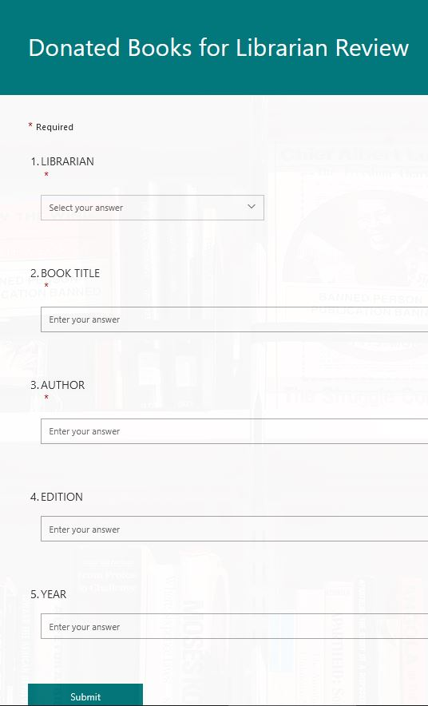
Donation Form

Slide 38
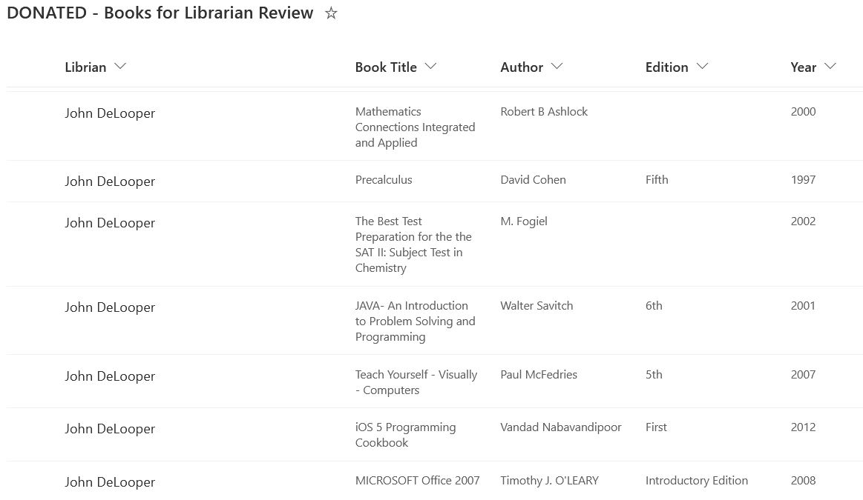
Donations List

Slide 39
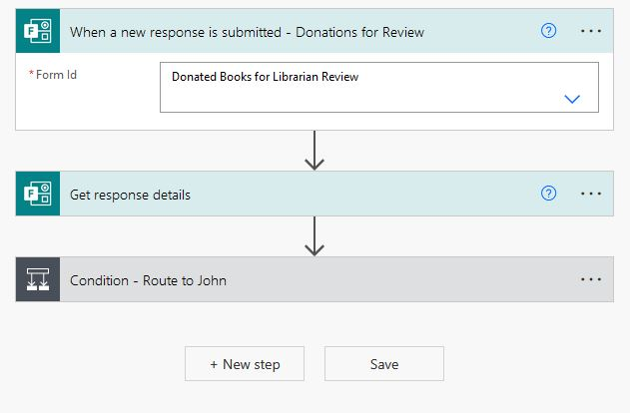
Route to Librarian

Slide 40
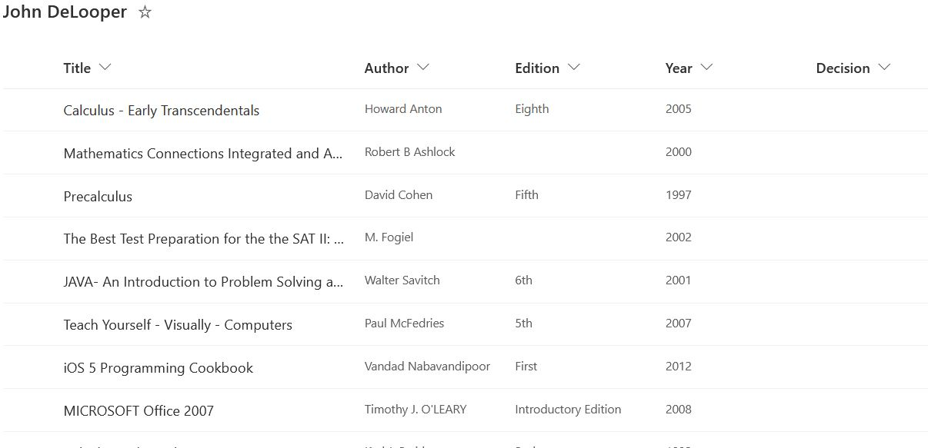
Librarian's view

Slide 41
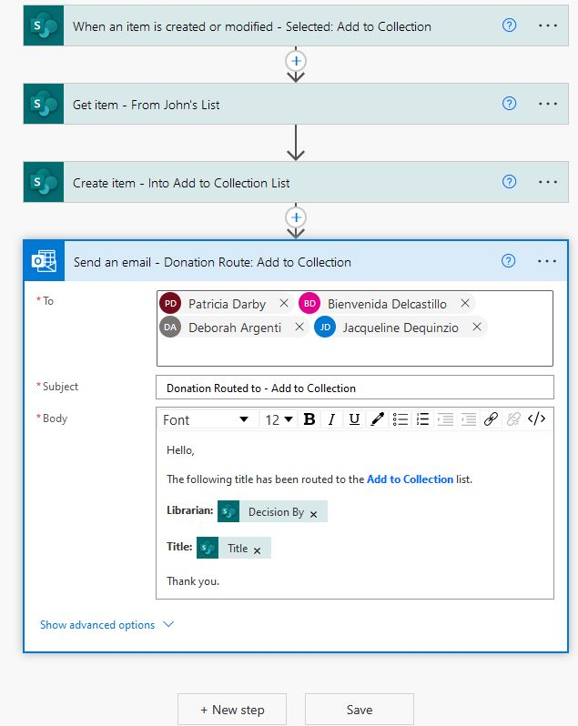
Librarian's Choice

Slide 42
Thank you and Questions
Stephen.Walker@lehman.cuny.edu

