Slide 1
What is a Collection Strategist?
Michele Potter
STEM
Collection Strategist
Carla Arbagey
Arts & Humanities Collection Strategist
University of California, Riverside

Slide 2
How would you define Collection Strategist?
Not just…a person who strategizes about collections!
Some things to consider:
What does this person do?
What does this person not do?
What are their responsibilities?
How do they have an impact on library services?
Notes:
Invite the audience to participate: hand out sticky notes / pieces of paper for them to write an answer. Invite them to come up and add their sticky note to the board as a way to stretch those legs?

Slide 3
Reviewing Your Answers
Many titles for the same role? Here are some titles we found at other research universities:
Subject
Liaison
Collections
Consulting
Collections & Research
Collection Management
Librarian
Notes:
Also found: bibliographer, subject specialist, and curator. Read

Slide 4
Our Definition of Collection Strategist
The Collection Strategist works collegially with other strategists, with librarians from Teaching & Learning and Research Services, and with staff from nearly every department in the library to brainstorm, select, and set into motion plans to make the library collections as effective as possible in supporting the teaching, research, retention and intellectual growth needs of the campus community.
Or, a librarian who decides what goes into and out of the library collection.

Slide 5
How We Became Collection Strategists
2017 and earlier: subject-based model with librarian liaisons in reference/information services departments, a few bibliographers
Fall 2017: switch to a functional model with 3 departments:
Teaching & Learning, Research Services, Collection Strategies
Winter 2018 and beyond: still refining the model
Notes:
2017 and earlier: With attrition, many subjects were not covered, or one person covered too many subjects; Reference & instruction librarians wanted to reinvision the services they provide to our users and focus less on collection building

Slide 6
The Functional Model:
Benefits
Challenges
Making the most of staffing situation
Focus on collections, build expertise
Allows our colleagues in research and teaching & learning to focus on their areas
“What happened to the art librarian?!”
Moving away from firm ordering towards increased automation
Working across departments
Notes:
Challenges: Loss of dedicated librarian for an academic department

Slide 7
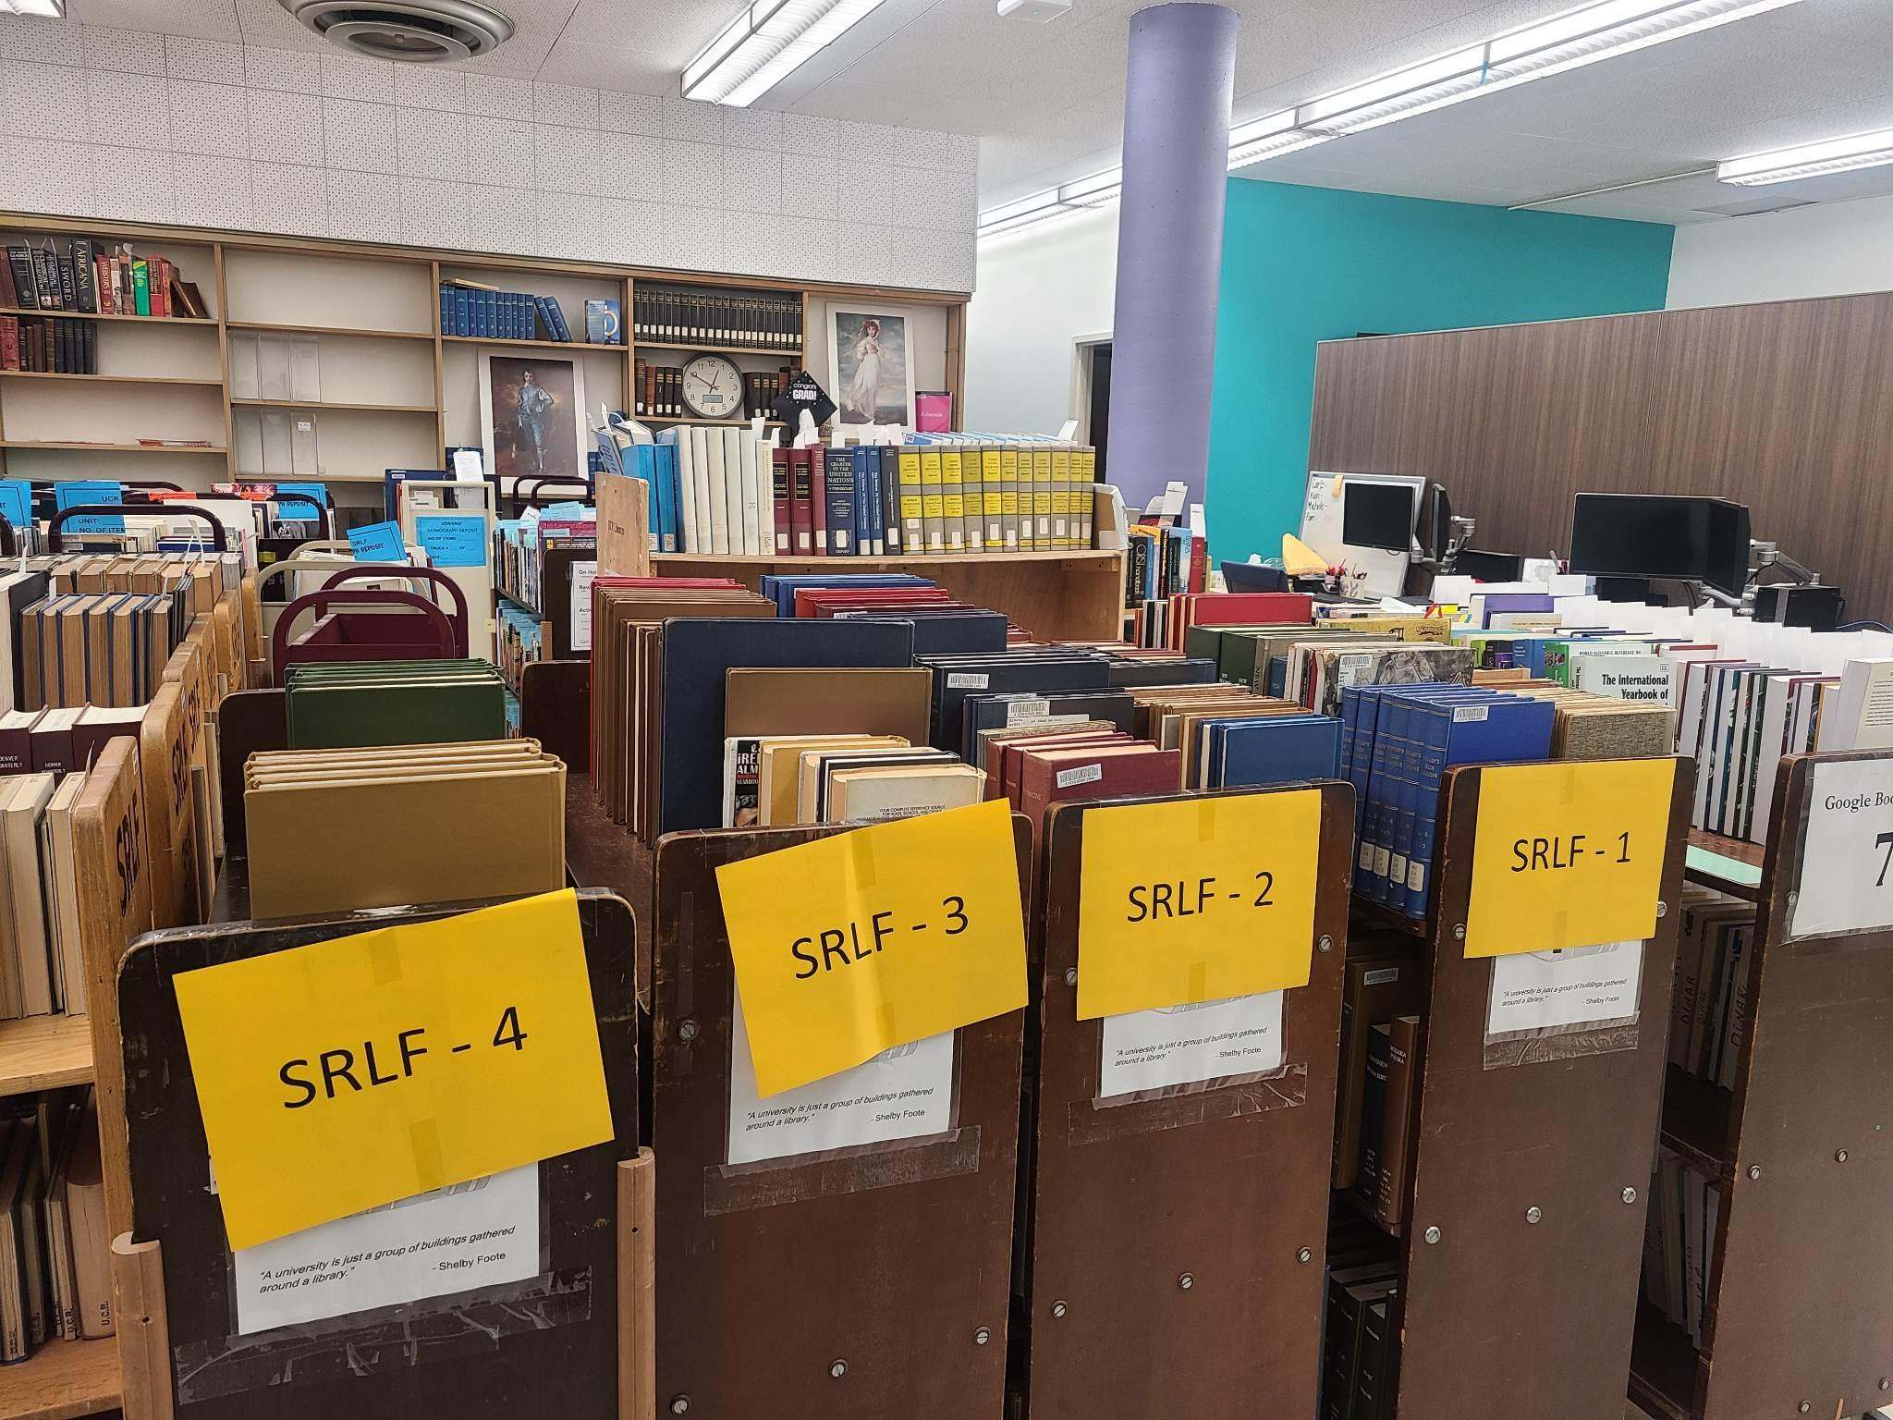
Our Areas of Responsibility
STEM - Arts & Humanities - Social Sciences & Area Studies
But also…
Gifts-in-kind
E-resources
Distinctive collections
Transformative & Open Access
Shared print
Technical services and ILS migration(s)
Items awaiting shipment to UC’s shared print/storage facility
Notes:
Distinctive collections include WRCA, GovPubs, Juvenile Lit, Leisure, and more.

Slide 8
Our Collections Landscape
Campus
Library Departments
We navigate many layers and and connect with numerous stakeholders when it comes to managing the library collection.
Collections Team
Collection Strategists
Notes:
Collections Team: 3 Collection Strategist Librarians; Collection Maintenance: CM Manager, CM Coordinator, CM Assistant, Collection Logistics Coordinator, Preservation Library Assistant
Interdepartmental Interfaces: Communications, Teaching and Learning, Research Services, Acquisitions, Metadata, Digitization, Reserves, ILL, Financial services, Facilities
Campus Interfaces: book/journal requests, graduate orientations & interaction with grad division, problem report form from our Primo catalog, departmental meetings outside our own, campus communication officers, departmental chairs and admins, direct faculty requests for resources, news and social media outlets, LibGuides, new resources blog, physical spaces such as bulletin boards and info kiosks

Slide 9
Strategizing Around Core Values
Our strategies aim to:
Minimize workload impacts (especially long term)
Maximize patron impact (for resources expended)
Some tools we use to accomplish this:
Ex Libris’ Alma ILS + Analytics
The power of Excel!
Productivity tools - Google drive, staff wiki
Springshare LibGuides, Databases A-Z list
Notes:
Minimize workload impact: streamlining our workflows especially with DDA and auto-ship plans; lean on our vendor reps for reports, statistics, suggestions on new resources, special sales, filling collection gaps; use existing tools such as our Alma Community Zone
Maximize patron impact: careful look at access; data-driven decision making from usage stats, ILL, turnaways; outreach, catalog & discovery enhancements, signage in library spaces
Tools: Alma: Community Zone, Analytics, Work Orders/Processes such as for lost, billed, repair items, Rialto; Excel -VLOOKUP and Pivot tables are our best friends! Especially when manipulating data coming from Alma and Analytics; Productivity tools - for collab on projects since we are on hybrid schedules, or to communicate to other library staff; LibGuides - we have a special guide for new major purchases, we also curate our databases A-Z list

Slide 10
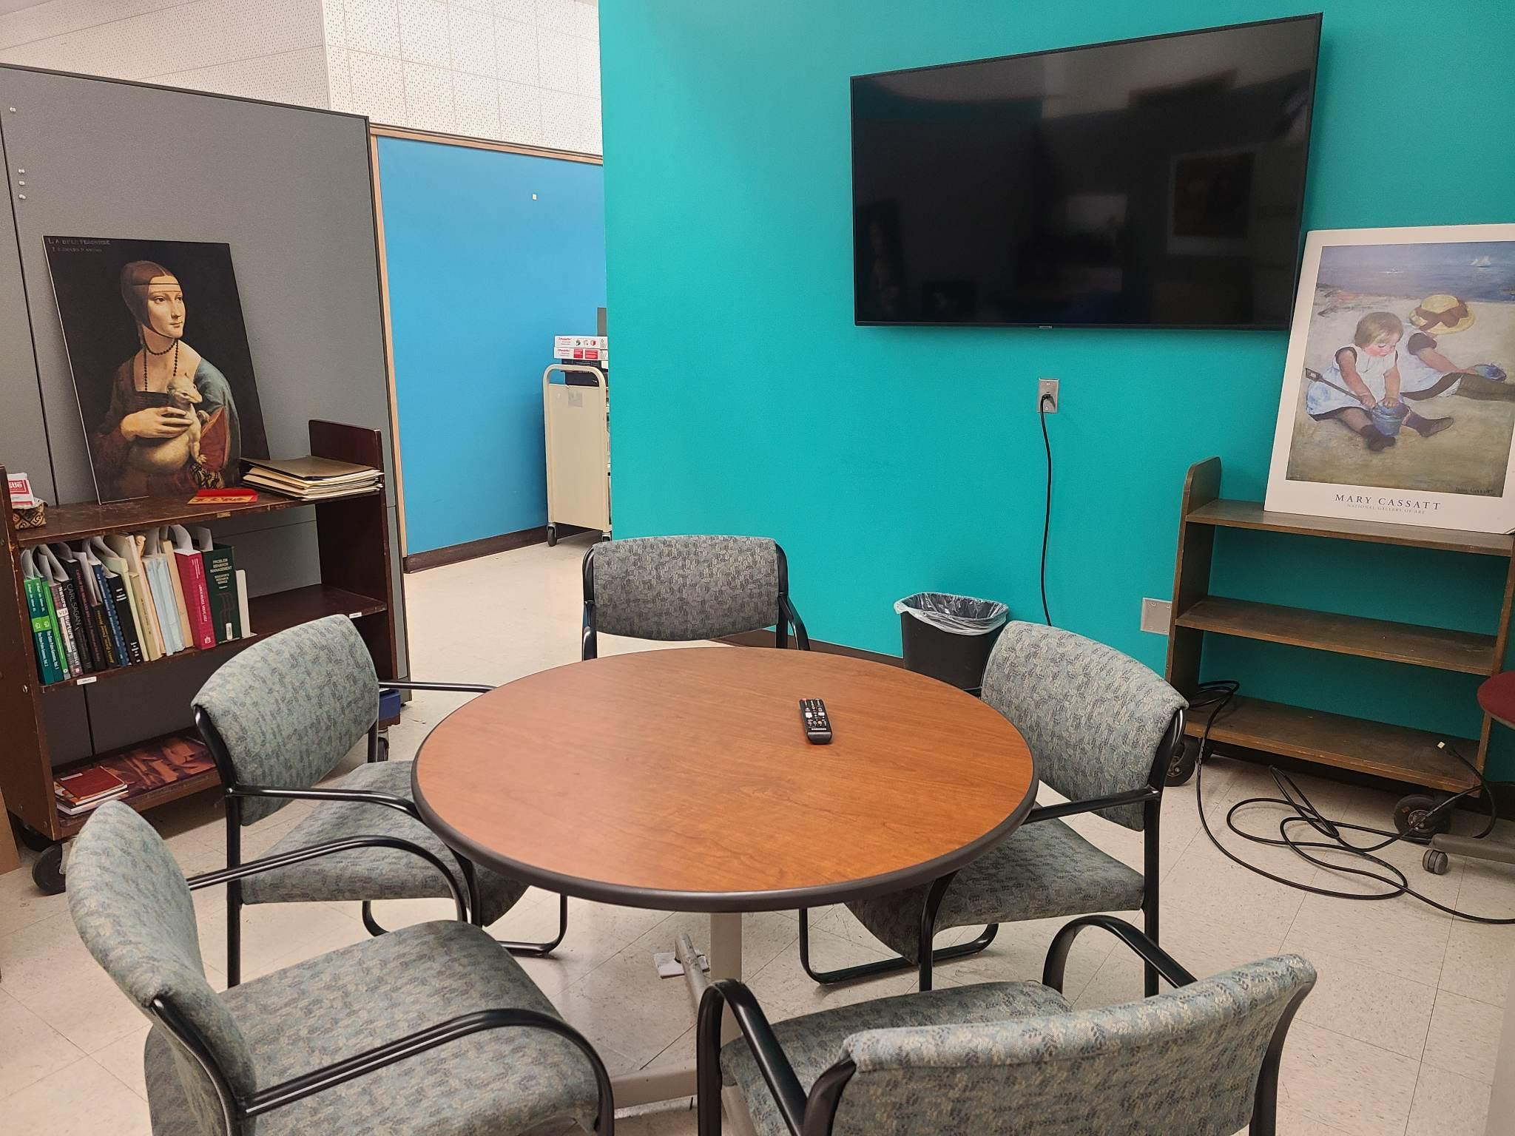
How We Strategize to Overcome Challenges
Converting our strategies into actions
Working on teams
Interactions: biweekly strategy meetings plus more!
our collab space
Notes:
Teams we work on: Consortial ILS teams related to exposure, utilization, and assessment of resources
Consortial Common Knowledge Groups (CKGs) for subject areas
Other University of California teams related to collection usability and strategy
UC Riverside communications staff in the library and on campus
Informal discipline-based teams
How we interact: vendor meetings, major purchase decisions, working together on general and multidisciplinary resources

Slide 11
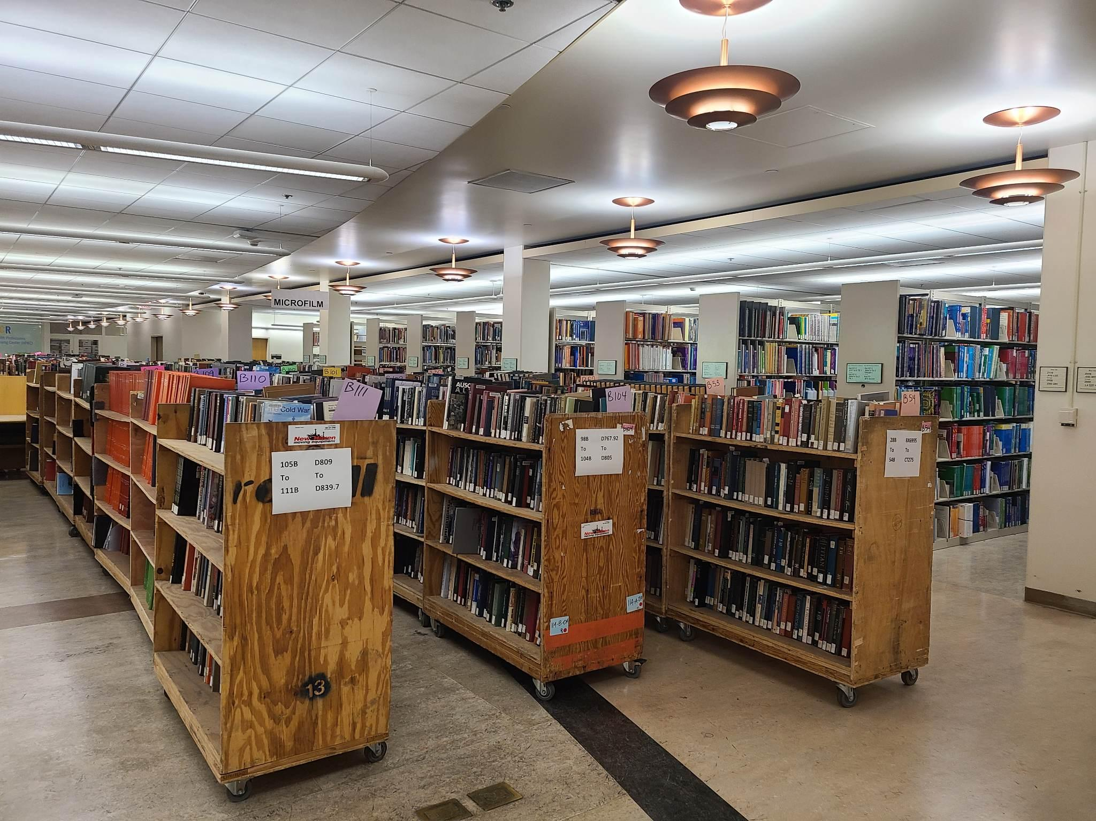
Sources and Motivators For Things We Need to Strategize
Library initiatives, strategies, and needs
University/department needs (stated and unstated)
Trends and hot topics
Budget changes
Grumblings and mumblings from other units
Tedium and time sinks
Wouldn’t it be awesome if…
Compact shelving chaos! Our basement project was motivated by several items from the list on the left.
Notes:
Basement project: the impending installation of compact shelving led to sub-projects, such as weeding our general works section, looking at usage to determine which large sections of the collection were lower-use and should be shifted to compact shelving (AC-AZ section); greater attention to other collections in our basement such as education and juvenile

Slide 12
Strategizing: Our Slow and Inefficient Repair Decision Process
Background
Preservation Services makes spreadsheets and sends them to us for decisions.
Potential Solutions
Shared Google sheet?
Alma Process?
Implementation
Worked with preservation, acquisitions and IT to create a review process for speedier decision making within Alma
Notes:
We chose to use Alma’s work order processes because it integrated well with the existing process of changing an item’s status to repair while allowing us to make decisions on individual titles remotely (for the most part). It also avoided duplicative work of putting information in spreadsheet that was already available in our ILS.

Slide 13
Strategizing: Mediated DDA Requests
Problem
We are spending too much time mediating DDA purchases from Routledge because many titles are above our price ceiling
We would like to get more value for our money on these titles
Possible Solutions
Raise our price ceiling?
Evidence-Based Acquisitions (EBA) plan from Taylor & Francis?
Notes:
We discussed possible solutions at our biweekly strategist meetings - Raise the trigger limit - less mediation but the ebooks from proQuest are not DRM-free
EBA plan - advantage of DRM free, less mediation. Disadvantage of higher spending floor, time to set up Rialto
Our strategy: implement Rialto (it was easier than we thought!) and set up EBA for T&F through Rialto - this is in progress

Slide 14
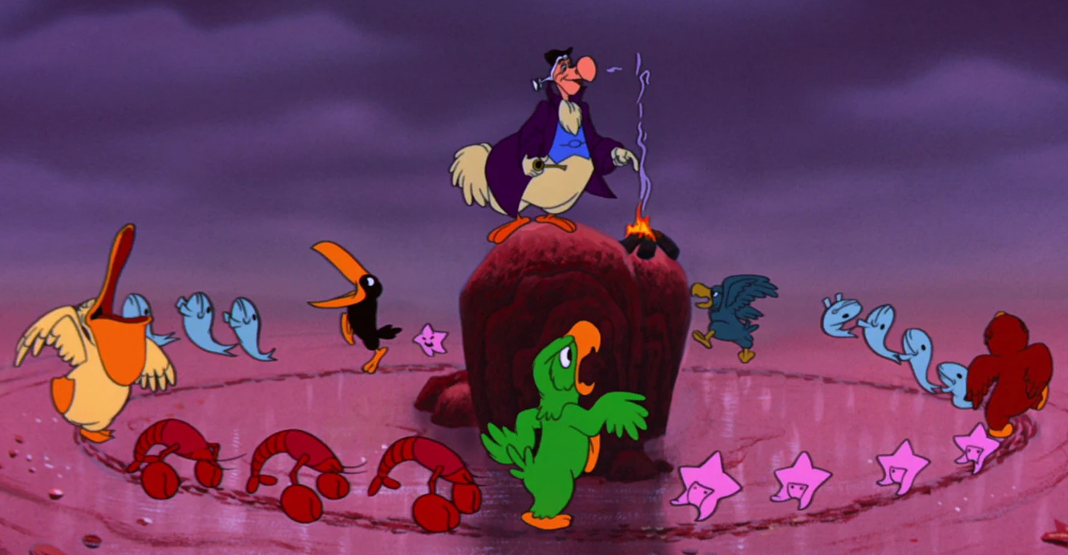
Strategizing: De-Selection BEFORE
Round and round…
…the alphabet of LC call numbers
© Disney
Notes:
With our previous model having subject selectors, de-selection was necessarily subject-based and used a single, one size-fits-all approach to most subjects

Slide 15
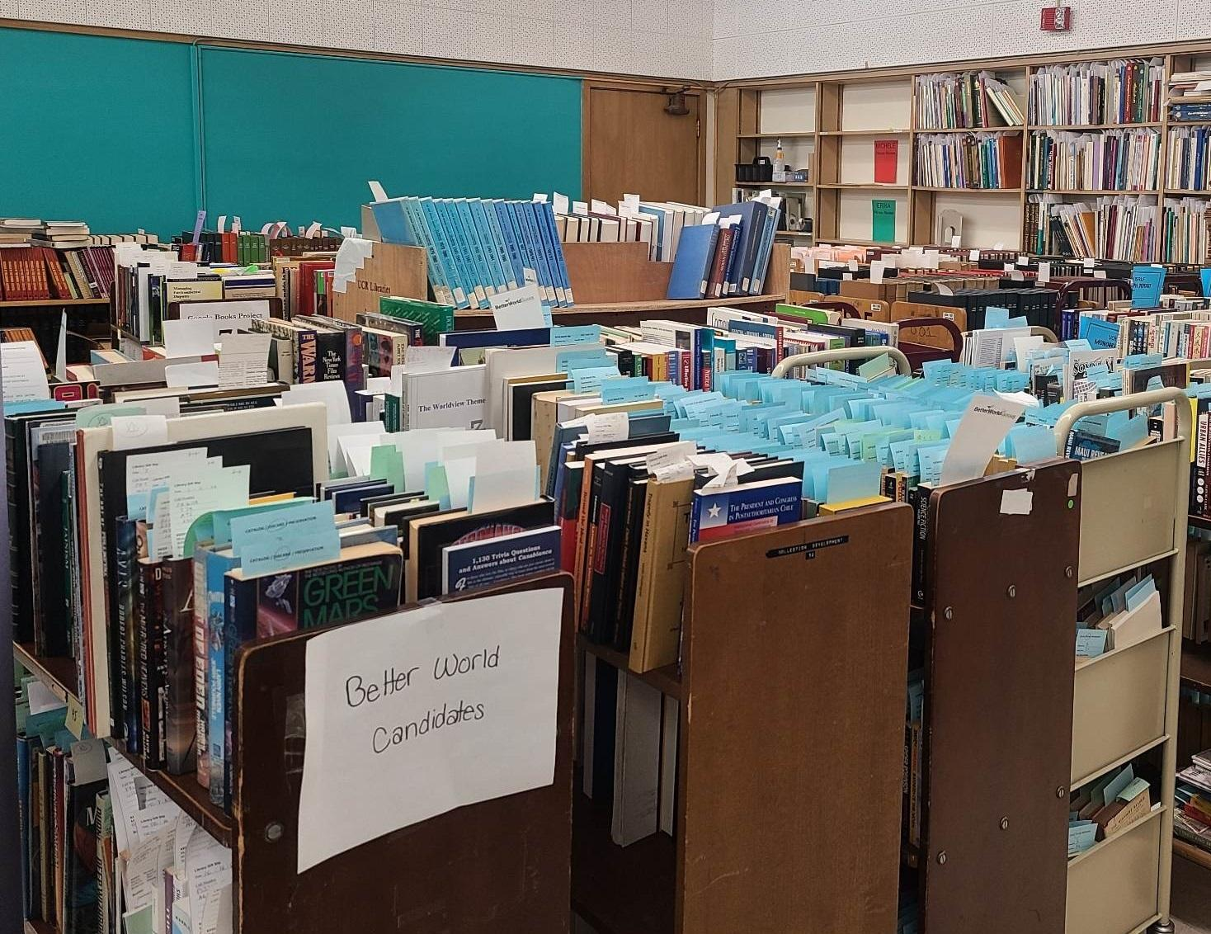
Strategizing: De-Selection AFTER
Functional model lends well to re-thinking our weeding strategy
Strategists develop guidelines tailored to the collecting area
Areas targeted are in response to needs & projects
De-selected titles go to storage or Better World Books
Notes:
Result is that we can be more efficient with our weeding, and our de-selection projects often have a measurable impact, such as opening up space for student collaboration,

Slide 16
Past, Present, and Future Strategizing
Open access resources
Processes by material type
Making the most of vendor visits
Tracking requests and major purchases
Annual reporting
Internal reporting
Promotion of resources to librarians and staff
Outreach to patrons
Library shutdown
Low use on specific resources
Strategic plan input / output
Accessibility implications in collections strategies
Website revamp
Collection review projects
Collection policies
Patron suggestion process
Collection maintenance/repair process
Collection related signage
Collection “spaces”
Notes:
Still plenty for us to do! Some of these are ongoing, some completed, some we aspire to do sometime soon.

Slide 17
What do strategists need to be most effective?
Not just…
…but also:
Blocks of time
Access to data
Tolerance for risk and failure
Access to IT expertise
Cross departmental teams
Input from many departments

Slide 18
Would you switch?
If you’re in a subject liaison model, would you switch?
If you’re in a functional model, would you switch?
BONUS!
We are planning a follow-up session to this presentation via Zoom, where you can join us to strategize on the topic of vendor visits.
Check your handout for invite info.
Notes:
We look forward to talking with you about this topic over dinner.

